Slide 1
Performance
Efficiency
Searching
Sorting

Slide 2
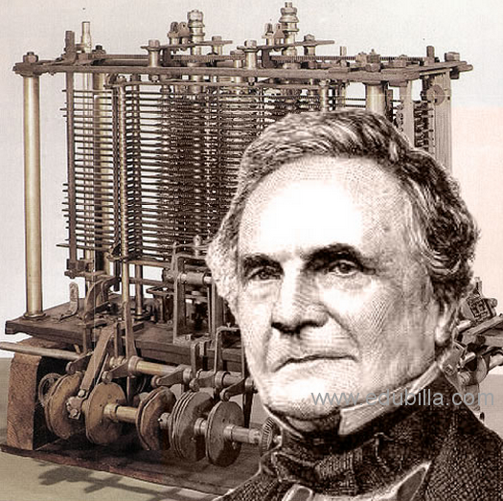
What is performance?
Since the early days in computing, computer scientists have concerned themselves with improving hardware, software, visualizations, etc
Performance can mean many different things
"The economy of human time is the next advantage of machinery in manufactures." – Charles Babbage

Slide 3
Examples of performance
Fewest computations
Smaller memory usage
Faster computations
Improving accuracy of computations
How we achieve these
Better algorithms
Better hardware
Better languages

Slide 4
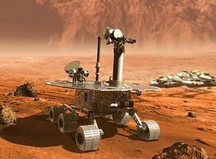
Why do we care?
We want to solve real problems (large) in real time

Slide 5
Big-Oh Complexity
We will focus our study of performance on time as a metric of performance
We can measure time experimentally like a stopwatch in our programs: start = time.time() # run algorithm stop = time.time() time = stop – start
We can measure time theoretically with big-oh analysis – an approximation technique for quantifying the time an algorithm takes

Slide 6
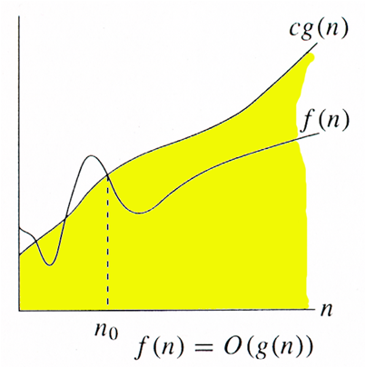
Big-oh complexity
A function $f\left(n\right)$ is $O\left(g\left(n\right)\right)$ (pronounced "big-oh") if there exists constants $c$, and $n_{0}$ such that $f\left(n\right)≤cg\left(n\right)$ for all $n≥n_{0}$
$f\left(n\right)$ – real time taken for an algorithm. This is what we want to approximate
$g\left(n\right)$ – a function that "approximates" $f\left(n\right)$, more precisely it is an upper bound to $f\left(n\right)$
We use this, as it describes how long an algorithm will take to compute as the problem size ($n$) increases
To determine – count the operations

Slide 7
Common Big-oh functions
Logarithmic – $O\left(\log{n}\right)$
Linear – $O\left(n\right)$
Example: searching for the minimum in an array. We must "look at" all $n$ elements of an array
Linearithmic – $O\left(n\log{n}\right)$
Quadratic – $O\left(n^{2}\right)$

Slide 8
Shameless plug for CMSC 221
This class is not about how we come up with these equations, or how we design better algorithms. For continued information, continue on in CS coursework
In this class, I want you to have an intuitive feel of what big-oh means through a few algorithms
In this class, understand the algorithms I present, but I do not expect you to come up with it yourself

Slide 9
Lets explore these concepts
Case study on Searching
Linear Search
Binary Search
Case study on Sorting
Bubble Sort
Selection Sort
Advanced Sort

Slide 10
Wait…how do we do experiments?
We vary the size of the data (usually by powers of two), so test on $n=2^{1},2^{2}, …, 2^{d}$
Repeat each experiment numerous times to:
Get an accurate time for operations faster than 1 microsecond (usually one tick of the clock)
Average timing considering other tasks running on the computer
Pseudocode
for $N←2^{1}…2^{d}$ do
Setup before timing
$start←$ time()
for $k←0…repeats$ do
experiment()
$stop←$time()
output($\frac{start−stop}{repeats}$)

Slide 11
Case study of searching

Slide 12
Linear Search
Pseudocode
Input: Array $arr$, Key $k$
Output: true if $arr$ contains $k$, false otherwise
for each $a∈arr$ do
if $a=k$ then
return true
return false
Complexity?
Linear – $O\left(n\right)$
Reasoning – The search might have to visit each of the $n$ elements contained in the array.
Note – it doesn't matter if the first element is equal to the key, that is a special case. On average we must search $\frac{n}{2}$ elements. Additionally, we don't care about a specific size, we are interested in performance as the size tends to infinity

Slide 13
Can we do better?
Computer scientists always ask this kind of question, can we do better?
Well in general…no, this is about the best we can do with searching.
Computer scientists then ask a follow-up questions, can we do better in special cases?
Yes! If we knew the input was sorted we could do much better.

Slide 14
Binary search
Pseudocode
Input: Sorted array arr, Key k
Output: true if arr contains k, false otherwise
$low←0$
$high←arr.length −1$
while $lo≤hi$ do
$mid←\frac{high+low}{2}$
if $k<arr[mid]$ then
$high←mid −1$
else if $k>arr[mid]$ then
$low←mid+1$
else
return true
return false

Slide 15
Binary Search
How it works?
Key is 7
0
1
3
4
5
7
8
9
11
14
16
18
19
l
m
h
0
1
3
4
5
7
8
9
11
14
16
18
19
l
m
h
0
1
3
4
5
7
8
9
11
14
16
18
19
l
m
h
0
1
3
4
5
7
8
9
11
14
16
18
19
l=m =h

Slide 16
Binary Search
Complexity?
Logarithmic – $O\left(\log{n}\right)$
Reasoning – in each iteration of the loop, we eliminate half of the indices as possible cells to hold the key. The number of times you can repeatedly divide a number by 2 is the definition of a logarithm
Note – I am loose on the base of the logarithm. If you feel more comfortable with one, it will always be base 2. However, in big-oh complexity the base doesn't matter. See me after class if you would like a proof.

Slide 17
Experiment searching
Download search.py from the course website. It contains an experiment ready to go comparing the different searches. Lets go through the file to ensure we understand each component.
Run the file, open up the csv file in Microsoft Excel
Make a line scatter plot of the size vs the time of the methods
Convert to a log-log plot to get a better picture of the data

Slide 18
Conclusion
A smaller complexity drastically affects runtime
$O\left(\log{n}\right)$ is much faster than $O\left(n\right)$

Slide 19
Case study of sorting

Slide 20
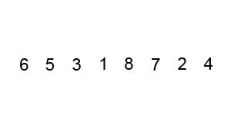
Bubble Sort
Pseudocode
Input: Array $arr$
Output: Sorted array
for $i←1…arr.length$ do
for $j←0…arr.length−i$ do
if $arr\left[j\right]>arr\left[j+1\right]$ then
swap($arr$, $j$, $j+1$)
Complexity
Quadratic – $O\left(n^{2}\right)$
Reasoning – There are $n$ passes over the array, in each pass $n$ elements are visited and possibly swapped. $n∗n=n^{2}$

Slide 21
Can we do better?
Computer scientists always ask this kind of question, can we do better?
Identify the weakness here, bubble sort swaps too much
Can we fix it?

Slide 22
Selection Sort
Pseudocode
Input: Array $arr$
Output: Sorted array
for $i←0…arr.length−2$ do
$min←i;$
for $j←i…arr.length−1$ do
if $arr\left[j\right]<arr[min]$ then
$min←j$
swap($arr$, $i$, $min$)
Complexity?
Quadratic – $O\left(n^{2}\right)$
Reasoning – In each iteration of the outer loop, we must find the minimum in the rest of the array, and we swap this minimum into place. Doing this $n$ times, takes in total $O\left(n^{2}\right)$ operations.

Slide 23
Can we do better?
This was not satisfying, bubble sort and selection sort have the same complexity, even though selection sort is a much nicer idea (and performs better in practice, will see soon)
Computer scientists always ask this kind of question, can we do better?
Many different ideas exist to perform better
Better for sorting is linearithmic – $O\left(n\log{n}\right)$, examples include Quick Sort, Merge Sort, etc.

Slide 24
Experiment sorting
Download sort.py from the course website. It contains an experiment ready to go comparing the different searches. Lets go through the file to ensure we understand each component.
Run the file, open up the csv file in Microsoft Excel
Make a line scatter plot of the size vs the time of the methods
Convert to a log-log plot to get a better picture of the data

Slide 25
Conclusion
Two algorithms can have the same complexity, but different actual performance
We need to experiment on our data
Smaller complexity will always beat an optimized higher complexity
However, note that this doesn't necessarily apply to small values of $n$
Lesson – choosing an appropriate algorithm requires understanding the size of your data

Slide 26
Algorithm summary
Searching
Linear Search – linear time or $O\left(n\right)$
Binary Search – logarithmic time or $O\left(\log{n}\right)$
Sorting
Bubble Sort – quadratic time or $O\left(n^{2}\right)$
Selection Sort – quadratic time or $O\left(n^{2}\right)$
Other Sorts – linearithmic time or $O\left(n\log{n}\right)$

