Slide 1
Chapter 13 Files and Exception Handling
ACKNOWLEDGEMENT: THESE SLIDES ARE ADAPTED FROM SLIDES PROVIDED WITH Introduction to Programming Using Python, Liang (Pearson 2013)

Slide 2
Motivations
Data stored in the program are temporary; they are lost when the program terminates. How would you permanently store data created from a program?
Example:
In bioinformatics, the result of a DNA test should be automatically stored for understanding in a crime scene investigation.
How can our programs work with a large amount of data?
Example:
How could you parse through 1,000,000 tweets related to a major world event to learn which countries it affects the most?
To permanently store the data created in a program, you need to save them in a file on a disk or other permanent storage. The file can be transported and can be read later by other programs. There are two types of files: text and binary. Text files are essentially strings on disk.

Slide 3
Motivations
When a program runs into a runtime error, the program terminates abnormally. How can you handle the runtime error so that the program can continue to run or terminate gracefully?
Example
You are working on Microsoft Word, and you try to open a file that does not exist OR is an incorrectly formatted .doc or .docx file (like someone tampered with it). What should happen?
(a) Microsoft crashes
(b) Microsoft alerts you of the issue
(c) Forget Microsoft, Apple is superior!

Slide 4
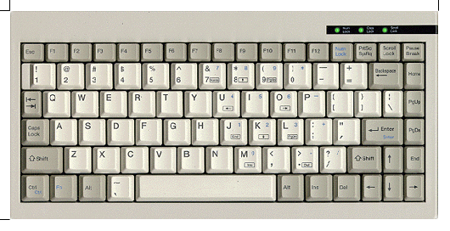
Input and Output
Input devices
Output devices.
Goal. Programs that interact with the outside world.
Programming languages support these interactions
We use the Operating System (OS) to connect our program to them
Keyboard
Mouse
Hard drive
Network
Digital camera
Microphone
Display
Speakers
Hard drive
Network
Printer
MP3 Player

Slide 5
What have we seen so far?
Standard output.
The OS output stream for text
By default, standard output is sent to Terminal.
Example: print() goes to standard output.
Standard input.
The OS input stream for text
By default, standard input is received from the Terminal.
Example: input()
“Standard Draw.”
Graphics and GUI libraries
Output to a window instead of a terminal
Example: turtle
EasyGoPiGo3
Robot actuation and sensing
Example: light and color sensor

Slide 6
FILE input and output

Slide 7
Open a File
How do you write data to a file and read the data back from a file?
You need to create a file object that is associated with a physical file. This is called opening a file. The syntax for opening a file is as follows: file = open(filename, mode)
Examples: f1 = open("MyOutputFile.txt", 'w') f2 = open("MyInputFile.txt", 'r')

Slide 8
Example
Lets write a series of random numbers to a file: import random file = open("Numbers.txt", 'w') for i in range(100): file.write(str(random.randint(1, 10000)) + '\n') file.close()

Slide 9
Example
Lets read those numbers back and average them: f = open('Numbers.txt', 'r') line = f.readline() avg = 0 count = 0 while line != '': count += 1 avg += int(line) line = f.readline() f.close() print("Average:", avg/count)

Slide 10
Methods of file objects

Slide 11
Testing File Existence
You can easily test if a file exists or not: import os.path if os.path.isfile("Numbers.txt"): print("Numbers.txt exists")

Slide 12
Exceptions
What happens when open is called on a file that does not exist? Traceback (most recent call last): File ".\TracingTests.py", line 7, in <module> f = open('Number.txt', 'r') FileNotFoundError: [Errno 2] No such file or directory: 'Number.txt'

Slide 13
Exception Handling
To protect against exceptions, a try-except clause may be used.
In exception handling, you have to provide an algorithm that takes care of the exception, called the handler.
Syntax: try: body except ExceptionType: handling code

Slide 14
Example of Exception Handling
try: f = open('Numbers.txt', 'r') # Could possibly raise an exception line = f.readline() avg = 0 count = 0 while line != '': count += 1 avg += int(line) line = f.readline() f.close() print("Average:", avg/count) except FileNotFoundError: print("Numbers.txt does not exist.") # Or maybe put in loop to retry?

Slide 15
Exception Handling
A broader syntax exists to handle various exception types. Full syntax: try: body that might raise exception except ExceptionType1: code handling exceptions of type ExceptionType1 ... except ExceptionTypeN: code handling exceptions of type ExceptionTypeN except: code handling any other exception types else: code that runs if there is no exception finally: code that will run after any excepts or the else

Slide 16
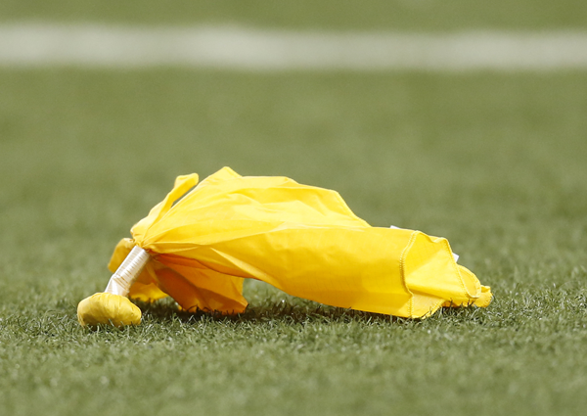
Raising exceptions
The previous code is all about invoking methods that might generate exceptions. In these cases, a try-except clause is appropriate when you know how to handle the code.
Imagine, opening a file in Microsoft Word again. The code generates an exception on an illegal file (or poorly formatted one) and allows a user to try again (it doesn't just crash!)
But how about when we detect an error, but do not know how to handle it?
In these cases, we should raise an exception so that the invoker of the method can then decide to handle it.

Slide 17
Raising exceptions
To raise an exception use the following syntax: raise ExceptionClass("Descriptive message")
Example: class Circle: def __init__(self, r): if r < 0: # Note, we do not know how to # handle the bad input here raise ValueError("Bad radius") self.__radius = r …

Slide 18
Note
Raising exceptions "returns" an object. We can access the object in calling code with the following syntax: try: body except ExceptionType as exceptionName: handling code
Example: try: f = open('Numbers.txt', 'r') except FileNotFoundError as fnfe: print(fnfe)

Slide 19
Built-in Python exceptions

Slide 20
Defining your own exception class
You can define your own exception classes, but it requires the use of inheritance. See the book for a detailed example.
A loose example: class RadiusException(RuntimeError): def __init__(self, radius): super().__init__() self.radius = radius
At the error site: if radius < 0: raise RadiusException(radius)
At the exception cite: except RadiusException as ex: print("The radius", ex.radius, "is invalid.")

Slide 21
Cautions When Using Exceptions
Exception handling separates error-handling code from normal programming tasks, thus making programs easier to read and to modify. Be aware, however, that exception handling usually requires more time and resources because it requires instantiating a new exception object, rolling back the call stack, and propagating the errors to the calling methods.

Slide 22
When to Throw Exceptions
When a variable reaches an unexpected value or algorithm reaches an unexpected state.
If you want the exception to be processed by its caller, you should create an exception object and raise it.
However, if you can handle the exception in the method where it occurs, there is no need to throw it, e.g., with if-else statements.

Slide 23
Exercise – Work in Pairs/triplets

Slide 24
Exercise
Write a program that will generate $N$ random cirlces, where $N∈[3, 20]$, the center $\left(x, y\right)$ points between $\left[−500, 500\right]$, and the radius is between $\left[10,90\right]$. Write the circles to a file – first line is $N$, each line after is the circle defined by $x$, $y$, and $r$
Write a program that reads your file and shows it to the user using Turlte. Try to use a random color to show the outline and a different random color to fill the circle.

Slide 25
Remote files
When working with the GoPiGo3, any file we write in a python program will be saved on the GoPiGo3 itself.
We may want to do this for "data-dumps" – a time stamped file with all of the sensor readings, AI decisions, and actuator commands.
How can we access the files?
Remote copy: scp pi@gopigoXX:~/remoteFile .
Example: scp pi@gopigo00:~/MyFile.txt .

Slide 26
Example
from easygopigo3 import EasyGoPiGo3
robot = EasyGoPiGo3()
distance_sensor = robot.init_distance_sensor()
servo = robot.init_servo()
servo.reset_servo()
f = open("Distances.txt", 'w')
for i in range(36):
f.write(str(distance_sensor.read_mm())+'\n')
robot.turn_degrees(10)

Slide 27
Competition
Form teams and solve the following problem. We will decide who wins tomorrow.
Make a robot follow a line. Whichever team gets the furthest along the line wins.
You can only use the raw data from the line sensor, i.e., the 6 data values.
You can assume that you start on the line.
You can assume that you will encounter curves and sharp turns up to 90 degrees.
The line might be of varying thickness.

