Slide 1
Chapter 2 Elementary Programming
ACKNOWLEDGEMENT: THESE SLIDES ARE ADAPTED FROM SLIDES PROVIDED WITH Introduction to Programming Using Python, Liang (Pearson 2013)

Slide 2
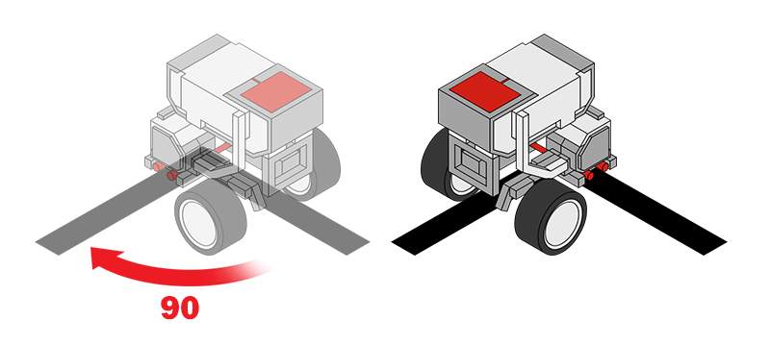
Next step in programming
Computations! Support for basic mathematics
Imagine, computing interest on a loan, dividend on a stock, or even computing an angle to go to a specific location
Here we make variables that store data and then alter those values which are stored.

Slide 3
Example: Computing the area
ComputeArea.py
# Assign a value to radius
radius = 20
# Compute the area
area = radius * radius * 3.14159
# Display the result
print("The area for a circle with radius", radius, "is", area)
Lets practice tracing, but first a note on memory

Slide 4
Memory
Memory is storage for data and programs
We will pretend that memory is an infinitely long piece of tape separated into different cells
Each cell has an address, i.e., a location, and a value
In the computer these values are represented in binary (0s and 1s) and addresses are located in hexadecimal (base 16, 0x)
x
y
z
…
…
0x0
0x1
0x2
0xA

Slide 5
Example: Computing the area
Output
The area for a circle with radius 20 is 1256.636
ComputeArea.py
# Assign a value to radius
radius = 20
# Compute the area
area = radius * radius * 3.14159
# Display the result
print("The area for a circle with radius", radius, "is", area)
Memory
radius: 20
area: 1256.636
A special symbol = gives a value to a variable, called assignment.
Actually operations are evaluated in a specific order. Temporary values are stored for these intermediate computations.
print can output a series of values separated by a comma. Each value is separated by a space in the output

Slide 6
Reading input from the console
ComputeArea.py
# Assign a value to radius
radius = eval(input("Enter a value for a radius: "))
# Compute the area
area = radius * radius * 3.14159
# Display the result
print("The area for a circle with radius", radius, "is", area)
input is a function to collect key strokes from the console
eval is a function that converts those key strokes to a value

Slide 7
Representing Data

Slide 8
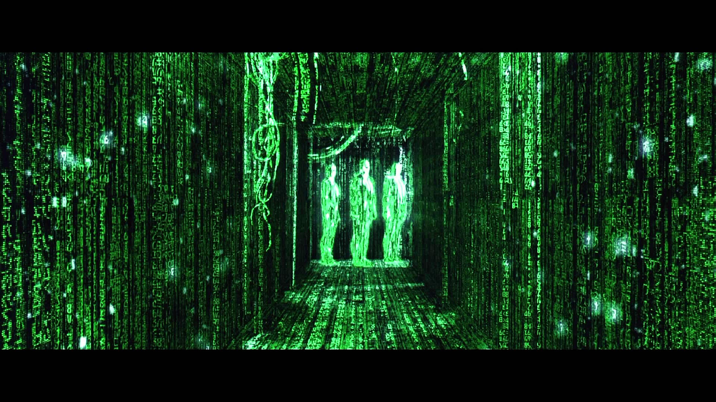
What about the 0s and 1s?
Yes, computers operate in 0s and 1s. The python interpreter handles this business for us, but memory also stores values as 0s and 1s
Memory also stores entirely 0s and 1s
So what we need to know is how computers do this

Slide 9
Integer Representation
First, a look at our number system. It is base 10, meaning we use 10 different symbols (the digits). Lets look at an example number: 1037.
And adding we use carry-and-add
1
0
3
7
$${10}^{3}=1000$$
$${10}^{2}=100$$
$${10}^{1}=10$$
$${10}^{0}=1$$
$$1∗{10}^{3}+$$
$$0∗{10}^{2}+$$
$$3∗{10}^{1}+$$
$$7∗{10}^{0}=1037$$
 | $$1$$ | $$0$$ | $$3$$ | $$7$$
$$+$$ | $$0$$ | $$0$$ | $$4$$ | $$9$$
 | $$1$$ | $$0$$ | $$8$$ | $$6$$

Slide 10
Integer Representation
Synonymously, binary numbers work the same way. Except instead of base 10, it is base 2. A digit can only be 0 or 1. Example: 0010 0101
And adding 0010 1010 + 0000 0101
Note there are other common number systems: Octal (base 8, digits 0-7) and Hexadecimal (base 16, digits 0-9 and A-F, used for memory addresses)
$$0$$
$$0$$
 | $$0$$ | $$0$$ | $$1$$ | $$0$$ | $$0$$ | $$1$$ | $$0$$ | $$1$$
$$+$$ | $$0$$ | $$0$$ | $$0$$ | $$0$$ | $$0$$ | $$1$$ | $$0$$ | $$1$$
 | $$0$$ | $$0$$ | $$1$$ | $$0$$ | $$1$$ | $$0$$ | $$1$$ | $$0$$

Slide 11
Integer Representation
By limiting the number of bits, we limit the expressiveness of the data type
Means that if we only have 2 bits, we can only represent 4 numbers: 00, 01, 10, 11
A 64 bit number can only represent values from $[−2^{64},2^{64})$
In programming, we must make conscious decisions about this otherwise there can be severe consequences

Slide 12
Data Types
Overall, data types define the available operations on and range of the data representation. Additionally, it notes how it is stored in memory.
Right now we have seen:
Strings – sequences of characters, e.g., "Hello"
Floating point numbers – representing real numbers with fractional components, e.g., 3.54
Integers – representing positive and negative whole numbers, e.g., 15
I want you to know about these, even though python will hide them from you and treat them fluidly

Slide 13
Activity
With a partner
Convert the binary number 1001 1001 to decimal
Add the binary number 0101 0101 to 1001 1001 (DO NOT DO THIS IN DECIMAL) and then convert to a decimal number
Bonus: 0xA1 to decimal, add 0x0E to it and convert to decimal. Hint: 0x means that the number is a hexadecimal (base 16)

Slide 14
Variables and NAming

Slide 15
Identifiers (names)
An identifier is a sequence of characters that consist of letters, digits, underscores (_), and asterisk (*).
An identifier must start with a letter or an underscore (_).
An identifier cannot be a reserved word. (See Appendix A, “Python Keywords,” for a list of reserved words).
An identifier can be of any length.

Slide 16
Variables
A variable is a named piece of data (memory). It stores a value!
It has a type that defines how the memory is interpreted and what operations are allowed
var = value

Slide 17
Expressions
Expressions are combinations of literals, variables, operations, and function calls that generate new values
$\frac{3+4x}{5}−\frac{10\left(y−5\right)\left(a+b+c\right)}{x}+9\left(\frac{4}{x}+\frac{9+x}{y}\right)$
is translated to
(3+4*x)/5 – 10*(y-5)*(a+b+c)/x + 9*(4/x + (9+x)/y)

Slide 18
Assignment Statements
Assignment statements give values to a variable
x = 1; // Assign 1 to x;
radius = 1.0; // Assign 1.0 to radius;
a = 'A'; // Assign 'A' to a;

Slide 19
Simultaneous assignment
Python allows a shorthand to create/assign multiple variables at a time. Variables and expressions will be comma separated. An example: x, y = (a+b)/2, (a-b)/2

Slide 20
Named Constants
Often, we need constants in programs, e.g., $π$., whose value never changes.
Python does not have a special syntax for naming constants. You can simply create a variable to denote a constant. To distinguish a constant from a variable, use all uppercase letters to name a constant.
PI = 3.14159
SIZE = 3

Slide 21
Naming Conventions
Choose meaningful and descriptive names.
Typically begin with lower case
Python typically names with underscores separating words (snake casing), but other styles capitalize the first letter of each subsequent word (camel casing):
my_area_variable
myAreaVariable
Constants will be all caps using snake casing: MY_PI_CONSTANT
Be consistent!

Slide 22
Literals
A literal is a constant value that appears directly in the program. For example, 34, 1,000,000, and 5.0 are literals in the following statements:
i = 34
x = 1000000
d = 5.0

Slide 23
Scientific Notation
Floating-point literals can also be specified in scientific notation, for example, 1.23456e+2, same as 1.23456e2, is equivalent to 123.456, and 1.23456e-2 is equivalent to 0.0123456. E (or e) represents an exponent and it can be either in lowercase or uppercase.

Slide 24
Expressions

Slide 25
Numeric Operators

Slide 26
Integers Division
Integers do not store decimals
Division computes how many times a divisor evenly goes into a number
Remainder (modulus) computes what is left over
5 / 2 yields an integer 2
5 % 2 yields 1 (the remainder of the division)
Practice:
What is 3456421 % 2?
25%3?
87%4?

Slide 27
How to Evaluate an Expression
Though Python has its own way to evaluate an expression behind the scene, the result of a Python expression and its corresponding arithmetic expression are the same.
Therefore, you can safely apply the arithmetic rules for evaluating a Python expression.

Slide 28
Underflow and Overflow
When a floating-point variable is assigned a value that is too large (in size) to be stored, it causes overflow, a run time exception. Example: 245 ** 1000
When a floating-point number is too small (i.e., too close to zero) to be stored, it causes underflow. Python approximates it to zero. So normally you should not be concerned with underflow.
Questions
Why does overflow/underflow occur?
What types of applications would we care about them?

Slide 29
Exercise
Write a program to compute the average of three numbers
Trace the execution in memory if the user enters 3, 5, 7

Slide 30
Augmented Assignment Operators
Operator | Name | Example | Equivalent
+= | Addition assignment | i += 8 | i = i + 8
-= | Subtraction assignment | i -= 8 | i = i - 8
*= | Multiplication assignment | i *= 8 | i = i * 8
/= | Float division assignment | i /= 8 | i = i / 8
//= | Integer division assignment | i //= 8 | i = i // 8
%= | Remainder assignment | i %= 8 | i = i % 8
**= | Exponent assignmnet | i **= 8 | i = i ** 8

Slide 31
Type Conversion

Slide 32
Type Conversion
Use int(), float(), str() to convert any type to integer, floating-point, or string respectively
Consider the following statements and their results:
int(4.7) $→$ 4
float(4) $→$ 4.0
str(4) $→$ "4"
To round floating point numbers use round()
round(4.7) $→$ 5

Slide 33
Exercise
Write a program to compute sales tax for a purchase.
How could you alter your program to only store 2 decimal places? Try it!
Trace your program with a purchase of $100

Slide 34
Exercise
With turtle graphics:
Write a program that asks the user to enter an $\left(x, y\right)$ coordinate representing the center of a rectangle. Additionally, ask the width and height of the rectangle.
Draw the rectangle.

Slide 35
Chapter 3 Math, Strings, and Objects
ACKNOWLEDGEMENT: THESE SLIDES ARE ADAPTED FROM SLIDES PROVIDED WITH Introduction to Programming Using Python, Liang (Pearson 2013)

Slide 36
Math Module
Python provides many useful mathematics methods in its Math module for performing common mathematical functions.
In order to use them we need to understand:
What a function is
How to use functions
Where we look up possible functions to use

Slide 37
Examples of Math Module
max(2, 3, 4) # Returns a maximum number : in this case 4
min(2, 3, 4) # Returns a minimum number : in this case 2
round(3.51) # Rounds to its nearest integer
round(3.4) # Rounds to its nearest integer
abs(-3) # Returns the absolute value
pow(2, 3) # Same as 2 ** 3

Slide 38
The math Functions

Slide 39
Strings and Characters
A string is a sequence of characters. String literals can be enclosed in matching single quotes (') or double quotes ("). Python does not have a data type for characters. A single-character string represents a character.
Strings have many methods to use to manipulate their data
Letter = 'A' # Same as letter = "A"
numChar = '4' # Same as numChar = "4"
message = "Good morning" # Same as message = 'Good morning'

Slide 40
The String Concatenation Operator
You can use the + operator add two numbers. The + operator can also be used to concatenate (combine) two strings. Here are some examples:
message = "Welcome " + "to " + "Python"

Slide 41
Reading Strings from the Console
To read a string from the console, use the input function. For example, the following code reads three strings from the keyboard:
s = input("Enter a string: ")
print("s is " + s)

Slide 42
Examples of string Object Methods
s = "Welcome"
s1 = s.lower() # Invoke the lower method, stores 'welcome'
s2 = s.upper() # Invoke the upper method, stores 'WELCOME'

Slide 43
Striping beginning and ending Whitespace Characters
Another useful string method is strip(), which can be used to strip the whitespace characters from the both ends of a string.
s = "\t Welcome \n"
s1 = s.strip() # Invoke the strip method, s1 stores 'Welcome'

Slide 44
Methods
Methods are subroutines that we would like to (re)use again and again in code
For example, would you like a method to compute $\sqrt{x}$ or write a lengthy algorithm every time you wish to use it?
Python provides many useful methods. Some we have seen:
print(), input(), round()

Slide 45
Interpreting Functions/methods
Consider the following from the Math library: sqrt(x)
sqrt is an identifier, i.e., a name, for this method
x is called a parameter, or an argument. This is the input to the method.
Methods can optionally output data too, in this case it will output a number.
In a few weeks, we will learn to write our own methods. For now, we need to know how to use them.

Slide 46
Introduction to Objects and Methods
In Python, all data—including numbers and strings—are actually objects.
An object is an entity. Each object has an id and a type. Objects of the same kind have the same type. You can use the id function and type function to get these information for an object.

Slide 47
Invoking a method
There is a difference between these math functions and how we used turtle
Methods sometimes depend on the value of an object/class and sometimes they do not. Common math functions, like sqrt, do not need to know anything besides the parameter. However, other things like turtle needs to know where the turtle currently is, so we invoke methods from a variable instead:
turtle.forward(100) //Use the variable

Slide 48
Formatting Numbers and Strings
Often it is desirable to display numbers in certain format. For example, the following code computes the interest, given the amount and the annual interest rate.
The format function formats a number or a string and returns a string.
format(item, format-specifier)

Slide 49
Formatting Floating-Point Numbers

Slide 50
Formatting in Scientific Notation
If you change the conversion code from f to e, the number will be formatted in scientific notation. For example
format(57.467657, '10.2e')
format(0.0033923, '10.2e')
format(57.4, '10.2e')
format(57, '10.2e')

Slide 51
Formatting as a Percentage
You can use the conversion code % to format numbers as a percentage. For example,
format(0.53457, '10.2%')
format(0.0033923, '10.2%')
format(7.4, '10.2%')
format(57, '10.2%')

Slide 52
Justifying Format
By default, the format is right justified. You can put the symbol < in the format specifier to specify that the item is a left justified in the resulting format within the specified width. For example,
format(57.467657, '10.2f')
format(57.467657, '<10.2f')

Slide 53
Formatting Strings
You can use the conversion code s to format a string with a specified width. For example,
format("Welcome to Python", '20s')
format("Welcome to Python", '<20s')
format("Welcome to Python", '>20s')

Slide 54
Exercise
Recall there is more information online and in your book
I assume you know what is in Ch. 3 of your book
Write a program that prompts the user to enter a side length and an angle from $\left(0°, 90°\right)$ and draws a right triangle accordingly. Label each side length and each angle using the turtle module.
500
60$°$
300
30$°$
90$°$
400

