Slide 1
Robotics Sense-Plan-act loop

Slide 2
Motivation
In project 1 our robot couldn't return to exactly the same location as it started.
Why?
We can solve this though continual feedback! We need to make decisions more often to adjust our actions.
Supports algorithmic thoughts like: drive until we see a wall, or turn until we face the right direction
Essentially, we need a loop!

Slide 3
Sense-plan-act loop
Sense
Read information from sensors.
Plan
Choose the next action to take.
Act
Send commands to alter the state of the robot.

Slide 4
Sense-plan-act loop
while robot_is_running():
sense() # Read all sensor information
plan() # Make a plan and decide action to take
act() # Send commands to the robot

Slide 5
Event driven programming
This loop is related to an approach for programming called event driven programming, which is extremely common in applications
More generally for event driven programming: while applicationIsRunning(): processInputs() doSomethingAutomagically() provideFeedbackToUser()
Tricky part is to alter your thinking to rely on this single loop to make things happen over time.

Slide 6
Lets think deeper about some robot functions
robot.forward()
Sets motors on
Continues application program immediately
Requires us to use time.sleep() to create motions
vs
robot.drive_cm(x)
Set motors on for a set distance
Waits to continue application program until motion is complete
Can specify fully: robot.drive_cm(x, True)
True requires motion to finish, False continues program immediately.

Slide 7
Frame limiting
Many robots need some fixed form of "waiting" to pass the time before the program ends. We can include this in our loop:
while robot_is_running():
sense() # Read all sensor information
plan() # Make a plan and decide action to take
act() # Send commands to the robot
wait() # Wait for an amount of time, or to be more # sophisticated, wait for a remaining amount # of time based on fixed rate.
Work with a partner to alter the loop for the added sophistication.

Slide 8
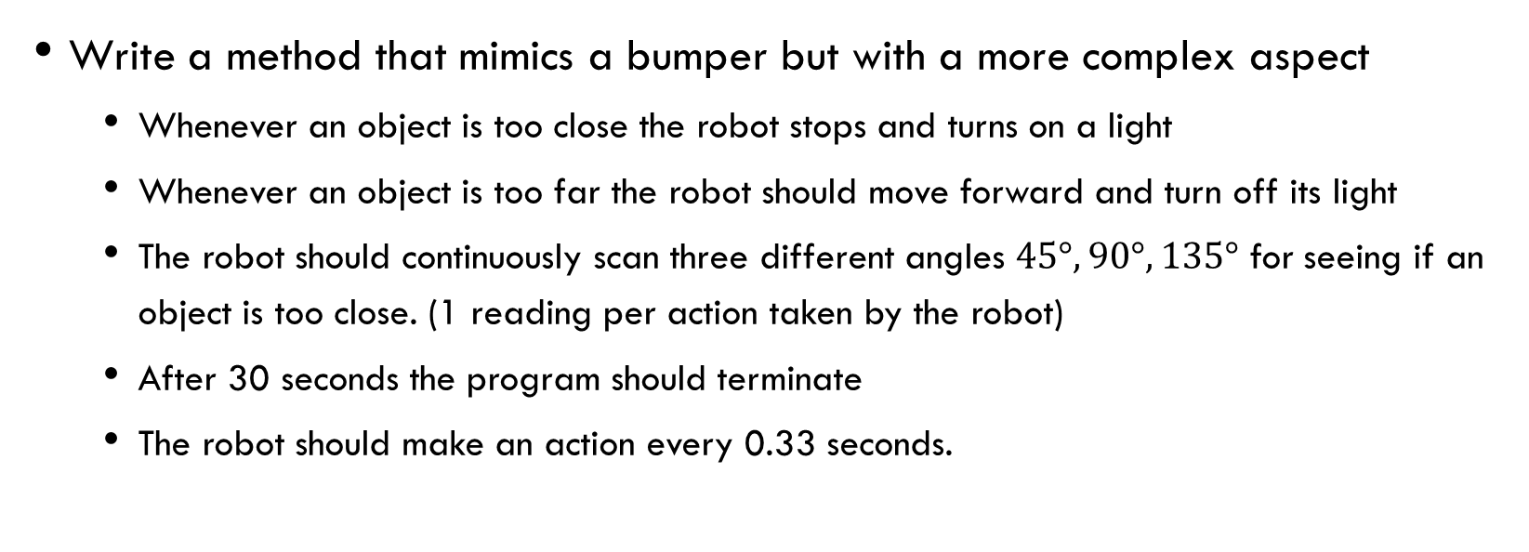
Exercise
Write a method that mimics a bumper but with a more complex aspect
Whenever an object is too close the robot stops and turns on a light
Whenever an object is too far the robot should move forward and turn off its light
The robot should continuously scan three different angles $45°, 90°, 135°$ for seeing if an object is too close. (1 reading per action taken by the robot)
After 30 seconds the program should terminate
The robot should make an action every 0.33 seconds.

