Slide 1
GoPiGo3
Sensors

Slide 2
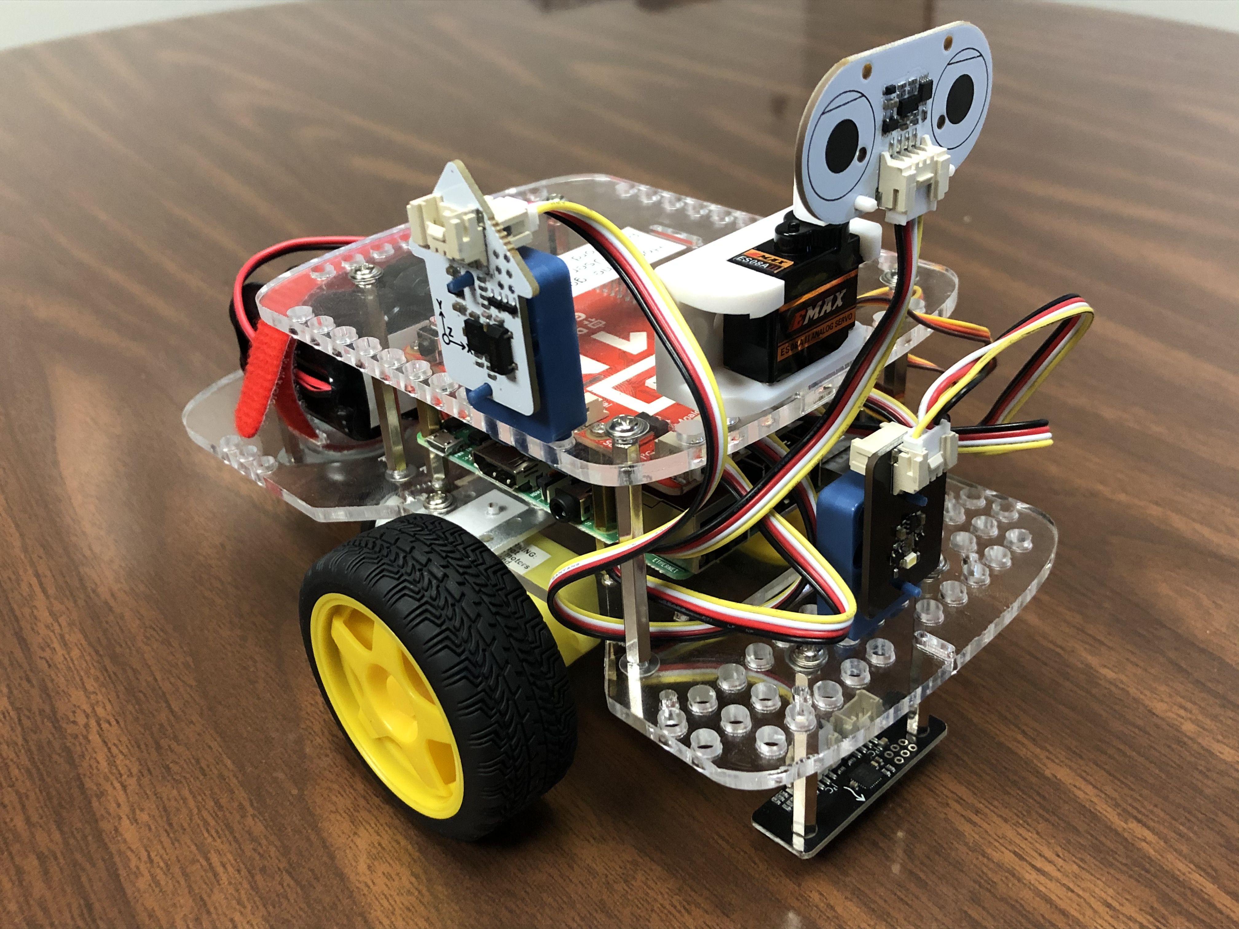
Additional Actuation
GoPiGo3s offer many ways to alter the state of the robot
  Wheels
  LEDs
  Servo motor
Simply need to call the right method.
  Together lets look up different methods for moving the robot.

Slide 3
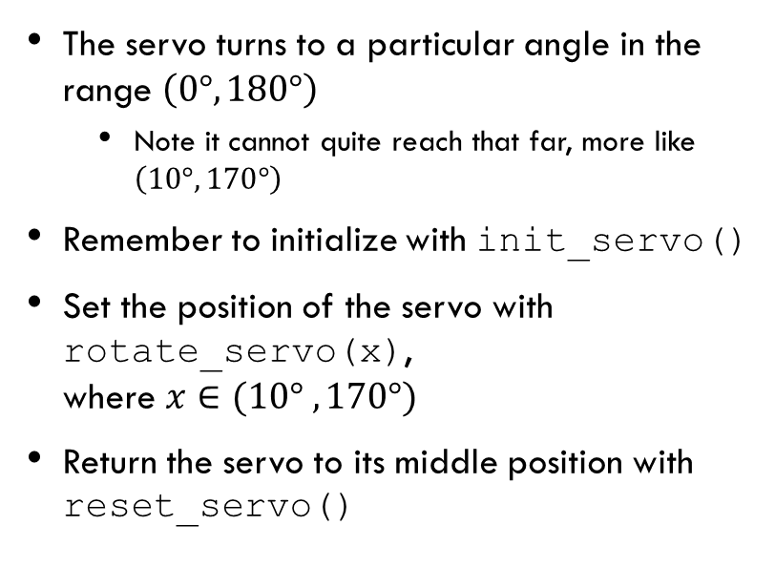
Using the servo
The servo turns to a particular angle in the range $\left(0°, 180°\right)$
  Note it cannot quite reach that far, more like $\left(10°, 170°\right)$
Remember to initialize with init_servo()
Set the position of the servo with rotate_servo(x),
where $x∈(10° ,170°)$
Return the servo to its middle position with reset_servo()
Servo.py
from easygopigo3
import EasyGoPiGo3
robot = EasyGoPiGo3()
servo = robot.init_servo()
servo.rotate_servo(45)
servo.reset_servo()

Slide 4
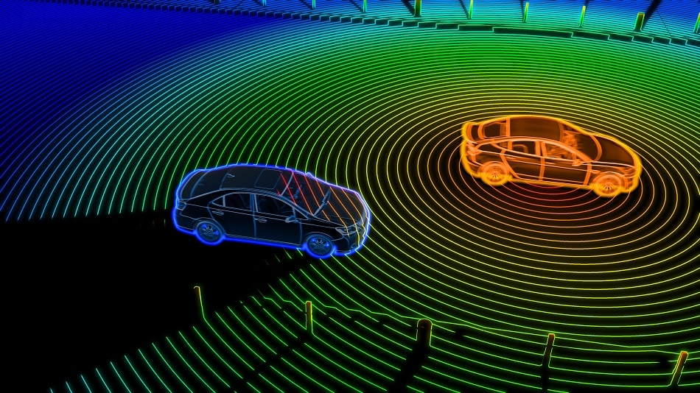
Sensors
Sensors gather input data from the physical world
  Images
  Distances
  Temperature
  Light values
  Etc.

Slide 5
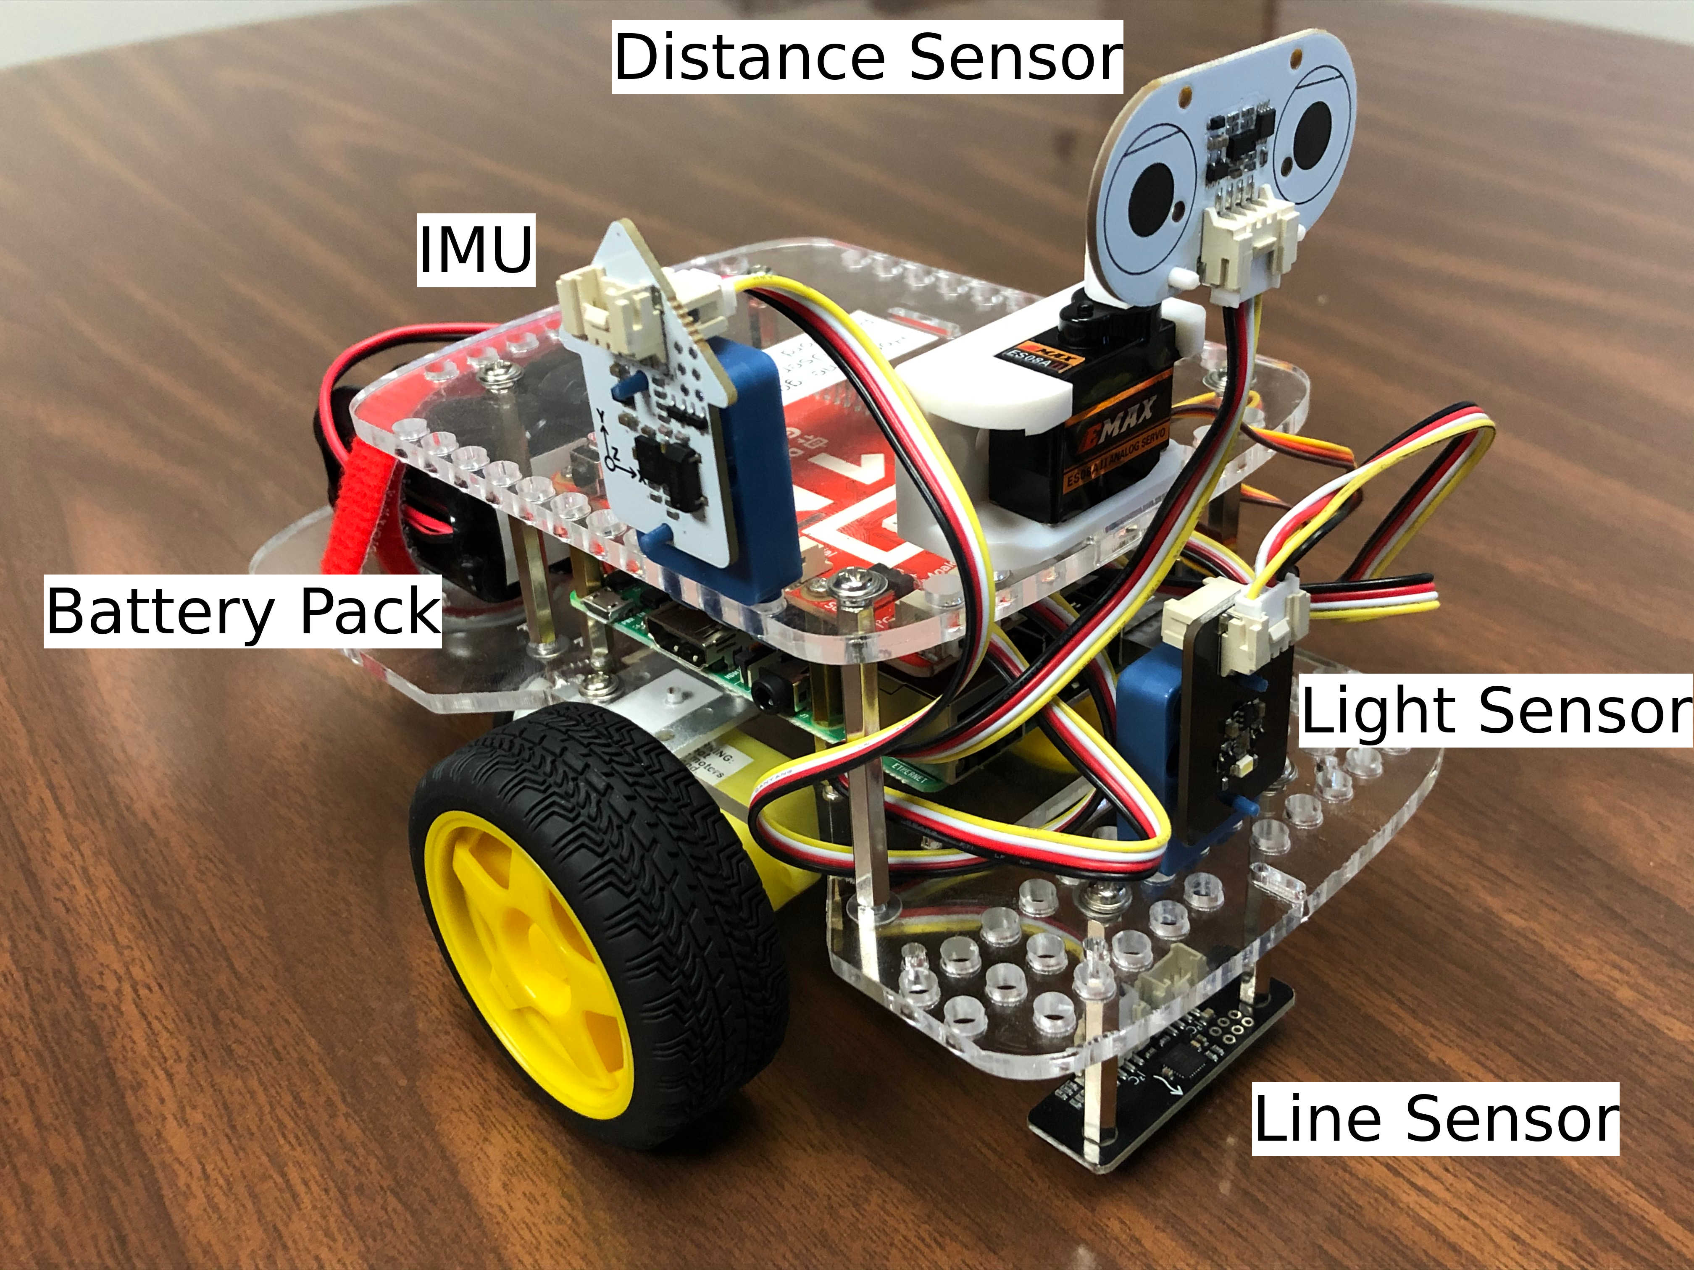
GoPiGo3 Sensor setup
Light/Color Sensor
Line Sensor
Distance Sensor
Inertial Measurement Unit (IMU)

Slide 6
Using sensors/actuators
In the beginning, we will use the "EasyGoPiGo" versions of things. Eventually, around halfway through the semester, we will start using the richer, advanced version "GoPiGo"
Same it true of sensors
When using, we need to specify the port that each sensor is connected to. This will always be the same for our purposes.

Slide 7
Distance Sensor
The distance sensor determines the distance to whatever is immediately in front of it
The sensor has a range of 2.3 meters and reports the distance in millimeters
Distnace.py
from easygopigo3 import EasyGoPiGo3
robot = EasyGoPiGo3()
distance_sensor = robot.init_distance_sensor()
distance = distance_sensor.read_mm()

Slide 8
Light and Color Sensor
The light and color sensor simply allows reading of a light intensity value
The light value is broken down into RGBA components
This sensor also has an LED that can be turned on and off
LightColor.py
from di_sensors.light_color_sensor import LightColorSensor
light_color_sensor = LightColorSensor(bus="GPG3_AD1")
light_color_sensor.set_led(True)
r, g, b, a = light_color_sensor.get_raw_colors()
light_color_sensor.set_led(False)

Slide 9
Line Follower Sensor
The line sensor detects whether the robot sits on top of a black line or not
  Essentially reads the color of the floor
Six different values are read by the sensor
LineFollower.py
from easygopigo3 import EasyGoPiGo3
robot = EasyGoPiGo3()
Line_follower= robot.init_line_follower()
ll, l, lc, rc, r, rr = line_follower.read()

Slide 10
Inertial Measurement Unit
Inertial Measurement Units (IMUs) measure orientation, velocities, and forces about the state of the sensor
  Also can measure temperature
We will always have to calibrate the sensor each time we use it (more on this later)
IMU.py
from di_sensors.inertial_measurement_unit
import InertialMeasurementUnit
imu = InertialMeasurementUnit(bus="GPG3_AD2")
a, b, g = imu.read_euler()
t = imu.read_temperature()

Slide 11
Exercise
Write a program that determines and outputs the distance in each "cardinal" direction
  Let "north" be where the robot originally faces.
After, work on program 1

