Slide 1
GPAT – Chapter 10
User Interfaces

Slide 2
Menu Systems

Slide 3
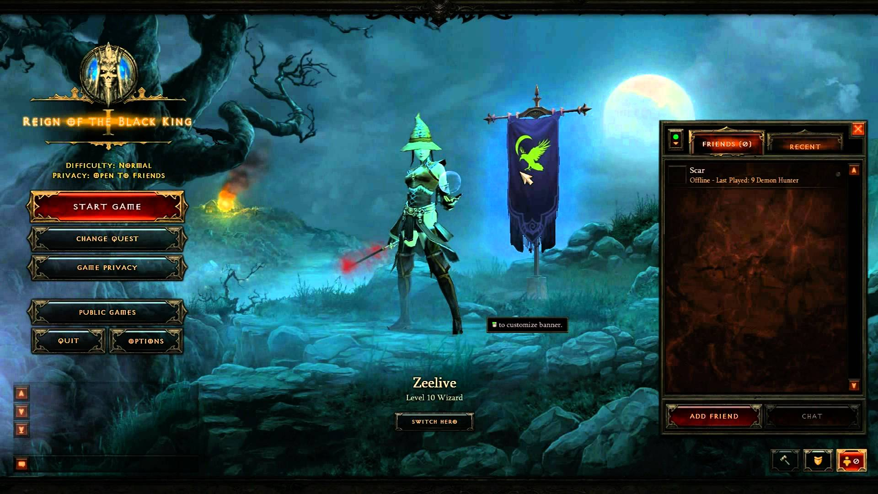
Menu Stack
Ensure a menu system has a stack
  Need base class for menus
Allows going back to a prior menu selection
  Its like allowing a user traversal of a tree
On entering a new menu – push
On exiting the current menu – pop
Good to offer the ability to go to top menu

Slide 4
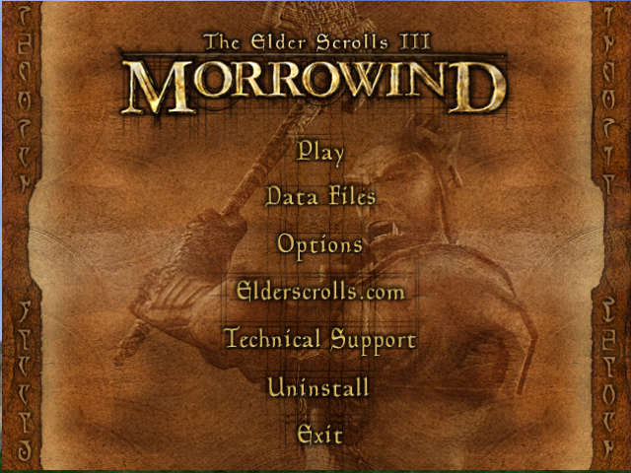
Buttons
Each button needs at least two visual states
  Selected
  Unselected
  Maybe pressed state as well
Possibly have a doubly-linked list of buttons or an array of buttons tracking an index
  Back
  Forward
  Wrap
Possibly have a 2D bounding box for clicking or tapping
Event system to manage what happens when a button is pressed

Slide 5
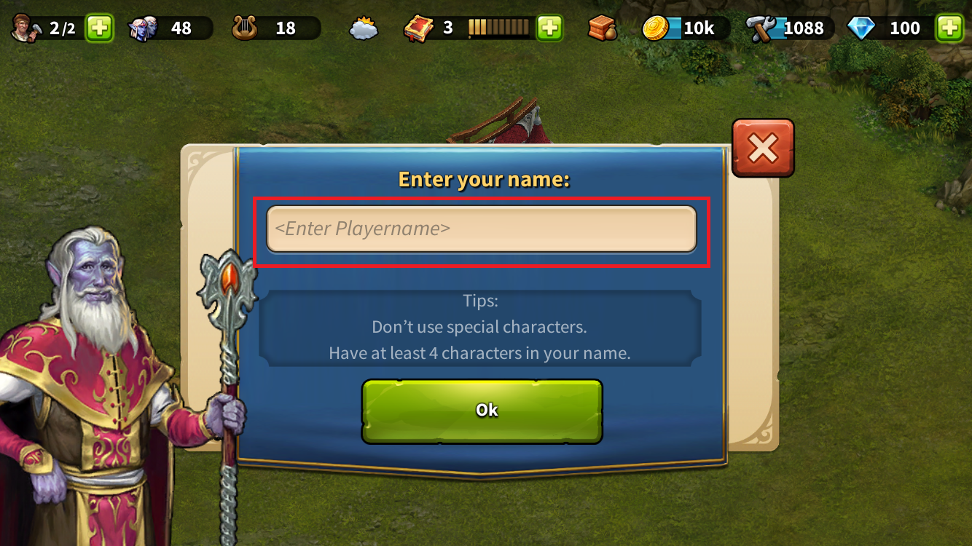
Typing
Supports allowing someone to customize names for avatars
You can only allow one key stroke at a time, so you construct a string as the player presses keys

Slide 6
HUD Elements

Slide 7
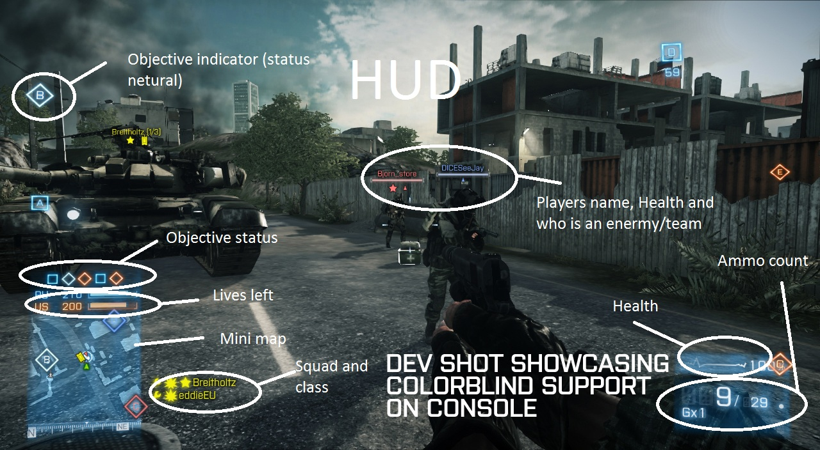
HUD Elements
The HUD or Heads Up Display displays pertinent information to a player for each gameplay mode
It is an overlay on top of the view of the game
Simple elements
  Buttons
  Score
  Health bars

Slide 8

Waypoint Arrow
Store vector for facing direction $\hat{f}$
Compute vector to target $\hat{t}$
Angle of rotation
  $θ=\cos^{−1}\left(\hat{t}⋅\hat{f}\right)$
Axis of rotation
  $\vec{a}=\hat{t}×\hat{f}$
Rendering considerations
  Should not be affected by camera transformation
  Should not be affected by z-buffering

Slide 9
Aiming reticule
Drawn as a crosshair at a set 2D position
Ray cast is performed into the scene from the unprojected 2D position
Depending on what the ray hits you change the color/shape of the reticule

Slide 10
Radar
Convert player and objects of interest into 2D positions
Determine distance and vector to objects of interest
  Draw blip if inside view based on target vector
N

Slide 11
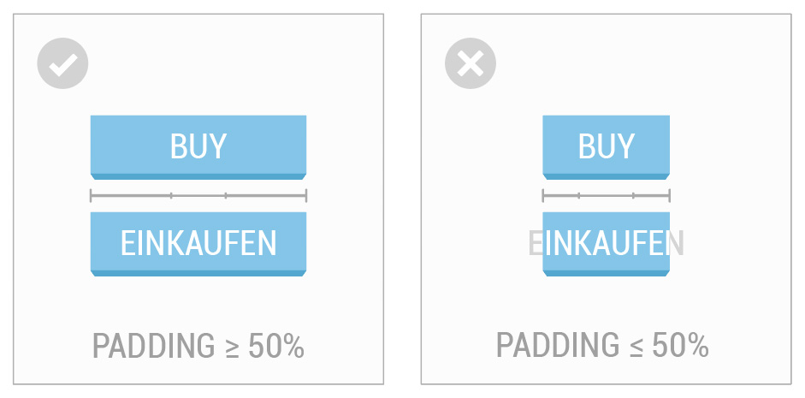
Other considerations
Design in relative coordinates to support multiple resolutions
Remember to support localization
Use middleware for the UI as much as possible
Design for user experience!

Slide 12
GPAT – Chapter 11 (not assigned in reading)
Scripting Languages and Data Format

Slide 13
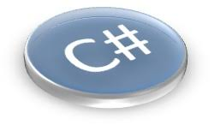
Scripting Languages
Allows designers to get involved in the programming
  Abstract the engine (hard stuff) from the game elements ("easier" stuff)
Use a scripting language that is interpreted/compiled by the engine
  Allows easy updates to the game to be distributed
  Can reload script dynamically for debugging
  Prevents crashes
  However, can be slow

Slide 14
Implementing a Scripting Language
Lexing
Parsing
Executing
Tokenization (Lexical analysis) – make "tokens" out of a stream of text. Typically done through regular expressions.
  Operators
  Identifiers
  Keywords
  Etc
Syntax analysis – ensure tokens follow rules of the language. Typically done through context-free grammars.
Code execution/generation

Slide 15
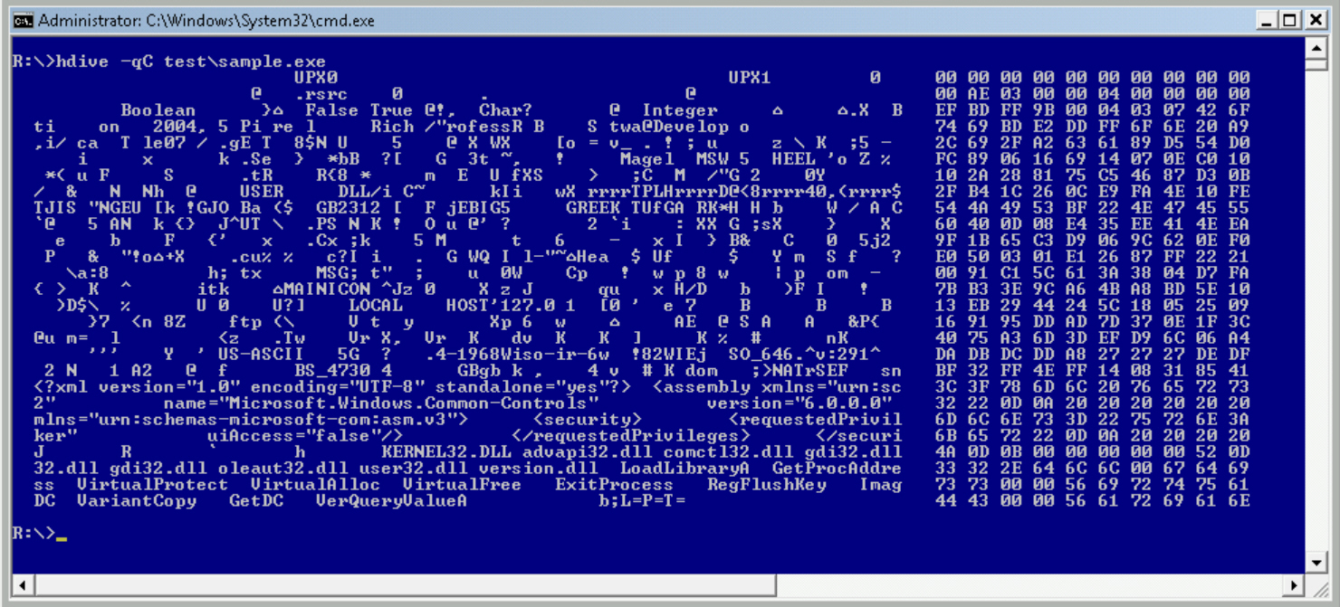
Data Formats
Binary file – unreadable file that stores values of the bits directly
  Efficient
  Needs some way to help debug/designers
Text-based file – readable file that stores values of the bits as strings
  Easy editing for designers and repositories
  Allows end users to modify (user mods)
  Can use standard options
    XML
    JSON
Both – text-based in development and binary in release

Slide 16
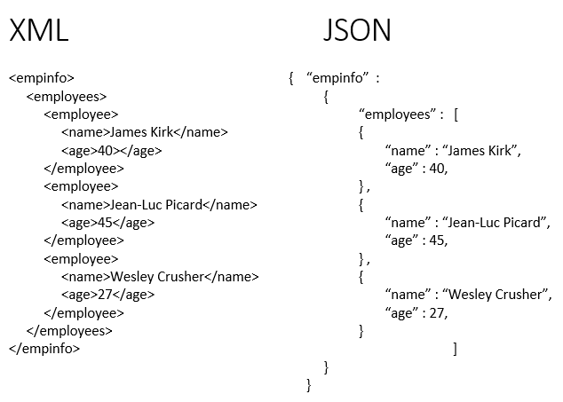
Data Formats

Slide 17
Work on designing your menu system and HUD for your primary gameplay modes

Slide 18
Summary
In this chapter, we looked at some basic approaches to defining and implementing a user interface for a game
  Menu systems
  HUD elements

