Slide 1
GPAT – Chapter 7 Physics

Slide 2
Physics Overview
Physics in games involves these two basic elements:
Object-object interaction (Geometry)
Collision detection
Collision response
Mechanics (Calculus)
Object movement
Also can be used to simulate
Visual effects such as water dynamics
More realistic sound and light effects
However, these are often too slow for gaming

Slide 3
Collision Detection

Slide 4
Basic Geometry
$$\hat{n}$$
C
Planes
Point $\vec{p}$, normal $\hat{n}$
$\vec{p}⋅\hat{n}+d=0$
Easy to derive from triangle
Rays
Point $\vec{R_{0}}$, direction $\vec{v}$, parametric value $t∈\left[0,∞\right)$
$\vec{R_{0}}+\vec{v}t$
Line segments
Same as ray except $t∈\left[0,1\right]$ (i.e., two endpoints)
A ray cast involves extending a ray into the scene to determine interaction with objects, e.g., ballistics in FPS games. Often computed by line segments and not actual rays
A
B
$$\vec{R_{0}}$$
$$\vec{v}$$
$$\vec{R_{0}}$$
$$\vec{R_{1}}$$

Slide 5
Collision Geometries
A separate geometric representation of objects is used instead of the real mesh geometry for collision detection
Compare a box (12 triangles) to a complex model for an avatar (>15,000 triangles)
Leads to false positives

Slide 6
Collision Geometries
Bounding Spheres (BSs)
Center
Radius
Axis-Aligned Bounding Boxes (AABBs)
Min/Max in each dimension (2 points)
Oriented Bounding Boxes (OBBs)
8 vertices or 6 planes

Slide 7
Collision Geometries
Capsules
2 points
Radius
Convex Polyhedrons (Convex Hulls)
Mesh
List of Geometries

Slide 8
BS-BS collision Detection
Collision if
$${\left\|A−B\right\|}^{2}<{\left(r_{a}+r_{b}\right)}^{2}$$
B
B
A
$$r_{b}$$
$$r_{b}$$
$$r_{a}$$
Collision
B
B
A
$$r_{b}$$
$$r_{b}$$
$$r_{a}$$
Non-collision

Slide 9
AABB-AABB Collision Detection
For 2D-boxes A and B: $A.max.x>B.min.x∧$ $B.max.x>A.min.x∧$ $A.max.y>B.min.y∧$ $B.max.y>A.min.Y$
$$B.max$$
$$A.max$$
$$B$$
$$A$$
$$B.min$$
$$A.min$$
Collision
$$B.max$$
$$B$$
$$A.max$$
$$B.min$$
$$A$$
$$A.min$$
Non-collision

Slide 10
Line Segment-plane Collision Detection
Given the two equations: $\vec{R_{0}}+\vec{v}t$ $\vec{p}⋅\hat{n}+d=0$
We solve for their intersection (a point on that plane): $\left(\vec{R_{0}}+\vec{v}t\right)⋅\hat{n}+d=0$ $\vec{R_{0}}⋅\hat{n}+\left(\vec{v}⋅\hat{n}\right)t+d=0$ $t=\frac{−\left(\vec{R_{0}}⋅\hat{n}+d\right)}{\vec{v}⋅\hat{n}}$
If $t∈\left[0,1\right]$ then there is a collision, else non-collision
Plug back in if you need the point
$$\vec{R_{0}}$$
$$\vec{p}$$
$$\hat{n}$$
$$\vec{v}$$

Slide 11
Line Segment-Triangle Collision Detection
First figure out the point hits the plane that the triangle lies in
Next we determine if that point lies in the triangle
Key idea is to determine if the point is on the same side of each edge of the triangle: $\left(\vec{AB}×\vec{AP}\right)⋅\hat{n}>0$
Can be more efficient with Barycentric coordinates
B
P
A
C

Slide 12
BS-Plane Collision Detection
Essentially, find a hypothetical plane parallel to the first plane and through the center of the sphere
Compare the difference of the plane's $d$ values to the spheres radius
Intersection if: $d_{B}=−B⋅\hat{n}$ $\left|d−d_{B}\right|<r_{b}$
B
$$O$$
$$r_{b}$$
$$\vec{p}$$
$$d_{B}$$
$$d$$
$$\hat{n}$$
Non-collision

Slide 13
Swept BS Collision Detection
$$t=0$$
$$t=1$$
Essentially, a version of continuous collision detection (or collision detection for capsules)
Again, construct parametric equations and solve
Specifically, construct rays for the motion of the object centers and find the point where the distance between the rays is the same as the sum of the radii
A
B
$$t=1$$
$$t=0$$
A
B

Slide 14
Swept BS Collision Detection
$$t=0$$
$$t=1$$
Center motion: $\vec{A_{t}}=\vec{A_{0}}+\vec{v_{A}}t$ $\vec{B_{t}}=\vec{B_{0}}+\vec{v_{B}}t$
Solve for $t$ in: $\left\|\vec{A_{t}}−\vec{B_{t}}\right\|=r_{A}+r_{B}$ $\left(\vec{A_{t}}−\vec{B_{t}}\right)⋅\left(\vec{A_{t}}−\vec{B_{t}}\right)={\left(r_{A}+r_{B}\right)}^{2}$
A
B
$$t=1$$
$$t=0$$
A
B

Slide 15
Swept BS Collision Detection
$$t=0$$
$$t=1$$
$\left(\vec{A_{t}}−\vec{B_{t}}\right)⋅\left(\vec{A_{t}}−\vec{B_{t}}\right)={\left(r_{A}+r_{B}\right)}^{2}$
Looking at $\vec{A_{t}}−\vec{B_{t}}$: $\vec{A_{0}}+\vec{v_{A}}t−\vec{B_{0}}−\vec{v_{B}}t$ $\vec{A_{0}}−\vec{B_{0}}+\left(\vec{v_{A}}−\vec{v_{B}}\right)t$
Let $\vec{C}=\vec{A_{0}}−\vec{B_{0}}, \vec{D}=\vec{v_{A}}−\vec{v_{B}}$ so: $\left(\vec{C}+\vec{D}t\right)⋅\left(\vec{C}+\vec{D}t\right)={\left(r_{A}+r_{B}\right)}^{2}$
A
B
$$t=1$$
$$t=0$$
A
B

Slide 16
Swept BS Collision Detection
$$t=0$$
$$t=1$$
Expanding the dot product: $\vec{C}⋅\vec{C}+2\left(\vec{C}⋅\vec{D}\right)t+\left(\vec{D}⋅\vec{D}\right)t^{2}={\left(r_{A}+r_{B}\right)}^{2}$
Let $a=\vec{D}⋅\vec{D},b=\vec{C}⋅\vec{D},$ $c=\vec{C}⋅\vec{C}−{\left(r_{A}+r_{B}\right)}^{2}$, so: $at^{2}+bt+c=0$
Solve with quadratic equation, and if the discriminant is greater than 0 and further $t∈\left[0,1\right]$, then there is a collision. Otherwise no collision (or tangent)
A
B
$$t=1$$
$$t=0$$
A
B

Slide 17
Collision Response
Simple examples
Objects "die"
One object loses health
Complex interactions
Need to determine exact point of collision (LERP)
Need to determine normals at point of collision
Reflect and scale velocities about normals depending on elasticity of collision
B
A
B
A

Slide 18
Optimizing Collision Detection
Often use a hierarchy of collision geometries (e.g., sphere/box then convex hull)
Use of spatial trees, e.g., quadtree to limit which objects collision is performed against (~logarithmic time and ~constant number of triangles to collision check)

Slide 19
Physics-based movement

Slide 20
Review of Linear (Newtonian) Mechanics
Newton's second law of motion – force is mass by acceleration $\vec{F}=m\vec{a}$
For position $\vec{x}$:
Velocity $\vec{v}=\dot{\vec{x}}$ (first derivative with respect to time)
Acceleration $\vec{a}=\dot{\vec{v}}=\ddot{\vec{x}}$ (second derivative with respect to time)
In games however, we are trying to compute the next time steps position ${\vec{x}}^{′}$, thus, we need the anti-derivative, i.e., integration
Further we need to use numerical integration, after all we don't even have a symbolic representation of our motion
Essentially cannot use variable time step
Accuracy is related to the magnitude of the time step
Begin by calculating the force, e.g., gravity, wind resistance, impulses, etc
Next compute acceleration $\vec{a}=\frac{\vec{F}}{m}$

Slide 21
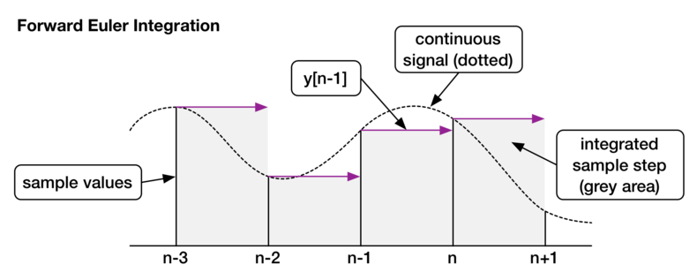
Euler and Semi-Implicit Euler Integration
Euler integration – use current velocity to alter position ${\vec{x}}^{′}=\vec{x}+\vec{v}Δt$ ${\vec{v}}^{′}=\vec{v}+\vec{a}Δt$
Semi-implicit Euler integration – use next velocity to alter position ${\vec{v}}^{′}=\vec{v}+\vec{a}Δt$ ${\vec{x}}^{′}=\vec{x}+{\vec{v}}^{′}Δt$

Slide 22
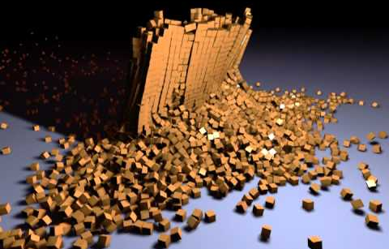
Advanced Considerations
Can use Velocity Verlet integration (essentially the trapezoid rule)
Could use Taylor series expansions, e.g., Fourth Order Runge-Kutta
All about how much error you can handle
For angular considerations – torque is moment of inertia by angular accelaration $\vec{τ}=I\vec{α}$ then use integration to get angular velocity $\vec{ω}$ and angle $\vec{q}$
Complicated as moment of interia is a matrix
Typically utilize existing libraries
PhysX
Bullet
etc

Slide 23
Summary
In this chapter we delved into the basics elements of emulating physics
Collision detection
Collision response
Physics-based movement through numerical integration

