Slide 1
GPAT – Chapter 2, 4, and 8 Graphics and Cameras

Slide 2
Some Basics of Graphics
A pixel is a picture element whose data is typically at least a color (but can be more, e.g., depth information)
The framebuffer is special location in memory of pixel data for the monitor to display
Monitor technology (e.g., CRT) used to be built upon the concept of a scan line, i.e., a row of pixels, and many algorithms still rely on this.
Cathode Ray Tube Monitor

Slide 3
Some basics of graphics
Colors are usually expressed in Red-Green-Blue (RGB) format
3 8-bit integers (each a value 0-255) or 3 floating-point numbers (each a value 0-1) representing intensity. 0 is no intensity or black
Often colors add in an alpha channel representing transparency. 0 is fully transparent. 255u or 1.f is fully opaque.

Slide 4
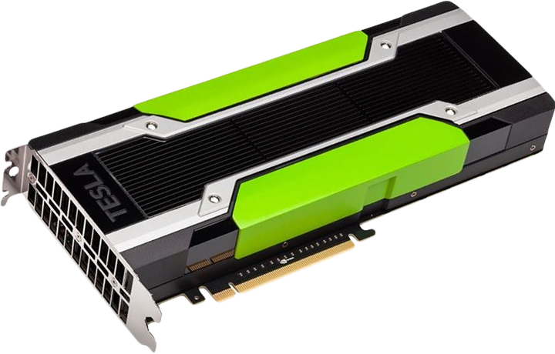
Some Basics of Graphics
Modern computers and consoles have graphics processing units (GPUs)
Knows how to render points, lines, and triangles
Has dedicated memory
Executes shaders, or small programs, to operate on data
Operates on 4-byte floating point numbers
Things to keep in mind:
Geometry data lives on GPU, not CPU – data transfer occurs through memory buffers
Picture information, often called a texture, also lives in GPU memory – also called a color map
GPUs are highly parallel, CPUs are not
GPUs have limited memory that must be managed properly

Slide 5
Double Buffering

Slide 6
There is a problem though!
What happens when the CPU changes the framebuffer while the monitor is drawing it?
Screen tearing or showing two partial frames at once

Slide 7
Solution – VSync
Synchronize the game loop rendering with the interval that the scanner is returning to the original position, called vertical blank interval
Problem?
Still not enough time!
Monitor
Vertical Blank Interval (VBLANK)

Slide 8
Solution – Double Buffering
Have two frame buffers
Render to the back buffer
Display the front buffer
At the end of the game loop rendering
Wait for VBLANK
Swap frame buffers
Back buffer (Render)
Front buffer (Display)
Swap Buffers

Slide 9
Sprites

Slide 10
Drawing Sprites
A sprite is a 2D visual game object that can be drawn with a single image
Examples – characters, objects, backgrounds
2D games have dozens to hundreds of sprites to manage as texture objects (its these game assets that make them large)
How should we draw them?
Draw in order of background to foreground, called the painter's algorithm
Give each sprite an integral "draw order"
Some libraries break further into layers, and each layer is drawn based on draw order
How do you store all of the sprites?
Sorted container
Update step should set draw order and re-sort container
class Sprite {
ImageFile image
int drawOrder
int x, y
void draw() {
// Draw image at correct
// (x, y)
}
}

Slide 11
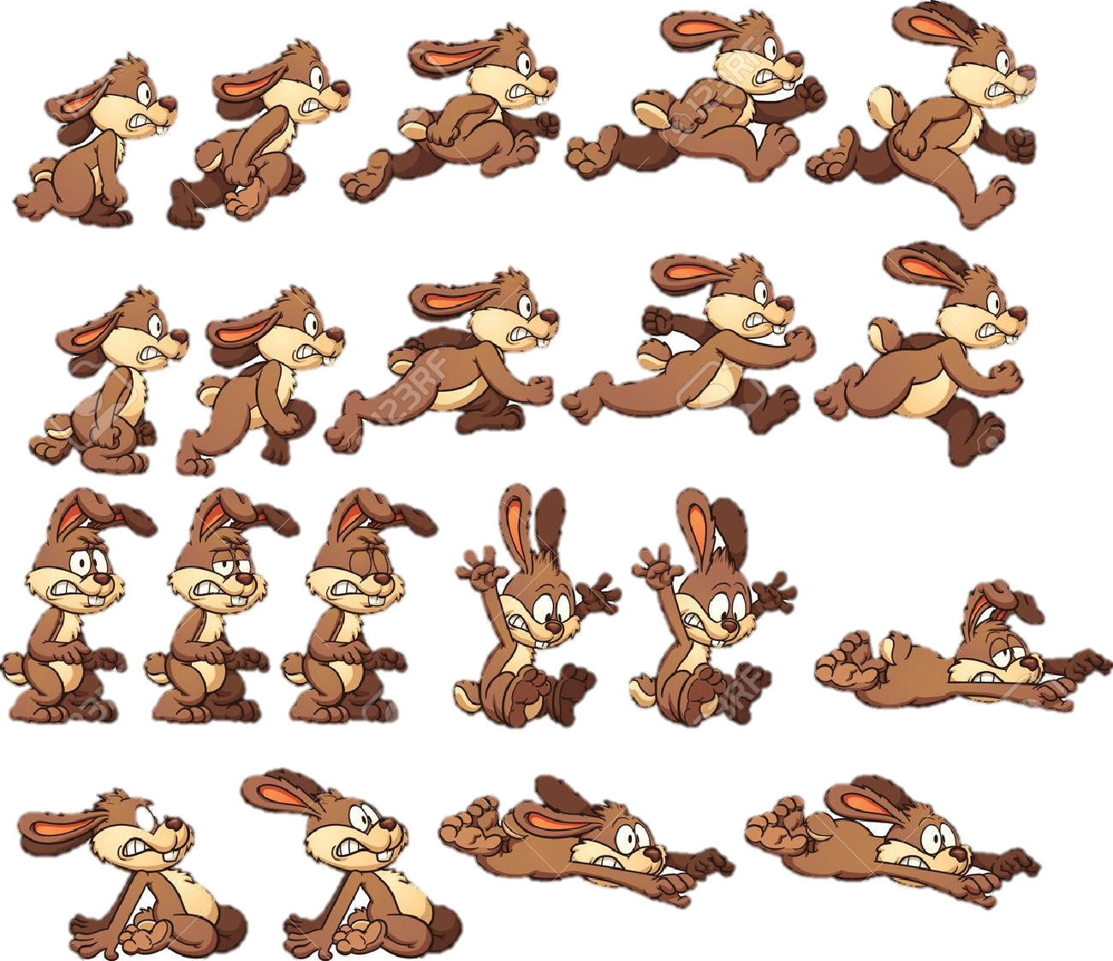
Animating Sprites
Based on "flipbook" animation
Show series of images fast enough
Store an array of sprite images in order of animation
struct AnimFrameData {
int startFrame; // Starting index for animation
int numFrames; // Number of frames in animation
}
struct AnimData {
ImageFile images[]; // All sprites for animations
AnimFrameData frameInfo[]; // Animation information
}

Slide 12
Animating Sprites
class AnimSprite extends Sprite {
AnimData animData; // All animation data
int animNum; // Active animation
int frameNum; // Frame of active animation
float frameTime; // Amount of time current frame has been displayed
float animFPS; // FPS of animation
void initialize(); // Create/set animData and
// starting animation
void updateAnim(float deltaTime); // Update based on delta game time
void changeAnim(int num); // Resets frameNum and frameTime to
// 0 and sets image to first of
// animation num
}

Slide 13
Animating Sprites
void updateAnim(float deltaTime) {
frameTime += deltaTime;
// Check to advance to next animation frame
if(framTime > 1/animFPS) {
// Advance (frameTime / (1/animFPS)) frames
frameNum += frameTime * animFPS;
// Wrap animation
frameNum %= animData.frameInfo[animNum].numFrames;
// Update image and frameTime
int imageNum = animData.frameInfo[animNum].startFrame + frameNum;
image = animData.images[imageNum]
frameTime %= 1/animFPS;
}
}

Slide 14
How do you switch between Animations?
Use a state machine
More on this when covering AI
Essentially, a graph
Nodes are specific animations (pick one to start on)
Edges represent transitions
Automatic (e.g., after 3 seconds)
Action (e.g., after pushing 'A')

Slide 15
Sprite Sheets
Efficient file representation for sprites. Put them all in a single texture (packed closely)

Slide 16
Scrolling

Slide 17
Single-axis Scrolling
Assume we have a finite set of images, all screen-sized segments (e.g., 960x640) scrolling on x-axis
Initialize ith image x at imageIndex*screenWidth
1st image at 0, 2nd at 960, 3rd at 1920, …
How many backgrounds should be drawn at a time?
2
Need x, y coordinates of "camera"
Starts at center of first screen
Lets have camera x be the players x, except cannot go behind first image/past last image

Slide 18
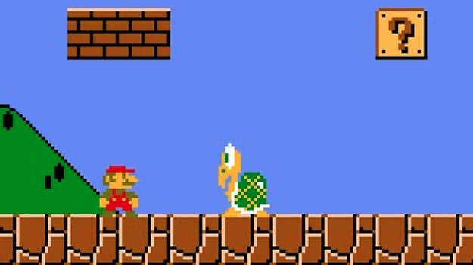
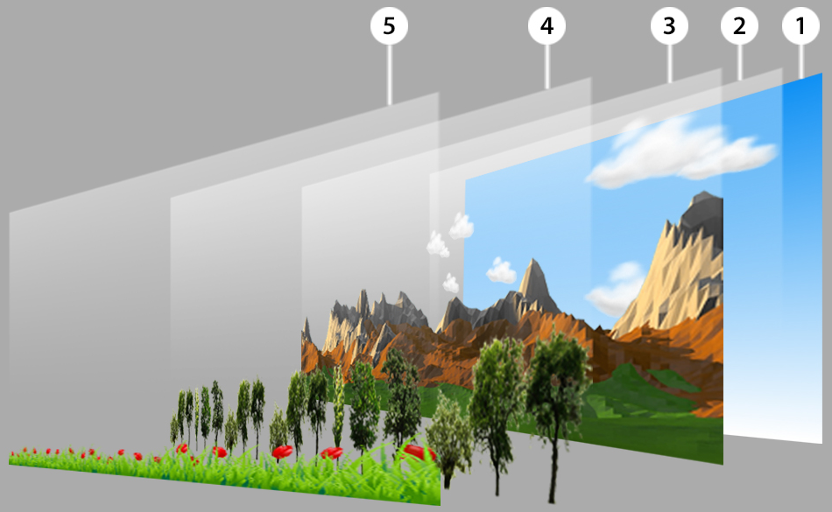
Single-axis Scrolling
camera.x = clamp(player.x, screenWidth/2, imageCount * screenWidth – screenWidth/2);
Find image i camera is in by camera.x/screenWidth;
Draw image i at (i.x – camera.x + screenWidth/2, 0);
Draw image (i+1) at (i.x – camera.x + screenWidth/2, 0);

Slide 19
Scrolling Extras
Infinite scrolling can be implemented by looping through images (wrapping) or randomly piecing image sequences together
Parallax scrolling breaks background into multiple layers at different depths
Typically need at least 3 layers
Implemented by drawing image i at (i.x – (camera.x – screenWidth/2) * speedFactor, 0)
Note need different find equation
Four-way scrolling
Incorporate the y-axis too
Have matrix of background images
How many images should be drawn?
4

Slide 20
Tile Maps

Slide 21
Creating worlds with Tile maps
Tile maps are a partitioning of the world into polygons of equal size (e.g., squares, parallelograms, or hexagons)
Each tile represents a sprite as a numeric lookup into the tile set

Slide 22
Simple Tile maps (Grid)
Step 1: determine size of tiles
Step 2: think of a file format to design tile maps
5,5 0 0 1 0 0 0 1 1 1 0 1 1 2 1 1 0 1 1 1 0 0 0 1 0 0
Step 3: class representation
class Level { const int tileSize = 32; int width, height; int tiles[][]; void draw() { for(int[] row : tiles) for(int tile : row) // Draw tile at // (col*tileSize, row*tileSize) } }

Slide 23
Isometric tile maps
Use diamonds or hexagons
Can utilize multiple layers
Higher levels have more complex/larger structures
Complex, but you can definitely figure them out! Get creative!

Slide 24
3D Viewing Pipeline

Slide 25
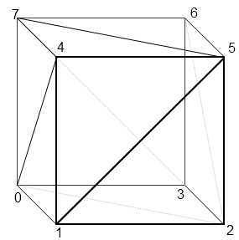
Defining Models
Models are polygonal meshes
Vertex data
Position
Normal
Texture coordinate
Etc
Face data (triangles)

Slide 26
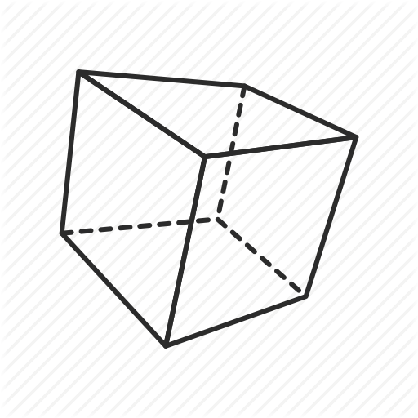
Viewing Pipeline
y
y
y
x
z
x
x
z
z
Model Coordinates
World Coordinates
Camera Coordinates
Projection Coordinates (Homogeneous)
Device Coordinates

Slide 27
Model space
Origin is typically the center of mass of the object, or a vertex
Humanoids might have the origin at the feet
y
x
z
Model Coordinates

Slide 28
World Space
Origin is a special point in the space
Models are transformed into this virtual scene
Scaled
Rotated
Translated
Homogeneous coordinates – use 4D vectors with the 4th component usually 0 (direction) or 1 (point)
y
x
z
World Coordinates

Slide 29
World space
Points get transformed by a series of matrix manipulations $p^{′}←Mp$
Translation $M=T\left(t_{x}, t_{y}, t_{z}\right)=\left[\begin{matrix}\begin{matrix}1 & 0\end{matrix} & \begin{matrix}0 & t_{x}\end{matrix} \\ \begin{matrix}\begin{aligned}0 \\ 0 \\ 0\end{aligned} & \begin{aligned}1 \\ 0 \\ 0\end{aligned}\end{matrix} & \begin{matrix}\begin{aligned}0 \\ 1 \\ 0\end{aligned} & \begin{aligned}t_{y} \\ t_{z} \\ 1\end{aligned}\end{matrix}\end{matrix}\right]$
Scale $M=S\left(s_{x}, s_{y}, s_{z}\right)=\left[\begin{matrix}\begin{matrix}s_{x} & 0\end{matrix} & \begin{matrix}0 & 0\end{matrix} \\ \begin{matrix}\begin{aligned}0 \\ 0 \\ 0\end{aligned} & \begin{aligned}s_{y} \\ 0 \\ 0\end{aligned}\end{matrix} & \begin{matrix}\begin{aligned}0 \\ s_{z} \\ 0\end{aligned} & \begin{aligned}0 \\ 0 \\ 1\end{aligned}\end{matrix}\end{matrix}\right]$
Rotation $M=R_{x}\left(θ\right)=\left[\begin{matrix}\begin{matrix}1 & 0\end{matrix} & \begin{matrix}0 & 0\end{matrix} \\ \begin{matrix}\begin{aligned}0 \\ 0 \\ 0\end{aligned} & \begin{aligned}\cos\left(θ\right) \\ \sin\left(θ\right) \\ 0\end{aligned}\end{matrix} & \begin{matrix}\begin{aligned}−\sin\left(θ\right) \\ \cos\left(θ\right) \\ 0\end{aligned} & \begin{aligned}0 \\ 0 \\ 0\end{aligned}\end{matrix}\end{matrix}\right]$ $M=R_{y}\left(θ\right)$ $M=R_{z}\left(θ\right)$

Slide 30
Word Space
Homogeneous coordinates allow for translation to be a matrix transformation
Imagine the various transforms to see how they work, for example $p^{′}←T\left(t_{x}, t_{y}, t_{z}\right)p=\left[\begin{matrix}\begin{matrix}1 & 0\end{matrix} & \begin{matrix}0 & t_{x}\end{matrix} \\ \begin{matrix}\begin{aligned}0 \\ 0 \\ 0\end{aligned} & \begin{aligned}1 \\ 0 \\ 0\end{aligned}\end{matrix} & \begin{matrix}\begin{aligned}0 \\ 1 \\ 0\end{aligned} & \begin{aligned}t_{y} \\ t_{z} \\ 1\end{aligned}\end{matrix}\end{matrix}\right]\left[\begin{matrix}p_{x} \\ p_{y} \\ \begin{aligned}p_{z} \\ 1\end{aligned}\end{matrix}\right]=?$
To apply multiple transformations $M=W=TR_{z}R_{y}R_{x}S$
Why is rotation and scale performed before translation?

Slide 31
Camera Space
Origin is now the camera
Axes are defined by the direction the camera faces
Camera definition
Eye – world position of camera
At – unit vector of camera $−z$-axis
Up – unit vector of camera $y$-axis
Transformation matrix computed an applied to all objects (look-at matrix)
y
x
z
Camera Coordinates
up
-at
eye
left

Slide 32
Projection space
Many projection options (always converts scene to homogeneous cube)
Orthographic projection – parallel lines stay parallel and object size is not relative to distance from camera
Perspective projection – parallel lines converge and object size is relative to distance from camera
Defined by field of view and aspect ratio
Projection Coordinates (Homogeneous)
-at
Near plane
Far plane

Slide 33
Projection space
Objects outside of homogeneous cube are clipped from the scene (performed efficiently on GPU)
Near plane is closest visible z-coordinate to camera
Far plane is farthest visible z-coordinate to camera
Again transformation performed by a transformation matrix
Projection Coordinates (Homogeneous)
-at
$$θ$$
Near plane
Far plane

Slide 34
Device space
Coordinates are transformed (by another matrix computation) to viewport coordinates (essentially x, y screen positions)
For efficiency, as many matrices as possible are multiplied together before being applied to objects
Why?
Which matrices can be collapsed?
Device Coordinates

Slide 35
Lighting

Slide 36
Texture mapping (not lighting)
Gives an object its base color
Each vertex has a texture coordinate which refers to a location in a texture
Texture coordinates are always in ${\left[0,1\right]}^{2}$ and are not pixel coordinates
Also called UV coordinates

Slide 37
Lights
Many types of lights, we will look at most basic ones
Ambient light – uniform amount of lighting in a space
Directional light – light without a position that affects entire scene, e.g., sun (single directional light per scene usually)
Point light – light with a position emitting light in all directions, e.g., lightbulb
Spotlight – light with position and direction, e.g., flashlight

Slide 38
Phong Reflection Model
Local lighting model – no secondary light reflections, i.e., object lighting is not affected by other objects
Ambient light – base illumination from scene
Diffuse light – primary reflection of light that is evenly scattered
Specular light – shiny reflections of light based on viewing direction

Slide 39
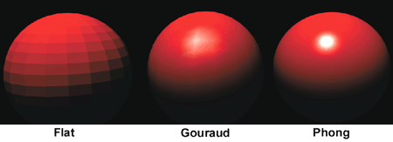
Shading
Shading is the determination of how the surface of a triangle is filled in, with respect to the lighting model
Flat shading – Uses face normal to compute light model one time and applies that color uniformly
Gouraud shading – light model computed for each vertex and color is interpolated
Phong shading – Vertex normal interpolated and light model computed for every pixel

Slide 40
Visibility

Slide 41
Back-face culling
Remove triangles from rendering which do not face the camera
Performed by analyzing dot product of face normal with camera at vector, if negative then do not render

Slide 42
Painter's algorithm (again)
Draw items in background to foreground
Any issues?
Order ill specified
Required resorting each frame
Overdraw (recomputing pixel color over and over again)

Slide 43
Z-buffering
The z-buffer is additional memory (in frame buffer) that stores depth (distance from camera) information of pixel
During rendering, we only update a pixel's color if a pixel is closer than currently stored in the z-buffer
Any issues?
Floating-point error
Transparency?
To handle transparency
Draw all opaque objects
Make z-buffer read only
Draw all transparent objects
Note – professional game engines employ many more techniques for efficient visibility determination

Slide 44
World Transform, Revisited

Slide 45
Representing Rotations
Euler angles
3 separate angles (essentially as discussed)
Difficult to interpolate
Gimbal lock
Rotation matrix
16 values
Expensive to interpolate

Slide 46
Representing rotations
Angle-axis
More intuitive
Store an axis of rotation and angle of rotation
Difficult to interpolate as is

Slide 47
Representing rotations
Quaternions
Alternative representation of angle-axis
Small storage – 4 values
Smooth interpolation
No gimbal lock
What could be terrible about them?
Most confusing mathematical concept you may ever learn (unless you jump into higher level math)
Unintuitive!
Tradeoff – will always need to convert to rotation matrix to actually transform object (but not really a negative)

Slide 48
Quaternions
"A 3D complex (real + imaginary) number"
Useful in representing 3D rotations, essentially, angle-axis rotations
Representation
Scalar value
Vector component (imaginary component)
In graphics, we will always have unit quaternions (magnitude of 1)
$q=\left\langle q_{s}, \vec{q_{v}}\right\rangle$
From angle-axis $\left(θ, \hat{a}\right)$
$q=\left\langle \cos{\frac{θ}{2}},\hat{a}\sin{\frac{θ}{2}}\right\rangle$
Libraries often provide convenient construction mechanisms from Euler Angles or Angle-axis rotations
Mathematics has many useful operations combined, e.g., multiplying (combines rotations), conjugation (inverse), etc.
Quaternion rotation applied to a point $p^{′}=q^{−1}pq$

Slide 49
Camera Models

Slide 50
Types of cameras
Fixed and non-player controlled cameras – same position or scripted positions by designer
First-person camera – gives perspective of the player
Need to worry about player model used in rendering
Third-person camera – possibly an omniscient perspective of the world
Follow camera – limited view that follows player in world
Cutscene camera – designed with smooth transitions using spline system

Slide 51
Review of cameras and perspective
Cameras defined by eye position, look-at direction, and up direction
Perspective projection defined by field of view (FOV), aspect ratio, near plane and far plane
Careful of the fisheye effect when the FOV is too large
y
x
z
Camera Coordinates
up
-at
$$θ$$
-at
eye
left
Near plane
Far plane

Slide 52
Basic Follow Camera
up
Camera
$$c_{eye},c_{at}, c_{up}$$
at
Vertical Follow Distance
$c_{eye}=t_{pos}−t_{fwd}h_{dist}+t_{up}v_{dist}$
$c_{at}=normalize\left(t_{pos}−c_{eye}\right)$
$c_{up}=normalize\left(c_{at}×normalize\left(t_{up}×c_{at}\right)\right)$
Horizontal Follow Distance
Target forward and up
$$t_{pos}, t_{fwd}, t_{up}$$

Slide 53
Spring follow camera
Idea
"Store" two camera positions – ideal and actual
Ideal camera computed from basic follow model
Actual is attached on a virtual spring to the ideal, and initialized as the ideal
Has a position and velocity
Ideal
Actual

Slide 54
Spring follow camera
$x=a_{eye}−i_{eye}$
$a=−kx−dv$
$a$ is acceleration, $k∈\left[0,1\right]$ is spring constant, $d∈\left[0,1\right]$ is damper constant
$v=v+aΔt$
$c_{eye}=c_{eye}+vΔt$
Euler integration will be discussed more in Ch. 7 (physics)
Can apply methodology to the at/up vectors as well
Ideal
$$i_{eye}, i_{at}, i_{up}$$
Actual
$$c_{eye}, c_{at}, c_{up},v$$

Slide 55
Orbit Camera
Determine camera position change based on change in yaw and pitch
Can use spherical coordinates instead
$q_{yaw}=QFromAA\left(w_{up},yaw\right)$
$offset=rotate\left(offset, q_{yaw}\right)$
$c_{up}=rotate\left(c_{up}, q_{yaw}\right)$
$left=normalize\left(c_{up}×normalize\left(−offset\right)\right)$
$q_{pitch}=QFromAA\left(left,pitch\right)$
$offset=rotate\left(offset, q_{pitch}\right)$
$c_{up}=rotate\left(c_{up}, q_{pitch}\right)$
$c_{eye}=t_{pos}+offset$
$c_{at}=t_{pos}$
Rotate about world y-axis (yaw)
Offset
Rotate about camera left (pitch)

Slide 56
First-person Camera
Essentially same as orbit, except that you rotate the target position instead, so yaw and pitch are stored instead of incrementally changed
Eye has a vertical offset from player position (ground level)
Target offset

Slide 57
Spline Camera
Smooth interpolation between reference frames in parametric coordinates $t∈\left[0,1\right]$
Example spline: Catmull-Rom spline $p_{t}=\frac{1}{2}(\left(2p_{1}+\left(−p_{0}+p_{2}\right)t+\left(2p_{0}−5p_{1}+4p_{2}−p_{3}\right)t^{2}+\left(−p_{0}+3p_{1}−3p_{2}+p_{3}\right)t^{3}\right)$
Or use Bezier curves
$$p_{3}$$
$$p_{1}$$
$$p_{0}$$
$$p_{2}$$

Slide 58
Additional considerations
Camera collision
Place object in front of occluding object
Make occluding object transparent
Picking
Click on object in 3D world
Required unprojection of device coordinate

Slide 59
Summary
Discussed 2D graphics tricks and provided an overview of 3D graphics concerns
Remember the 3D viewing pipeline
Overviewed some basic mathematics of camera models

