Slide 1
FGD – Chapter 4 and 5 Understanding The Player and Machine

Slide 2
player Personality

Slide 3
Domains of play
Mix of psychology and expert designer opinion
Attempts to classify what might attract players to different types of games
In other words, what aspects of games do players seek out
In general – you can't appease everyone, but you should know your target audience!

Slide 4
Domains of play
Novelty vs familiarity
Challenge vs "sandbox"
Stimulation (social vs solo gaming)
Harmony (cooperative vs competitive)
Threat (unpleasant vs pleasant emotions)
Storytelling
Where do you lie in these 6 domains?

Slide 5
Player DemographiC Categories

Slide 6
Do you have stereotypes?
What do you think is the difference between genders as it relates to games?
What about age?
Keep these in mind as we discuss, and you may learn you have some misconceptions
Additionally, the following information is representational of the current state of gaming; so (1) it may have bias and (2) it may change in the future

Slide 7
Men and Women
Fact – women represent a large portion of the gamer market
More adult women than teenage boys actually
Gender inclusiveness – you don't need to specifically design for stereotypically feminine interests
Avoid
Hypersexualized female avatars
Repetitive play
Play without meaningful goals
Solitary play (or just be aware of this turn-off)
A minority of men keep pushing various stereotypes; ignore them
Example: female protagonists won't sell

Slide 8
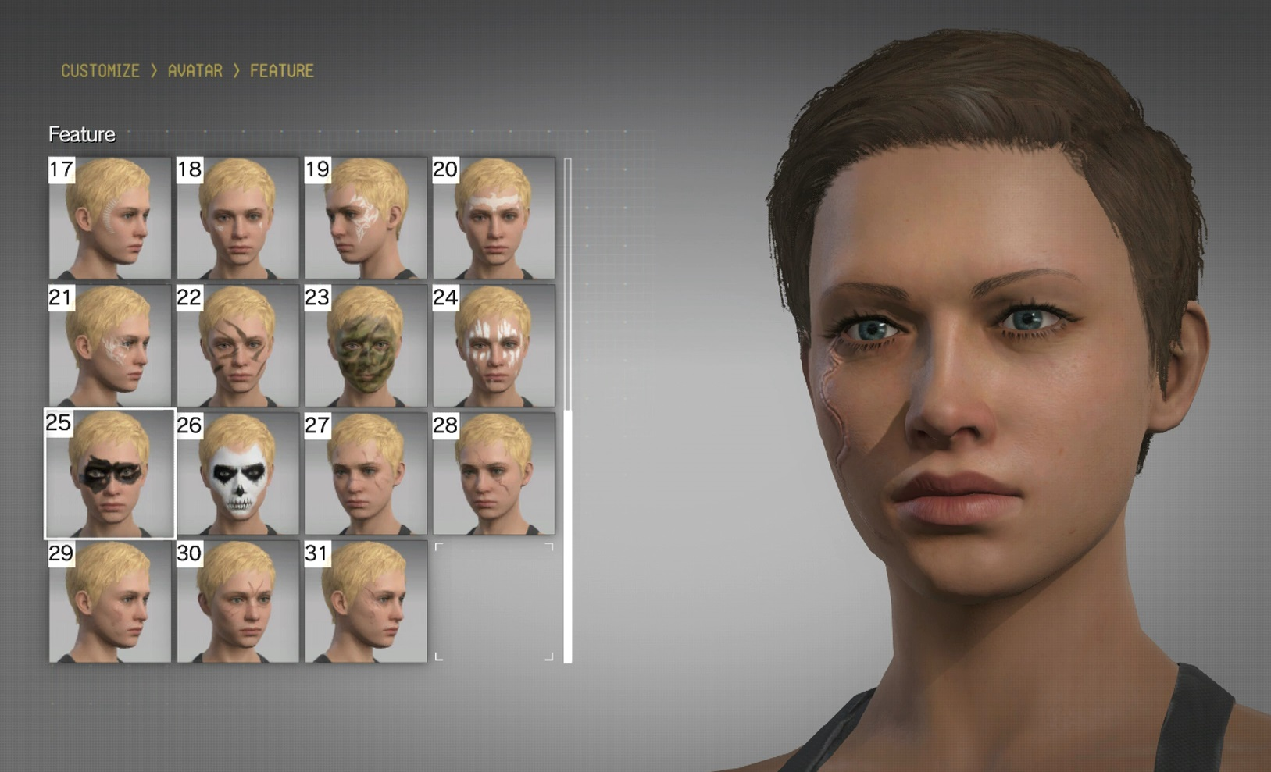
Men and Women
A few generalities about gender differences (general trends, not rules!):
Learning
Attitudes toward risk
Degree of socializing
Conflict resolution style
Mental challenges
Customization
Leisure time and money
Design rule: women are a market, not a genre!
Consider inclusion of avatars/main characters of various genders
Remember to include differences so that female characters aren't simply a different skin on an inherently male oriented character

Slide 9
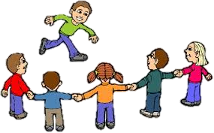
Children
General categories
Preschool and Kindergarten (3-6)
Early elementary (5-8)
Upper elementary (7-12)
Middle and high school (13 and up)
Late teens to mid-20s – brains still developing
Each group has own interests and abilities
As with gender, these are generalities, not rules

Slide 10
children
Consider
Hand-eye coordination
Logic development
Systemic thinking
Immediate vs long-term goals
Visual design
Linguistic complexity
Experimentation
Reading
Appropriate content
Kisses of death for children's entertainment – big misconceptions:
Kids love anything sweet
Give them what is good for them
All you do is have to amuse them
Always play it safe
All kids are created equal
Explain everything
Be sure characters are wholesome

Slide 11
A Note on Games for girls
Boy's and girl's interests diverge widely (for better or for worse)
Many early efforts failed if the publisher let them attempt it at all
Caused by gender stereotypes!
Look at places with market success, e.g., Mattel or Blitz

Slide 12
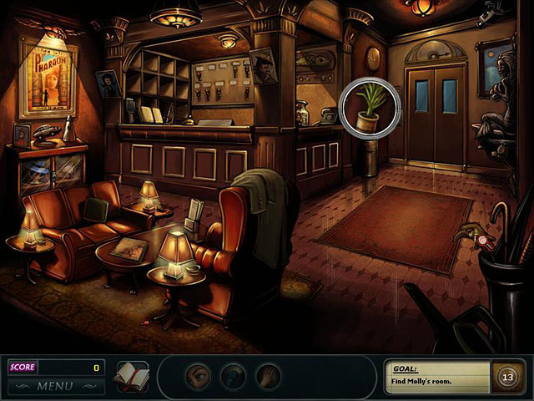
A note on games for girls
To make more inclusive strive for gameplay that allows
Characterization
Context
Control
Customization
Creativity
Misconceptions
Girls don't like computer games because its techie
Girls don't like violence
Girls want everything sweet and happy
Girls don't like to be scared
Remember that you don't need to enforce societal gender stereotypes for men, women, boys, or girls

Slide 13
Gamer Qualities

Slide 14
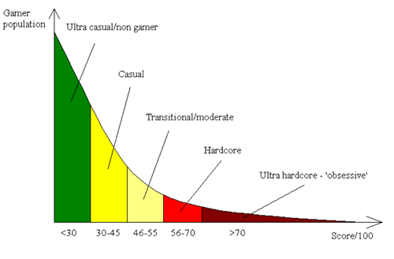
Gamer Dedication
Many aspects of gamer dedication level
Technology savvy
Owns high-end gear
Willingness to pay
Preference for violence/action
Preference for depth/complexity
Plays over many long sessions
Seeks game-related information
Discusses games online
Plays for completion (winning)
Tolerant of frustration
Engaged in competition
Started playing at a young age
Knowledge of the industry
Early adoption
Desire to modify/extend games

Slide 15
Dangers of Binary thinking
Cant make a game for everyone
Reason statistically about the various factors we discussed
Avoid thinking in binary
Design rule: Keep exclusionary material out of your game
Don't try to attract everyone
Strive for inclusiveness and avoid repelling people away from your game

Slide 16
Understand the machine
A game concept is incomplete without a description of the machine

Slide 17
Home game consoles
Typical use
Placed in living room, player away from screen
Small text is bad idea
Controller
Limited inputs (possible motion sensor)
Excellent for local multiplayer games
Long usage
Dedicated hobbyists
Internal workings are a trade secret and you need a license to develop (consoles protect their brand)

Slide 18
Personal Computers
Typical use
On a desk, operated by one person
Supports small text and complex user interfaces
Keyboard and mouse (maybe joystick/controller)
Much richer input modality
Anyone can develop but no two machines are alike
Stand-alone vs browser-based games

Slide 19
Portable Devices
Typical use
Carried around by single person
Size varies from small mobile phones to tablets
Screen realty is premium
Need simple interface
Player must hold device while playing
Touch screens or limited buttons on input
Cartridge platforms necessitate small games
Typical play is for a few minutes at a time
Play can be interrupted easily
Mobile phones!
App store restrictions

Slide 20
Other Devices
Think of the following industries
Airlines?
Casinos?
Theme parks?
Many other niche markets

Slide 21
Summary
Design for inclusiveness – avoid binary thinking
Don’t try to attract everyone, instead work to avoid repelling players
Understand your machine and how it affects gameplay

