Slide 1
GPAT – Chapter 1 Game Programming Overview

Slide 2
Brief Historical Remarks
Console focused

Slide 3
Atari Era (1977-1985)
Very little RAM, slow processor speed
All games created in assembly
Solo programmers

Slide 4
NES and SNES Era (1985-1995)
More powerful hardware, but not enough for C. However, developer kits were released to help debugging
Small programmer teams (3-9)

Slide 5
Playstation/Playstation 2 Era (1995-2005)
More powerful hardware, single thread, single core
Games written in C (assembly for performance critical sections)
Early years 8-10 programmers, late years up to 15 programmers

Slide 6
XBOX 360, PS3, Wii Era (2005-2013)
High definition support
Advanced hardware support (multi-threading, multi-core)
C++ and more with developer kits, e.g., Unity
Programmer teams scaled immensely
Over 75 for Assassin's Creed Revelations, for example

Slide 7
XBOX One, PS4, Wii Switch, and beyond
More cores, more memory, 4K resolution, and on
Larger and larger teams
More independent titles
Seeing resurgence of solo/small programmer teams

Slide 8
The Game Loop

Slide 9
Traditional Game Loop
while gameIsRunning() do
// Process inputs
// Update game world
// Generate outputs
Processing inputs requires detecting inputs from keyboard, mouse, controller, etc. Also includes communication over a network
Generating outputs includes rendering graphics, audio, force feedback, etc.

Slide 10
Example Game Loop for Pac-Man
while player.lives > 0 do
// Process inputs
JoyStickData j = getJSD()
// Update game world
player.update(j)
player.killOrDeath(ghosts)
ghosts.updateAI(player)
// pellets, etc
// Generate outputs
drawWorld()
updateAudio()

Slide 11
Multi-threaded Game loops
More difficult to form to multi-core systems
One such solution, separate rendering and delay by one frame
Creates input lag
Other issues?

Slide 12
Time

Slide 13
Real Time vs Game Time
Real time is the amount of time passed in the physical world
Game time is the amount of time elapsed in the imaginary world
Considerations:
Pausing the game?
"bullet-time" physics?
Reverse time?
Example: Prince of Persia: The Sands of Time

Slide 14
Logic as a function of Delta Time
Early programming had a specific processor speed in mind, but once the processor speed was different the game would break
Delta time is the amount of game time elapsed since the last frame
Think and program in a frame-centric and game-centric notion

Slide 15
Game loop with Delta Time
while gameIsRunning() do
realdt = lastt
gamedt = realdt * gametf
// Process inputs
// Update game world with gamedt
// Generate outputs
Problems?
Different behavior with different frame rates
Online play?
Solution – frame limiting, i.e., limit the frame rate

Slide 16
Game Loop with Frame Limiting
targetft = 0.17f
while gameIsRunning() do
realdt = lastt
gamedt = realdt * gametf
// Process inputs
// Update game world with gamedt
// Generate outputs
// Frame limiting
while framet < targetft do
doSomethingSmall()
Problems?
Dropping a frame

Slide 17
Game Objects

Slide 18
Types of game objects
A game object is anything in the game world that needs to be updated, drawn, or both in every frame
Updateable and drawable
Example – Mario (or any character)
Drawable only
Example – Brick (or any static object)
Updatable only
Example – Camera, hit box, location that starts an event (trigger)
How would you implement?
Interface for each + inheritance
Class GameObject
Interface Drawable
Interface Updatable
Classes for DrawableGameObject, UpdatableGameObject, DrawableUpdatableGameObject
Class for GameWorld that contains lists of DrawableObjects and UpdatableObjects

Slide 19
Game Objects in the loop
targetft = 0.17f
while gameIsRunning() do
realdt = lastt
gamedt = realdt * gametf
// Process inputs
// Update game world
for Updatable o in GameWorld.updateableObjects do
o.update(gamedt)
// Gemerate outputs
for Drawable o in GameWorld.drawableObjects do
o.draw()
// Frame limiting
while framet < targetft do
doSomethingSmall()

Slide 20
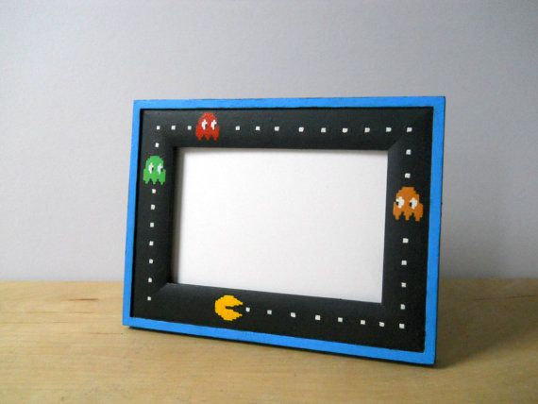
Summary
Explored general frameworks surrounding game programming
Need to remember to be frame-centric when developing a game

