Slide 1
Chapter 14
Graph Algorithms
1843
ORD
SFO
802
337
1743
LAX
1233
DFW
Acknowledgement: These slides are adapted from slides provided with Data Structures and Algorithms in Java, Goodrich, Tamassia and Goldwasser (Wiley 2016)
Notes:
1
1

Slide 2
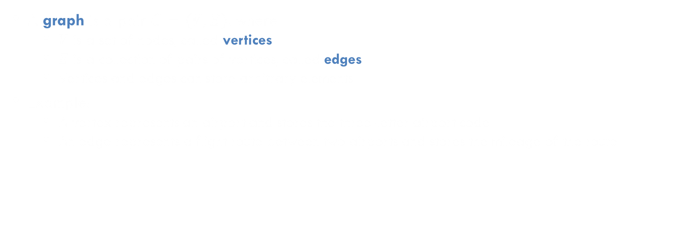
Graph
A graph is a pair $G=(V, E)$, where
  $V$ is a set of nodes, called vertices
  $E$ is a collection of pairs of vertices, called edges
  Vertices and edges can store arbitrary elements
Example:
  A vertex represents an airport and stores the three-letter airport code
  An edge represents a flight route between two airports and stores the mileage of the route
849
PVD
1843
ORD
142
SFO
802
LGA
337
1743
1387
HNL
2555
1099
LAX
1233
DFW
1120
MIA
Notes:
Represent connectivity information between objects

Slide 3
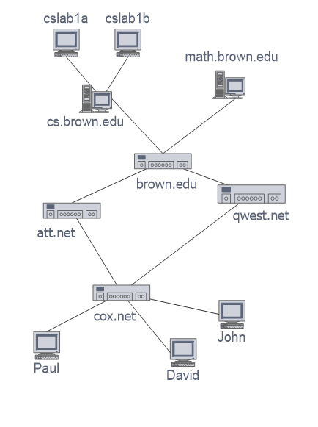
Applications
Electronic circuits
  Printed circuit board
  Integrated circuit
Transportation networks
  Highway network
  Flight network
Computer networks
  Local area network
  Internet
  Web
Databases
  Entity-relationship diagram

Slide 4






Terminology
Edge And Graph Types
Edge Types
  Directed edge
    ordered pair of vertices $(u, v)$
    first vertex $u$ is the origin/source
    second vertex $v$ is the destination/target
    e.g., a flight
  Undirected edge
    unordered pair of vertices $(u, v)$
    e.g., a flight route
  Weighted edge
    Numeric label associated with edge
Graph Types
  Directed graph (Digraph)
    all the edges are directed
    e.g., route network
  Undirected graph
    all the edges are undirected
    e.g., flight network
  Weighted graph
    all the edges are weighted
flight
AA 1206
flight
route
$$(u, v)$$
ORD
DFW
ORD
DFW
$$u$$
802 miles
$$v$$
$$u$$
802 miles
$$v$$

Slide 5

Terminology
Vertices and Edges
V
End points (or end vertices) of an edge
  $U$ and $V$ are the endpoints of $a$
Edges incident on a vertex
  $a$, $d$, and $b$ are incident on $V$
Adjacent vertices
  $U$ and $V$ are adjacent
Degree of a vertex
  $X$ has degree 5
Parallel (multiple) edges
  $h$ and$i$ are parallel edges
Self-loop
  $j$ is a self-loop
a
b
h
j
U
d
X
Z
c
e
i
W
g
f
Y
Note: A graph with no parallel edges or self loops are said to be simple. Unless otherwise stated, you should assume all graphs discussed are simple

Slide 6

Terminology
Vertices and Edges
V
Outgoing edges of a vertex
  $h$ and $b$ are the outgoing edges of $X$
Incoming edges of a vertex
  e, g, and $i$ are incoming edges of $X$
In-degree of a vertex
  $X$ has in-degree 3
Out-degree of a vertex
  $X$ has out-degree 2
b
h
j
d
X
Z
e
i
W
g
f
Y

Slide 7
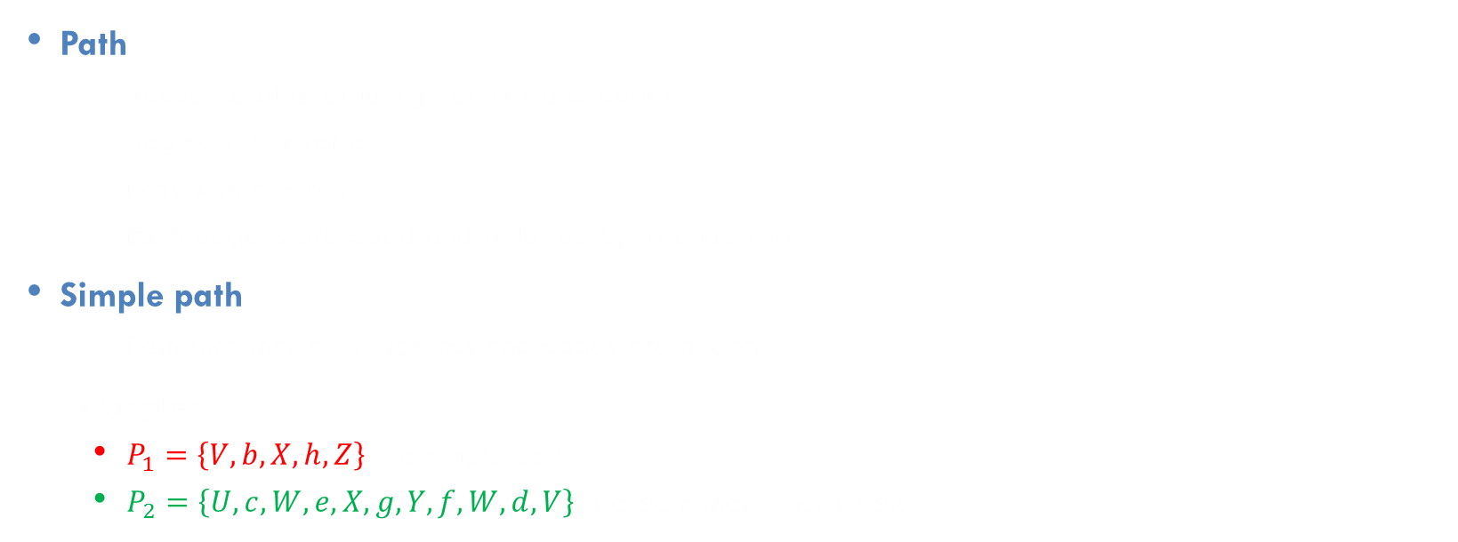
Terminology
Paths
Path
  Sequence of alternating vertices and edges
  Begins with a vertex
  Ends with a vertex
  Each edge is preceded and followed by its endpoints
Simple path
  Path such that all its vertices and edges are distinct
Examples
  $P_{1}=\left\{V,b,X,h,Z\right\}$is a simple path
  $P_{2}=\left\{U,c,W,e,X,g,Y,f,W,d,V\right\}$ is a path that is not simple
V
a
b
P₁
d
U
X
Z
P₂
h
c
e
W
g
f
Y

Slide 8

Terminology
Cycles
Cycle
  Circular sequence of alternating vertices and edges
  Each edge is preceded and followed by its endpoints
Simple cycle
  Cycle such that all its vertices and edges are distinct except for
  the beginning and ending vertex
Examples
  $C_{1}=\left\{V,b,X,g,Y,f,W,c,U,a,V\right\}$is a simple cycle
  $C_{2}=\left\{U,c,W,e,X,g,Y,f,W,d,V,a,U\right\}$is a cycle that is not simple
A digraph is called acyclic if it does not contain any cycles
V
a
b
d
U
X
Z
C₂
h
e
C₁
c
W
g
f
Y

Slide 9
Exercise on Terminology
Number of vertices?
Number of edges?
What type of the graph is it?
Show the end vertices of the edge with largest weight
Show the vertices of smallest degree and largest degree
Show the edges incident to the vertices in the above question
Identify the shortest simple path from HNL to PVD
Identify the simple cycle with the most edges
849
PVD
1843
ORD
142
SFO
802
LGA
337
1743
1387
HNL
2555
1099
LAX
1233
DFW
1120
MIA
Notes:
Represent connectivity information between objects

Slide 10



Exercise
Properties of Undirected Graphs
Property 1 – Total degree
  $$Σ_{v}deg\left(v\right)=?$$
Property 2 – Total number of edges
  In an undirected graph with no self-loops and no multiple edges
  $$m≤Upper Bound? \\ Lower Bound?≤m$$
Notation
  $n$ number of vertices
  $m$ number of edges
  $deg(v)$ degree of vertex v
Example
  $n=?$
  $m=?$
  $\deg\left(v\right)=?$
A graph with given number of vertices (4) and maximum number of edges

Slide 11



Exercise
Properties of Undirected Graphs
Property 1 – Total degree
  $$Σ_{v}deg\left(v\right)=2m$$
Property 2 – Total number of edges
  In an undirected graph with no self-loops and no multiple edges
  $$m≤\frac{n(n−1)}{2} \\ 0≤m$$
  Proof: Each vertex can have degree at most $\left(n−1\right)$
Notation
  $n$ number of vertices
  $m$ number of edges
  $deg(v)$ degree of vertex v
Example
  $n=4$
  $m=6$
  $\deg\left(v\right)=3$
A graph with given number of vertices (4) and maximum number of edges

Slide 12

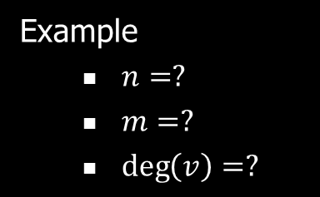

Exercise
Properties of Directed Graphs
Property 1 – Total in-degree and out-degree
$Σ_{v}in−deg⁡(v)=?$
$Σ_{v}out−\deg\left(v\right)=?$
Property 2 – Total number of edges
  In an directed graph with no self-loops and no multiple edges
  $m≤UpperBound?$
  $LowerBound?≤m$
Notation
  $n$ number of vertices
  $m$ number of edges
  $deg⁡(v)$ degree of vertex v
Example
  $n=?$
  $m=?$
  $\deg\left(v\right)=?$
A graph with given number of vertices (4) and maximum number of edges

Slide 13

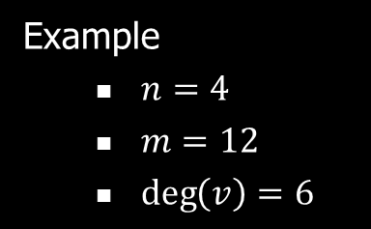
Exercise
Properties of Directed Graphs
Property 1 – Total in-degree and out-degree
$Σ_{v}in−deg⁡(v)=m$
$Σ_{v}out−\deg\left(v\right)=m$
Property 2 – Total number of edges
  In an directed graph with no self-loops and no multiple edges
  $m≤n\left(n−1\right)$
  $0≤m$
Notation
  $n$ number of vertices
  $m$ number of edges
  $deg⁡(v)$ degree of vertex v
Example
  $n=4$
  $m=12$
  $\deg\left(v\right)=6$
A graph with given number of vertices (4) and maximum number of edges

Slide 14







Terminology
Connectivity
$$u$$
$$v$$
Given two vertices $u$ and $v$, we say $u$ reaches $v$, and that $v$ is reachable from $u$, if there exists a path from $u$ to $v$. In an undirected graph reachability is symmetric
A graph is connected if there is a path between every pair of vertices
A digraph is strongly connected if there every pair of vertices is reachable
Connected graph
$u$ and $v$ are reachable
$$u$$
$$v$$
Connected digraph
$u$ and $v$ are not mutually reachable

Slide 15
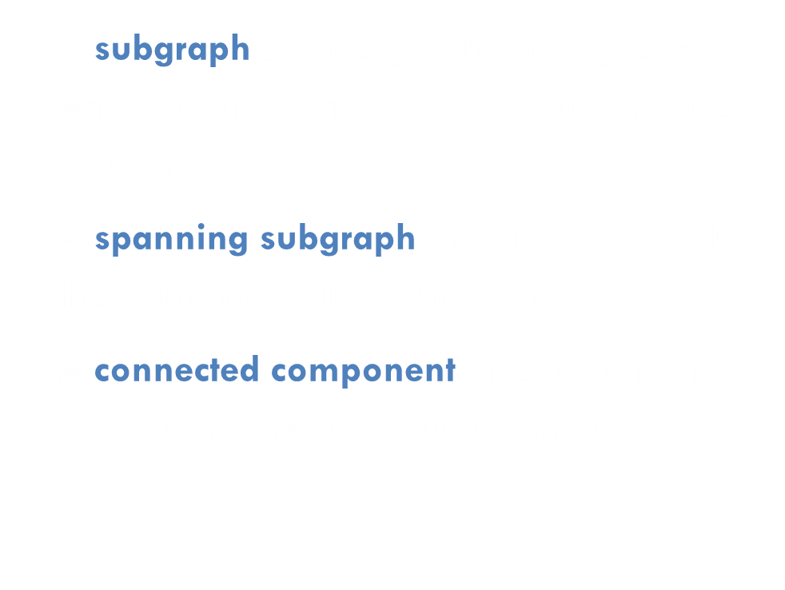
Terminology
Subgraphs
Subgraph
A subgraph $H$ of a graph $G$ is a graph whose vertices and edges are subsets of $G$, respectively
A spanning subgraph of $G$ is a subgraph that contains all the vertices of $G$
A connected component of a graph $G$ is a maximal connected subgraph of $G$
Spanning subgraph
Non connected graph with two connected components

Slide 16
Terminology
Trees and Forests
A forest is a graph without cycles
A (free) tree is connected forest
  This definition of tree is different from the one of a rooted tree
The connected components of a forest are trees
Tree
Forest

Slide 17
Spanning Trees and Forests
A spanning tree of a connected graph is a spanning subgraph that is a tree
A spanning tree is not unique unless the graph is a tree
Spanning trees have applications to the design of communication networks
Graph
Spanning tree

Slide 18
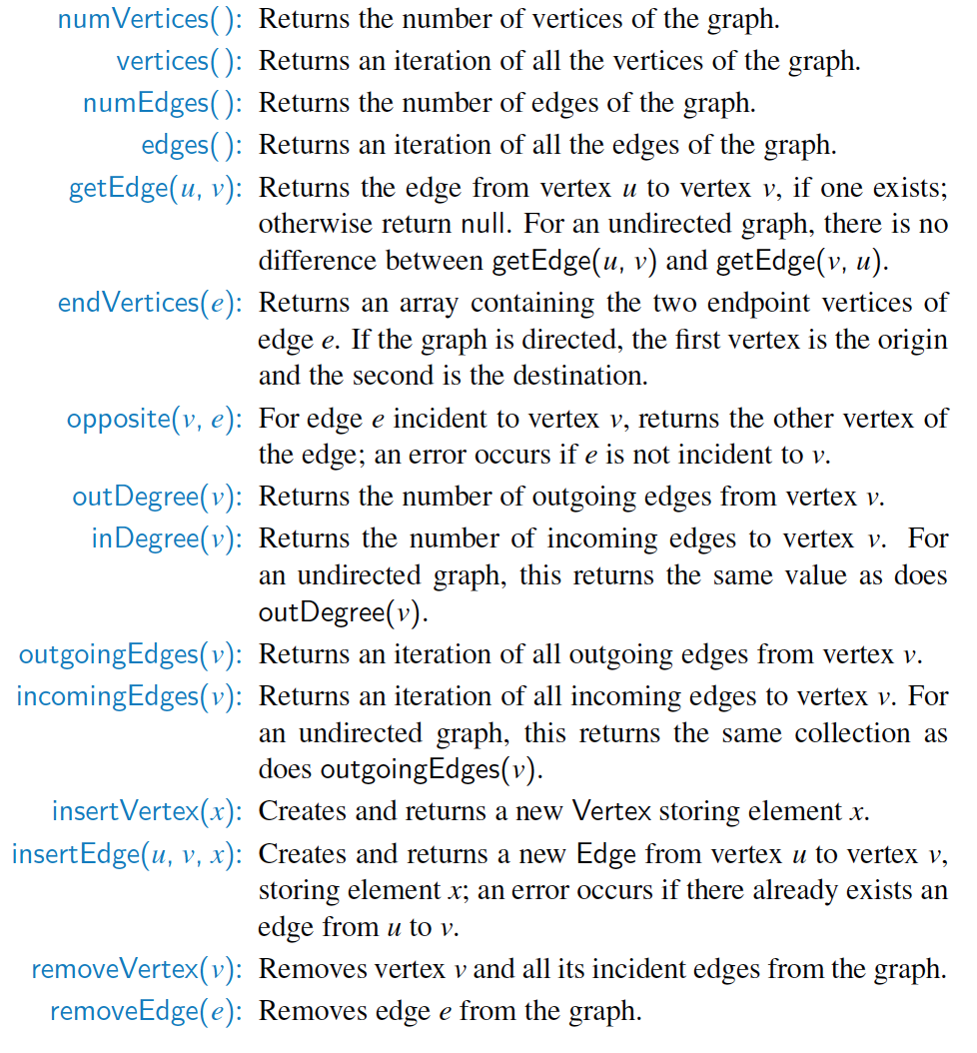
Graph ADT
Vertices and edges are lightweight objects and store elements
Although the ADT is specified from the graph object, we often have similar functions in the Vertex and Edge objects

Slide 19


Exercise on ADT
insertVertex$(iah)$
insertEdge$(mia, pvd, 1200)$
removeVertex$(ord)$
removeEdge$(\left\{dfw, ord\right\})$
outgoingEdges$(ord)$
incomingEdges$(ord)$
outDegree$(ord)$
endVertices$(\left\{lga, mia\right\})$
opposite$(dfw, \left\{dfw, lga\right\})$
849
PVD
1843
ORD
142
SFO
802
LGA
337
1743
1387
HNL
2555
1099
LAX
1233
DFW
1120
MIA
Notes:
Represent connectivity information between objects

Slide 20
Edge List Structure
849
PVD
ORD
142
802
LGA
1387
1099
Edge List
Vertex List
DFW
1120
MIA
{ORD, PVD, 849}
ORD
An edge list can be stored in a list or a map/dictionary (e.g. hash table)
Vertex object
  element
  reference to position in vertex sequence
Edge object
  element
  origin vertex object
  destination vertex object
  reference to position in edge sequence
{ORD, DFW, 802}
LGA
{LGA, PVD, 142}
PVD
{LGA, MIA, 1099}
DFW
{DFW, LGA, 1387}
MIA
{DFW, MIA, 1120}

Slide 21
Exercise
Edge List Structure
Construct the edge list for the following graph
x
u
w
y
z
v

Slide 22

Asymptotic Performance
Edge List Structure
Edge List
Vertex List
$n$vertices, $m$ edges No parallel edges No self-loops | Edge List
Space | ?
getEdge$\left(u, v\right)$, outDegree$\left(v\right)$, outgoingEdges$\left(v\right)$, insertEdge$(u, v, w)$, removeVertex$(v)$ | ?
insertVertex$(x)$, removeEdge$(e)$ | ?
{ORD, PVD, 849}
ORD
{ORD, DFW, 802}
LGA
{LGA, PVD, 142}
PVD
{LGA, MIA, 1099}
DFW
{DFW, LGA, 1387}
MIA
{DFW, MIA, 1120}

Slide 23

Asymptotic Performance
Edge List Structure
Edge List
Vertex List
$n$vertices, $m$ edges No parallel edges No self-loops | Edge List
Space | $$O(n+m)$$
getEdge$\left(u, v\right)$, outDegree$\left(v\right)$, outgoingEdges$\left(v\right)$, insertEdge$(u, v, w)$, removeVertex$(v)$ | $$O(m)$$
insertVertex$(x)$, removeEdge$(e)$ | $$O(1)$$
{ORD, PVD, 849}
ORD
{ORD, DFW, 802}
LGA
{LGA, PVD, 142}
PVD
{LGA, MIA, 1099}
DFW
{DFW, LGA, 1387}
MIA
{DFW, MIA, 1120}

Slide 24
Adjacency List Structure
849
PVD
ORD
142
802
LGA
1387
1099
DFW
1120
MIA
Adjacency List
Adjacency Lists associate vertices with their edges
(in addition to edge list!)
Each vertex stores a list of incident edges
  List of references to incident edge objects
Augmented edge object
  Stores references to associated positions in incident adjacency lists
ORD
{ORD, PVD}
{ORD, DFW}
LGA
{LGA, PVD}
{LGA, MIA}
{LGA, DFW}
PVD
{PVD, ORD}
{PVD, LGA}
DFW
{DFW, ORD}
{DFW, LGA}
{DFW, MIA}
MIA
{MIA, LGA}
{MIA, DFW}

Slide 25
Exercise
Adjacency List Structure
Construct the adjacency list for the following graph
x
u
a
y
z
v

Slide 26

Asymptotic Performance
Adjacency List Structure
$n$vertices, $m$ edges No parallel edges No self-loops | Adjacency List
Space | ?
getEdge$\left(u, v\right)$, insertEdge$(u, v, w)$ | ?
outDegree$\left(v\right)$, insertVertex$(x)$, removeEdge$(e)$ | ?
outgoingEdges$(v)$, removeVertex$(v)$ | ?
Adjacency List
ORD
{ORD, PVD}
{ORD, DFW}
LGA
{LGA, PVD}
{LGA, MIA}
{LGA, DFW}
PVD
{PVD, ORD}
{PVD, LGA}
DFW
{DFW, ORD}
{DFW, LGA}
{DFW, MIA}
MIA
{MIA, LGA}
{MIA, DFW}

Slide 27

Asymptotic Performance
Adjacency List Structure
$n$vertices, $m$ edges No parallel edges No self-loops | Adjacency List
Space | $$O(n+m)$$
getEdge$\left(u, v\right)$, insertEdge$(u, v, w)$ | $$O\left(\min\left(\deg\left(v\right),\deg\left(u\right)\right)\right)$$
outDegree$\left(v\right)$, insertVertex$(x)$, removeEdge$(e)$ | $$O(1)$$
outgoingEdges$(v)$, removeVertex$(v)$ | $$O\left(\deg\left(v\right)\right)$$
Adjacency List
ORD
{ORD, PVD}
{ORD, DFW}
LGA
{LGA, PVD}
{LGA, MIA}
{LGA, DFW}
PVD
{PVD, ORD}
{PVD, LGA}
DFW
{DFW, ORD}
{DFW, LGA}
{DFW, MIA}
MIA
{MIA, LGA}
{MIA, DFW}

Slide 28
Adjacency Map Structure
We can store augmenting incidence structures in maps, instead of lists. This is called an adjacency map.
  In general an "adjacency list" means storing adjacency with vertices, so the terms are interchangeable
What would this do to the complexities?
  If it is implemented as a hash table?
  If it is implemented as a red-black tree?

Slide 29

Adjacency Matrix Structure
849
2:PVD
0:ORD
142
1:LGA
 | 0 | 1 | 2 | 3 | 4
0 | $$∅$$ | $$∅$$ | {0, 2} | {0, 3} | $$∅$$
1 | $$∅$$ | $$∅$$ | {1, 2} | {1, 3} | {1, 4}
2 | {0, 2} | {1, 2} | $$∅$$ | $$∅$$ | $$∅$$
3 | {0, 3} | {1, 3} | $$∅$$ | $$∅$$ | {3, 4}
4 | $$∅$$ | {1, 4} | $$∅$$ | {3, 4} | $$∅$$
802
1387
1099
3:DFW
1120
4:MIA
Adjacency matrices store references to edges in a table
(in addition to the edge list)
Augment vertices with integer keys (often done in all graph implementations!)

Slide 30
Exercise
Adjacency Matrix Structure
Construct the adjacency matrix for the following graph
x
u
a
y
z
v

Slide 31


Asymptotic Performance
Adjacency Matrix Structure
 | 0 | 1 | 2 | 3 | 4
0 | $$∅$$ | $$∅$$ | {0, 2} | {0, 3} | $$∅$$
1 | $$∅$$ | $$∅$$ | {1, 2} | {1, 3} | {1, 4}
2 | {0, 2} | {1, 2} | $$∅$$ | $$∅$$ | $$∅$$
3 | {0, 3} | {1, 3} | $$∅$$ | $$∅$$ | {3, 4}
4 | $$∅$$ | {1, 4} | $$∅$$ | {3, 4} | $$∅$$
$n$vertices, $m$ edges No parallel edges No self-loops | Adjacency Matrix
Space | ?
outDegree$\left(v\right)$, outgoingEdges$\left(v\right)$ | ?
getEdge$(u, v)$, insertEdge$(u, v, w)$, removeEdge$(e)$ | ?
insertVertex$(x)$, removeVertex$(v)$ | ?

Slide 32

Asymptotic Performance
Adjacency Matrix Structure
 | 0 | 1 | 2 | 3 | 4
0 | $$∅$$ | $$∅$$ | {0, 2} | {0, 3} | $$∅$$
1 | $$∅$$ | $$∅$$ | {1, 2} | {1, 3} | {1, 4}
2 | {0, 2} | {1, 2} | $$∅$$ | $$∅$$ | $$∅$$
3 | {0, 3} | {1, 3} | $$∅$$ | $$∅$$ | {3, 4}
4 | $$∅$$ | {1, 4} | $$∅$$ | {3, 4} | $$∅$$
$n$vertices, $m$ edges No parallel edges No self-loops | Adjacency Matrix
Space | $$O(n^{2})$$
outDegree$\left(v\right)$, outgoingEdges$\left(v\right)$ | $$O\left(n\right)$$
getEdge$(u, v)$, insertEdge$(u, v, w)$, removeEdge$(e)$ | $$O(1)$$
insertVertex$(x)$, removeVertex$(v)$ | $$O\left(n^{2}\right)$$

Slide 33

Asymptotic Performance
$n$vertices, $m$ edges No parallel edges No self-loops | Edge List | Adjacency List | Adjacency Matrix
Space | $$O(n+m)$$ | $$O(n+m)$$ | $$O\left(n^{2}\right)$$
outgoingEdges$(v)$ | $$O(m)$$ | $$O\left(\deg\left(v\right)\right)$$ | $$O\left(n\right)$$
getEdge$(u, v)$ | $$O\left(m\right)$$ | $$O\left(\min\left(\deg\left(v\right),\deg\left(w\right)\right)\right)$$ | $$O\left(1\right)$$
insertEdge$(u, v, w)$ | $$O(m)$$ | $$O(\min\left(\deg\left(v\right),\deg\left(w\right)\right))$$ | $$O\left(1\right)$$
eraseEdge$(e)$ | $$O\left(1\right)$$ | $$O\left(1\right)$$ | $$O\left(1\right)$$
insertVertex$(x)$ | $$O\left(1\right)$$ | $$O\left(1\right)$$ | $$O(n^{2})$$
removeVertex$(v)$ | $$O(m)$$ | $$O\left(\deg\left(v\right)\right)$$ | $$O\left(n^{2}\right)$$
Notes:
Weight of an edge

