Slide 1
Ch6.
Stacks, Queues, and Deques
Acknowledgement: These slides are adapted from slides provided with Data Structures and Algorithms in Java, Goodrich, Tamassia and Goldwasser (Wiley 2016)

Slide 2
Abstract Data Types (ADTs)
An abstract data type (ADT) is an abstraction of a data structure
An ADT specifies:
  Data stored
  Operations on the data
  Error conditions associated with operations
Example: ADT modeling a simple stock trading system
  The data stored are buy/sell orders
  The operations supported are
    order buy(stock, shares, price)
    order sell(stock, shares, price)
    void cancel(order)
  Error conditions:
    Buy/sell a nonexistent stock
    Cancel a nonexistent order

Slide 3
Stacks (Ch 6.1)

Slide 4

Stacks
A data structure similar to a neat stack of something, basically only access to top element is allowed – also reffered to as LIFO (last-in, first-out) storage
Direct applications
  Page-visited history in a Web browser
  Undo sequence in a text editor
  Chain of method calls in the Java Virtual Machine
Indirect applications
  Auxiliary data structure for algorithms
  Component of other data structures

Slide 5
Example Stack
Method Stack in the JVM
The Java Virtual Machine (JVM) keeps track of the chain of active methods with a stack
When a methods is called, the JVM pushes on the stack a frame containing local variables and return value
When a method ends, its frame is popped from the stack and control is passed to the method on top of the stack
main() {
int i = 5;
foo(i);
}
foo(int j) {
int k = j+1;
bar(k);
}
bar(int m) {
…
}
bar
m = 6
foo
j = 5
k = 6
main
i = 5

Slide 6
The Stack ADT
The Stack ADT stores arbitrary objects
Insertions and deletions follow the last-in first-out (LIFO) scheme
Main stack operations:
  push(e): inserts element e at the top of the stack
  Element pop(): removes and returns the top element of the stack (last inserted element)
Auxiliary stack operations:
  Element top(): returns reference to the top element without removing it
  Integer size(): returns the number of elements in the stack
  Boolean isEmpty(): a Boolean value indicating whether the stack is empty
Attempting the execution of pop or top on an empty stack return null

Slide 7
Example Stack interface in Java
public interface Stack<E> {
int size(); /** Return number of elements */
boolean isEmpty(); /** True is size is 0 */
E top(); /** Return visible stack element */
void push(E e); /** Add to the stack */
E pop(); /** Remove from the stack */
}

Slide 8
Exercise: Stacks
Illustrate the following operations starting with an empty stack
  push(8)
  push(3)
  pop()
  push(2)
  push(5)
  pop()
  pop()
  push(9)
  push(1)

Slide 9
What happens when an operation is invalid? Like pop on an empty stack.
It is a design decision!
Attempting the execution of an operation of an ADT may sometimes cause an error condition
Java supports a general abstraction for errors, called exceptions. Exceptions are said to be thrown by an operation that cannot be properly executed
In our Stack ADT, we did not use exceptions
Instead, we allow operations pop and top to be performed even if the stack is empty by returning null

Slide 10
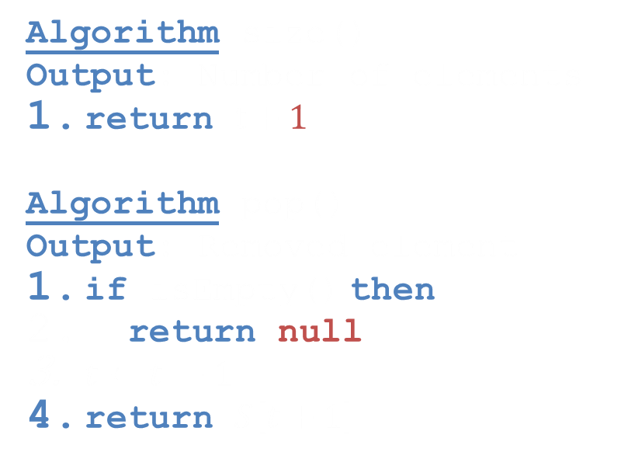
Array-based Stack
A simple way of implementing the Stack ADT uses an array
We add elements from left to right
A variable keeps track of the index of the top element
Algorithm size()
Output: Number of elements
return $t+1$
Algorithm pop()
Output: Removed element
if isEmpty() then
return null
$t←t −1$
return $S\left[t+1\right]$
…
S
0
1
2
t

Slide 11

Array-based Stack
The array storing the stack elements may become full
A push operation will then throw an IllegalStateException
  Limitation of the array-based implementation
  Not intrinsic to the Stack ADT
Algorithm push(e)
Input: Element e
if $t=S.length−1$ then
throw IllegalStateException
$t←t+1$
$S\left[t\right]←e$
…
S
0
1
2
t

Slide 12
Java Implementation
public class ArrayStack<E> implements Stack<E> {
private E[] stack;
private int t = -1;
public ArrayStack() {this(10);}
public ArrayStack(int capacity) {
stack = (E[]) new Object[capacity];
}
public int size() {return t + 1;}
public boolean isEmpty() {return t == -1;}
public E top() {
if(isEmpty()) return null;
return stack[t];
}
public void push(E e)
throws IllegalStateException {
if(size() == stack.length)
throw IllegalStateException(
"Stack is full");
stack[++t] = e;
}
public E pop() {
if(isEmpty()) return null;
E e = stack[t];
stack[t--] = null;
return e;
}
}

Slide 13
Performance and Limitations array-based implementation
Performance
  Let $n$ be the number of elements in the stack
  The space used is $O(n)$
  Each operation runs in time $O(1)$
Limitations
  The maximum size of the stack must be defined a priori, and cannot be changed
  Trying to push a new element into a full stack causes an implementation-specific exception

Slide 14

Growable Array-based Stack
In a push operation, when the array is full, instead of throwing an exception, we can replace the array with a larger one
How large should the new array be?
  incremental strategy: increase the size by a constant $c$
  doubling strategy: double the size
Algorithm push(e)
Input: Element $e$
if $t=S.length−1$ then
$A←$new array of size ?
for $i←0$ to $t$ do
$A\left[i\right]←S[i]$
$S←A$
$S\left[t\right]←e$
$t←t+1$

Slide 15

Comparison of the Strategies
We compare the incremental strategy and the doubling strategy by analyzing the total time $T(n)$ needed to perform a series of $n$ push operations
We assume that we start with an empty stack represented
We then use amortized analysis to determine cost of a single operation. For this kind of operation, the amortized time will be the average time taken by a push over the series of operations, i.e., $T(n)/n$

Slide 16

Incremental Strategy Analysis
Let $c$ be the constant increase and $n$ be the number of push operations
We replace the array $k = n/c$times
The total time $T(n)$ of a series of $n$ push operations is proportional to
$$n + c + 2c + 3c + 4c + … + kc$$
$$=n + c\left(1 + 2 + 3 + … + k\right)$$
$$=n + c\frac{k(k+1)}{2}$$
$$=O\left(n+k^{2}\right)=O\left(n+\frac{n^{2}}{c^{2}}\right)=O\left(n^{2}\right)$$
$T(n)$ is $O(n2)$ so the average time of a push is $\frac{O\left(n^{2}\right)}{n}=O(n)$
Side note:
$$1+2+…+k \\ =\sum_{i=0}^{k}{i} \\ =\frac{k\left(k+1\right)}{2}$$

Slide 17

Doubling Strategy Analysis
We will use an amortized technique here based on accounting.
Performing a push operation will "cost" cyber-dollars
(imaginary cost of the operation). Then we sum the total
amount of cyber dollars to determine run-time
Lets assume push costs 1 cyber dollar. Also assume growing an
array from size $k$ to size $2k$ requires k cyber-dollars (for $k$
copies)
So we can "charge" (overcharge) each push to be 3 cyber-dollars
  One for their push into the array
  One for their copy on resizing
  One for one of the first $\frac{k}{2}$ elements copy on resizing
Put another way, a resize occurs when there are $2^{i}$ elements. Doubling the size of the array costs $2^{i}$ cyber-dollars, which are found in cells $2^{i−1}$ through $2^{i}−1$
Thus all of the computation is paid for the the amortization is valid
We pay $3n$ for $n$ push operations which takes $O\left(n\right)$ time and one push is $\frac{O\left(n\right)}{n}=O(1)$ amortized time
2
4
1
1
8

Slide 18

Exercise
Stack with a singly-linked list
Describe how to implement a stack using a singly-linked list
  Stack operations: push($e$), pop(), size(), isEmpty()
  For each operation, give the running time
  What are the downsides of such an implementation?

Slide 19
Exercise
Stack with a Singly-Linked List
We can implement a stack with a singly linked list
The top element is stored at the first node of the list
The space used is $O(n)$ and each operation of the Stack ADT takes $O(1)$ time
nodes
top
∅
elements

Slide 20
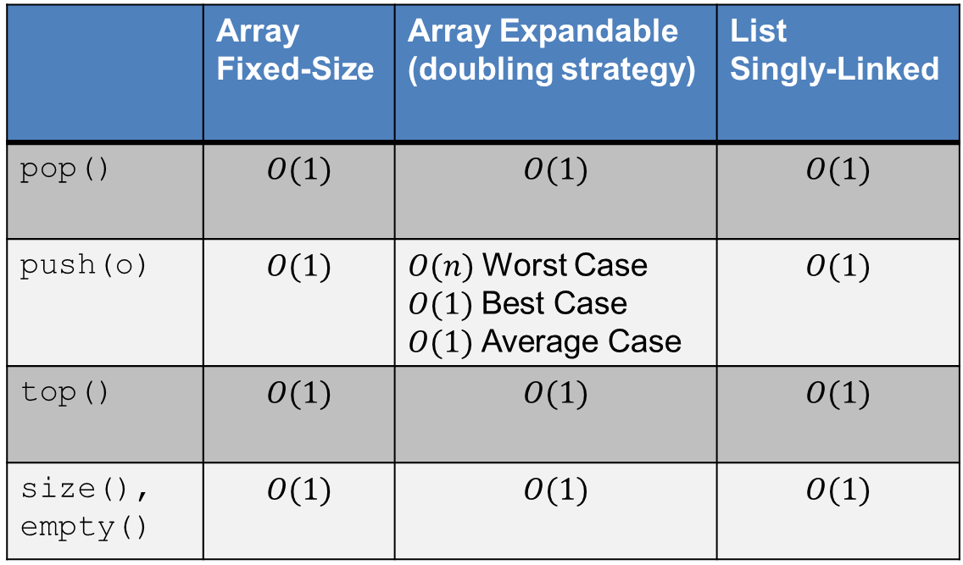
Stack Summary
 | Array Fixed-Size | Array Expandable (doubling strategy) | List Singly-Linked
pop() | $$O(1)$$ | $$O(1)$$ | $$O(1)$$
push(o) | $$O(1)$$ | $O(n)$Worst Case $O(1)$Best Case $O(1)$Average Case | $$O(1)$$
top() | $$O(1)$$ | $$O(1)$$ | $$O(1)$$
size(), empty() | $$O(1)$$ | $$O(1)$$ | $$O(1)$$

Slide 21
Queues (Ch 6.2)

Slide 22
Applications of Queues
Direct applications
  Waiting lines
  Access to shared resources (e.g., printer)
  Multiprogramming
Indirect applications
  Auxiliary data structure for algorithms
  Component of other data structures

Slide 23

The Queue ADT
The Queue ADT stores arbitrary objects
Insertions and deletions follow the first-in first-out (FIFO) scheme
Insertions are at the rear of the queue and removals are at the front of the queue
Main queue operations:
  enqueue(e): inserts element $e$ at the end of the queue
  Element dequeue(): removes and returns the element at the front of the queue
Auxiliary queue operations:
  Element first(): returns the element at the front without removing it
  Integer size(): returns the number of elements stored
  Boolean isEmpty(): indicates whether no elements are stored
Boundary cases
  Attempting the execution of dequeue or first on an empty queue returns null

Slide 24
Example Queue interface in Java
public interface Queue<E> {
int size(); /** Return number of elements */
boolean isEmpty(); /** True is size is 0 */
E first(); /** Return visible queue element */
void enqueue(E e); /** Add to the queue */
E dequeue(); /** Remove from the queue */
}

Slide 25
Exercise: Queues
Illustrate the following operations starting with an empty queue
  enqueue(8)
  enqueue(3)
  dequeue()
  enqueue(2)
  enqueue(5)
  dequeue()
  dequeue()
  enqueue(9)
  enqueue(1)

Slide 26



Array-based Queue
Use an array of size $N$ in a circular fashion, i.e., a circular array
Two variables keep track of the front and rear
  $f$ index of the front element
  $sz$ number of stored elements
When the queue has fewer than $N$ elements,
array location $r← \left(f + sz\right) mod N$
is the first empty slot past
the rear of the queue
normal configuration
Q
0
1
2
f
$$r$$
wrapped-around configuration
Q
0
1
2
$$r$$
f

Slide 27

Queue Operations
We use the modulo operator (remainder of division)
Algorithm size()
Output: Number of elements
return $sz$
Algorithm isEmpty()
Output: True if no elements in queue, false otherwise
return $sz=0$
Q
0
1
2
f
r
Q
0
1
2
r
f

Slide 28

Queue Operations
Operation enqueue throws an exception if the array is full
This exception is implementation-dependent
Algorithm enqueue(e)
Input: Element e
if $size()=N−1$then
throw IllegalStateException
$r←\left(f+sz\right) mod N$
$Q\left[r\right]←e$
$sz←sz+1$
Q
0
1
2
f
r
Q
0
1
2
r
f

Slide 29
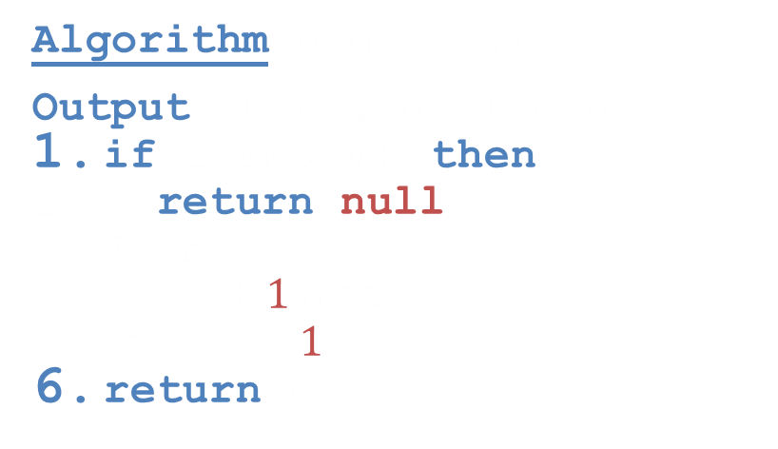
Queue Operations
Operation dequeue returns null if the queue is empty
Algorithm dequeue()
Output: Removed element
if isEmpty() then
return null
Element e$←Q[f]$
$f←f+1 mod N$
$sz←sz−1$
return e
Q
0
1
2
f
r
Q
0
1
2
r
f

Slide 30
Java Implementation
public class ArrayQueue<E> implements Queue<E> {
private E[] queue;
private int f = 0, sz = 0;
public ArrayQueue() {this(10);}
public ArrayQueue(int capacity) {
queue = (E[]) new Object[capacity];
}
public int size() {return sz;}
public boolean isEmpty() {return sz == 0;}
public E first() {
if(isEmpty()) return null;
return queue[f];
}
public void enqueue(E e)
throws IllegalStateException {
if(size() == data.length)
throw IllegalStateException(
"Queue is full");
stack[(f+sz)%queue.length] = e;
++sz;
}
public E dequeue() {
if(isEmpty()) return null;
E e = queue[f];
queue[f] = null;
f = (f+1)%queue.length;
--sz;
return e;
}
}

Slide 31

Performance and Limitations array-based implementation
Performance
  Let $n$ be the number of elements in the queue
  The space used is $O(n)$
  Each operation runs in time $O(1)$
Limitations
  The maximum size of the queue must be defined a priori, and cannot be changed

Slide 32

Growable Array-based Queue
In enqueue($e$), when the array is full, instead of throwing an exception, we can replace the array with a larger one
Similar to what we did for an array-based stack
enqueue($e$) has amortized running time
  $O(n)$with the incremental strategy
  $O(1)$ with the doubling strategy

Slide 33

Exercise
Queue with a Singly-linked List
Describe how to implement a queue using a singly-linked list
  Queue operations: enqueue($e$), dequeue(), size(), empty()
  For each operation, give the running time

Slide 34

Exercise
Queue with a Singly-Linked List
The first element is stored at the head of the list, The rear element is stored at the tail of the list
The space used is $O(n)$ and each operation of the Queue ADT takes $O(1)$ time
NOTE: we do not have the limitation of the array based implementation on the size of the stack b/c the size of the linked list is not fixed, i.e., the queue is NEVER full.
r
nodes
first
f
∅
rear
elements

Slide 35
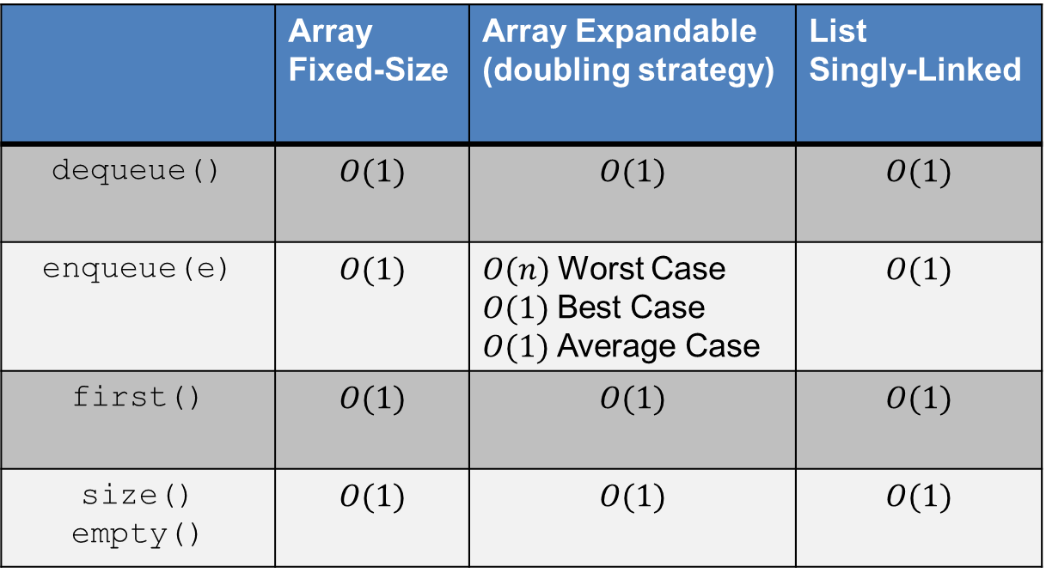
Queue Summary
 | Array Fixed-Size | Array Expandable (doubling strategy) | List Singly-Linked
dequeue() | $$O(1)$$ | $$O(1)$$ | $$O(1)$$
enqueue(e) | $$O(1)$$ | $O(n)$Worst Case $O(1)$Best Case $O(1)$Average Case | $$O(1)$$
first() | $$O(1)$$ | $$O(1)$$ | $$O(1)$$
size() empty() | $$O(1)$$ | $$O(1)$$ | $$O(1)$$

Slide 36

The Double-Ended Queue ADT (Ch. 6.3)
The Double-Ended Queue, or Deque, ADT stores arbitrary objects. (Pronounced ‘deck’)
Richer than stack or queue ADTs. Supports insertions and deletions at both the front and the end.
Main deque operations:
  addFirst(e): inserts element $e$ at the beginning of the deque
  addLast(e): inserts element $e$ at the end of the deque
  Element removeFirst(): removes and returns the element at the front of the queue
  Element removeLast(): removes and returns the element at the end of the queue
Auxiliary queue operations:
  Element first(): returns the element at the front without removing it
  Element last(): returns the element at the front without removing it
  Integer size(): returns the number of elements stored
  Boolean isEmpty(): indicates whether no elements are stored

Slide 37
Deque with a Doubly Linked List
The front element is stored at the first node
The rear element is stored at the last node
The space used is $O(n)$ and each operation of the Deque ADT takes $O(1)$ time
first
last
elements

Slide 38

Performance and Limitations doubly linked list implementation
Performance
  Let $n$ be the number of elements in the deque
  The space used is $O(n)$
  Each operation runs in time $O(1)$

Slide 39
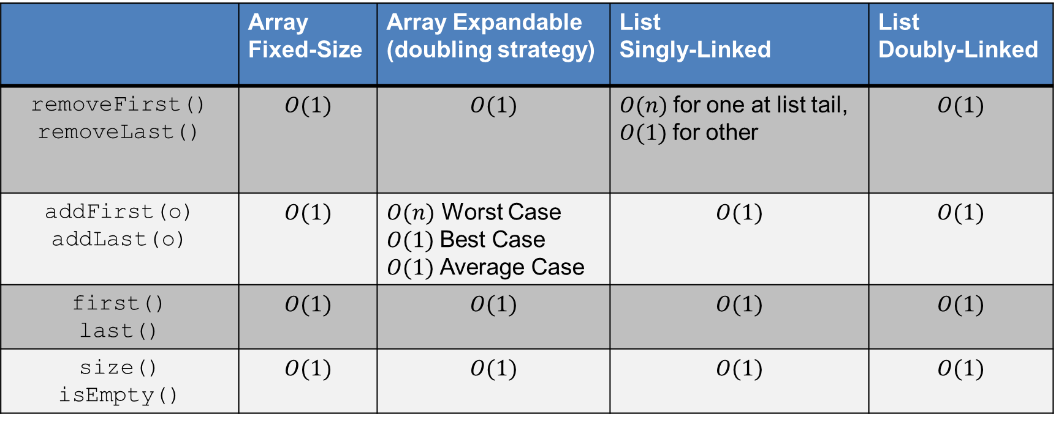
Deque Summary
 | Array Fixed-Size | Array Expandable (doubling strategy) | List Singly-Linked | List Doubly-Linked
removeFirst() removeLast() | $$O(1)$$ | $$O(1)$$ | $O(n)$for one at list tail, $O(1)$for other | $$O(1)$$
addFirst(o) addLast(o) | $$O(1)$$ | $O(n)$ Worst Case $O(1)$Best Case $O(1)$Average Case | $$O(1)$$ | $$O(1)$$
first() last() | $$O(1)$$ | $$O(1)$$ | $$O(1)$$ | $$O(1)$$
size() isEmpty() | $$O(1)$$ | $$O(1)$$ | $$O(1)$$ | $$O(1)$$

Slide 40
Interview Question 1
How would you design a stack which, in addition to push and pop, also has a function min which returns the minimum element? push, pop and min should all operate in $O(1)$ time

Slide 41
Interview Question 2
An animal shelter holds only dogs and cats, and operates in a strictly "first in, first out" basis. People must adopt either the "oldest" (based on arrival time) of all animals at the shelter, or they can select whether they prefer a dog or cat (and will receive the oldest animal of that type). They cannot select which specific animal they would like. Create the data structure(s) to maintain this system and implement operations such as enqueue, dequeueAny, dequeueDog, and dequeueCat.

