Slide 1
Ch 4 Algorithm Analysis
Acknowledgement: These slides are adapted from slides provided with Data Structures and Algorithms in Java, Goodrich, Tamassia and Goldwasser (Wiley 2016)

Slide 2
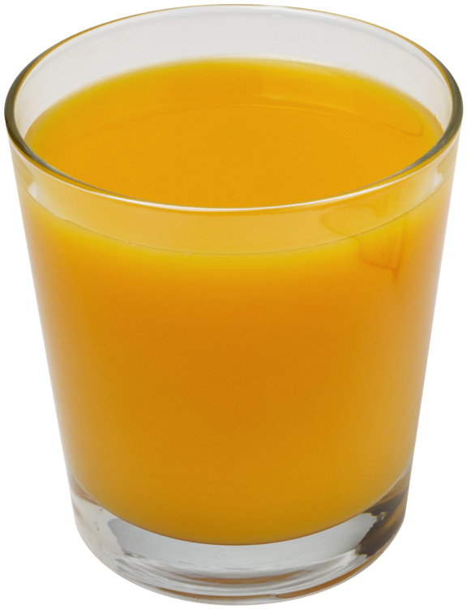
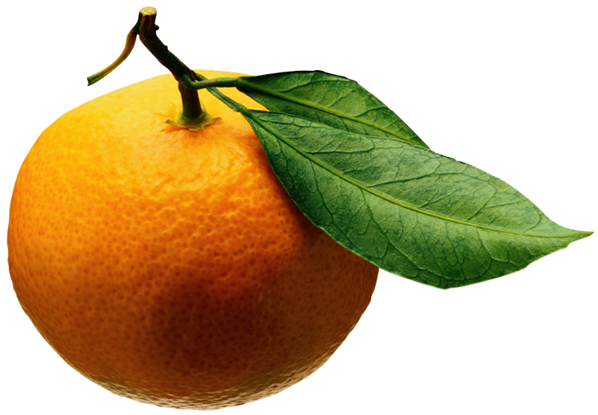
Analysis of Algorithms (Ch 4.2-4.3)
Input
Algorithm
Output

Slide 3
Running Time
Most algorithms transform input objects into output objects.
The running time of an algorithm typically grows with the input size.
We focus on the worst case running time.
Easier to analyze
Crucial to applications such as games, finance, and robotics

Slide 4
Limitations of Experiments
It is necessary to implement the algorithm, which may be difficult
Results may not be indicative of the running time on other inputs not included in the experiment.
In order to compare two algorithms, the same hardware and software environments must be used

Slide 5
Theoretical Analysis
Uses a high-level description of the algorithm instead of an implementation
Characterizes running time as a function of the input size, $n$
Takes into account all possible inputs
Allows us to evaluate the speed of an algorithm independent of the hardware/software environment

Slide 6
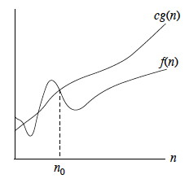
Big-Oh Notation
Given functions $f\left(n\right)$ and $g\left(n\right)$, we say that $f\left(n\right)$ is $O\left(g\left(n\right)\right)$ if there are positive constants $c$ and $n_{0}$ such that $f\left(n\right)≤cg\left(n\right)$ for $n≥n_{0}$
$f\left(n\right)$ - might represent real computation time (measured time, if you will)
$g\left(n\right)$ - approximation function
Example: 2n + 10 is O(n)
$2n+10≤cn$
$\frac{10}{c−2}≤n$
Pick $c=3$ and $n_{0}=10$
To reduce: Strip constants, and take highest order terms
Constants do no matter because of limits as $n$ goes to infinity

Slide 7
Practice with Big-oh
Determine the big-oh approximation for the following functions:
$2^{100}$
$4n^{2}+3n−10$
$n\log{n}+100n$
${3∗2}^{n}+400n^{2}$
$2^{\log{n}}$
$46n^{2}+m$
$n\sqrt{n}+23m\log{n}$
$\cos{x}$

Slide 8
Big-oh notation for algorithms
In comparison of algorithms, $f\left(n\right)$ is the real (measurable) time an algorithm takes to compute on hardware (tied to an implementation)
Again, hard to compare to other algorithms
To determine big-oh approximation we count the maximum number of steps required by our algorithm
Unary and binary math operations, (e.g., +, -, *, /) and single memory accesses are $O\left(1\right)$
Loops or math operations like summation/product are $O\left(k\right)$ where $k$ is the number of iterations performed
Essentially, we don't care about constants or exact times, we are reasoning about a general trend of $n$ vs $f\left(n\right)$

Slide 9
Example Adding to an array
To add an entry $e$ into array $A$ at index $i$, we need to make room for it by shifting forward the $n−i$ entries $A\left[i\right], …, A\left[n−1\right]$
Algorithm Add
Input: Array $A$, index $i$, element $e$
for $k←n$ to $i+1$ do
$A\left[k\right]← A[k−1]$
$A\left[i\right]← e$
$n←n+1$
A
0
1
2
i
n
A
0
1
2
i
n
A
e
0
1
2
i
n

Slide 10
Example Adding to an array
Best case
Add at the end of the array
One comparison, one copy, one increment
$3=O\left(1\right)$, by removal of constants
Worst case
Add at the beginning of the array
$n$ comparisons, $n$ copies, $2n$ increments
$4n=O\left(n\right)$, by removal of constants
Average case?

Slide 11
Exercises
Removing from an array
Best, average, worst cases
Inserting at head or tail of linked list
Removing head of tail of doubly-linked list
Removing head of singly-linked list
Removing tail of singly-linked list

Slide 12
Seven Important Functions
Seven functions that often appear in algorithm analysis:
Constant ≈ 1
Logarithmic ≈ $\log{n}$
Linear ≈ $n$
Linearithmic ≈ $n\log{n}$
Quadratic ≈ $n^{2}$
Cubic ≈ $n^{3}$
Exponential ≈ $2^{n}$
In a log-log chart, the slope of the line corresponds to the growth rate

Slide 13
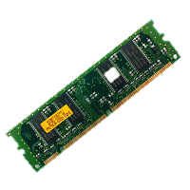
Big-oh analysis applies to time and memory
How about recursion?
Each function call uses memory!
Practice: How much memory does a recursive binary search use?

Slide 14
Big-Omega and Big-Theta
Big-oh describes an upper bound. Similar constructs exist for lower bounds (Big-omega $Ω\left(g\left(n\right)\right)$), "tight" bounds (Big-theta $Θ\left(g\left(n\right)\right)$), strict upper bounds (little-oh $o\left(g\left(n\right)\right)$), and strict lower bounds (little-omega $ω\left(g\left(n\right)\right)$)
Given functions $f\left(n\right)$ and $g\left(n\right)$, we say that $f\left(n\right)$ is $Ω\left(g\left(n\right)\right)$ if there are positive constants $c$ and $n_{0}$ such that $f\left(n\right)≥cg\left(n\right)$ for $n≥n_{0}$
Given functions $f\left(n\right)$ and $g\left(n\right)$, we say that $f\left(n\right)$ is $Θ\left(g\left(n\right)\right)$ if there are positive constants $c′$, $c′′$, and $n_{0}$ such that $c^{′}g\left(n\right)≤f\left(n\right)≤c′′g\left(n\right)$ for $n≥n_{0}$
To prove: You must show upper and lower bounds hold. Because of this, in CS we often just say big-oh, but really big-theta is more accurate.

Slide 15
Big-oh vs "worst" case
Despite common belief, big-oh does not always mean worst case
Big-oh is an upper bound. So worst-case, average-case, and best case can each have a unique upper bound. It depends what we are describing.
Similarly, big-omega does not mean best case and big-theta definitely does not mean average case

Slide 16
Common proof techniques for this class
Direct proof – using knowledge of axioms and definitions
Used for determining theoretical complexity
Loose example
Copying takes one operation. My loop runs $n$ times and performs $n$ copies. Therefore the total runtime is $O\left(n\right)$
Contradiction – assume the opposite and reach an impossibility
We will see this later in the course, in proving properties of structures
Loose example
Prove: if $ab$ is odd, then $a$ is odd and $b$ is odd. Proof: Assume $a$ is even, then $a=2j$ for some integer $j$. Thus $ab=2(jb)$, implying $ab$ is even. This is a contradiction to our original assumption, thus $a$ cannot be even.
Induction – not on a test or homework, only for my lectures
Counterproof by example

