Slide 1
Welcome to
CSCE 221: Data Structures

Slide 2

Syllabus

Slide 3
Review
Computing, Data, and Memory

Slide 4



computer science
Input
Algorithm
Output
Study of algorithms
Study of computing tools
It is not just:
  Programming
  Electronics
  Etc.
In this class, we formalize this study of
algorithms through the basics of data
structures – a bread-and-butter
component of almost all algorithms

Slide 5

Pseudocode
High-level description of an algorithm
More structured than English prose
Less detailed than a program
Preferred notation for describing algorithms
Hides program design issues
Basic rundown
  Use common math notations
  Use $←$ vs $=$ for assignment
  Do not use (), {}, ;, etc.
  Let indenting denote scope
  Use objects and functions without having to define them
Look at my website LaTex tutorial for more info

Slide 6
the basic methods to store data from 150
One variable per data element – does not associate data together and can be very verbose
Arrays – group a large amount of data all of the same type
Objects – group a large amount of data all of different types

Slide 7
Memory
Memory is storage for data and programs
We will pretend that memory is an infinitely long piece of tape separated into different cells
Each cell has an address, i.e., a location, and a value
In the computer these values are represented in binary (0s and 1s) and addresses are located in hexadecimal (base 16, 0x)
x
y
z
…
…
0x0
0x1
0x2
0xA

Slide 8
Memory
Arrays
We will review arrays in Java later today
Arrays are a sequential piece of memory all of the same type
Pointer (e.g., Java reference) – a variable that stores a memory location
Array A
0
x
1
y
…
0xB
100
…
x
y
…
z
…
…
…
99
z
0xA
0xB
0xB+99
Array A
A's size
Simpler View
Realistic View

Slide 9
Memory
Objects
We will review objects in Java and learn new concepts/syntax about objects tomorrow
Objects are entities in your program. Another way to think about them is that they are collections of data of unassociated types.
Objects are stored as pointers in Java, always.
Object A
x
y
…
0xB
…
x
y
…
z
…
…
z
0xA
0xB
0xB+B's "size"
Object A
Simpler View
Realistic View

Slide 10

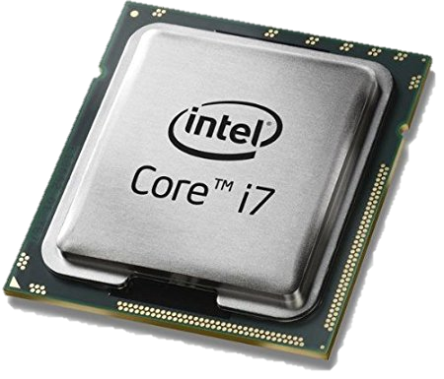

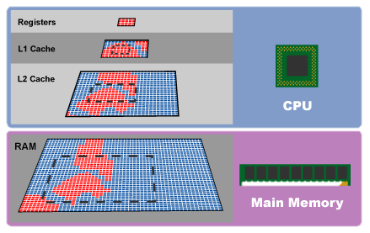
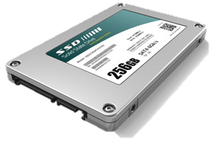
Basic Computer Organization
Central Processing Unit
(CPU)
Processes commands as 0’s and 1’s
Performs arithmatic
Requests (reads) and writes to/from memory
Input
Files
Keyboard
Mouse
Etc.
Output
Monitor
Force feedback
Files
Etc.
Bus
Memory
Data encoded as 0s and 1s
Cache
Random Access Memory (RAM)
Hard drive

Slide 11

Takeaways about memory
Programs can operate more efficiently when data is close together, e.g., arrays. This is called locality of data. The reason it works better is the cache.
Pointers are not usually located close to the data. They hurt locality.

Slide 12
Ch3.
Fundamental Data Structures
Acknowledgement: These slides are adapted from slides provided with Data Structures and Algorithms in Java, Goodrich, Tamassia and Goldwasser (Wiley 2016)

Slide 13

Ch 3.1 Arrays

Slide 14

Array Definition
An array is a sequenced collection of variables all of the same type. Each variable, or cell, in an array has an index, which uniquely refers to the value stored in that cell. The cells of an array, $A$, are numbered $0$, $1$, $2$, and so on.
Each value stored in an array is often called an element of that array.
A
0
1
2
i
n

Slide 15

Array Length and Capacity
Since the length of an array determines the maximum number of things that can be stored in the array, we will sometimes refer to the length of an array as its capacity.
In Java, the length of an array named a can be accessed using the syntax a.length. Thus, the cells of an array, a, are numbered 0, 1, 2, and so on, up through a.length−1, and the cell with index $k$ can be accessed with syntax a[k].
a
0
1
2
k
n

Slide 16

Declaring Arrays (first way)
The first way to create an array is to use an assignment to a literal form when initially declaring the array, using a syntax as:
ElementType[] arrayName = {$initialValue_{0}, initialValue_{1},…,initialValue_{N−1}$};
The ElementType can be any Java base type or class name, and arrayName can be any valid Java identifier. The initial values must be of the same type as the array.

Slide 17
Declaring Arrays (second way)
The second way to create an array is to use the new operator.
  However, because an array is not an instance of a class, we do not use a typical constructor. Instead we use the syntax:
  new ElementType[length]
length is a positive integer denoting the length of the new array.
The new operator returns a reference to the new array, and typically this would be assigned to an array variable.

Slide 18
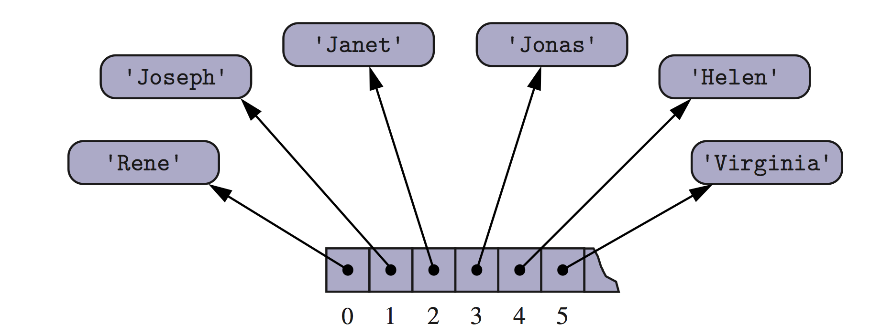
Arrays of Objects
Recall an array of objects is an array of pointers to objects

Slide 19


Adding an Entry
To add an entry $e$ into array $A$ at index $i$, we need to make room for it by shifting forward the $n−i$ entries $A\left[i\right], …, A\left[n−1\right]$
Algorithm Add
Input: Array $A$,
index $i$, element $e$
for $k←n$ to $i+1$ do
$A\left[k\right]← A[k−1]$
$A\left[i\right]← e$
$n←n+1$
A
0
1
2
i
n
A
0
1
2
i
n
A
e
0
1
2
i
n

Slide 20


Removing an Entry
To remove the entry $e$ at index $i$, we need to fill the hole left by $e$ by shifting backward the $n−i−1$ elements $A\left[i+1\right], …, A[n−1]$
Algorithm Remove
Input: Array $A$,
index $i$, element $e$
for $k←i+1$ to $n−1$ do
$A\left[k−1\right]← A[k]$
$A\left[n−1\right]←null$
$n←n−1$
A
e
0
1
2
i
n
A
0
1
2
i
n
A
0
1
2
i
n

Slide 21

Exercise
With a partner, write an algorithm in pseudocode to compare the equality of two arrays $A$ and $B$. Use '$=$' for equality checking in pseudocode, not '$==$'.

Slide 22
Ch 3.2 Singly Linked Lists

Slide 23





Linked structures
A linked data structure stores nodes that contain data and pointers to other nodes in the structure
  Compare this to an array!
$$y$$
$$u$$
$$x$$
$$v$$
$$z$$
Example of a linked structure – graph (Ch 14)

Slide 24
Singly Linked List
A singly linked list is a concrete data structure consisting of a sequence of nodes, starting from a head pointer
Each node stores
  element
  link to the next node
next
element
node
head
∅
A
B
C
D

Slide 25
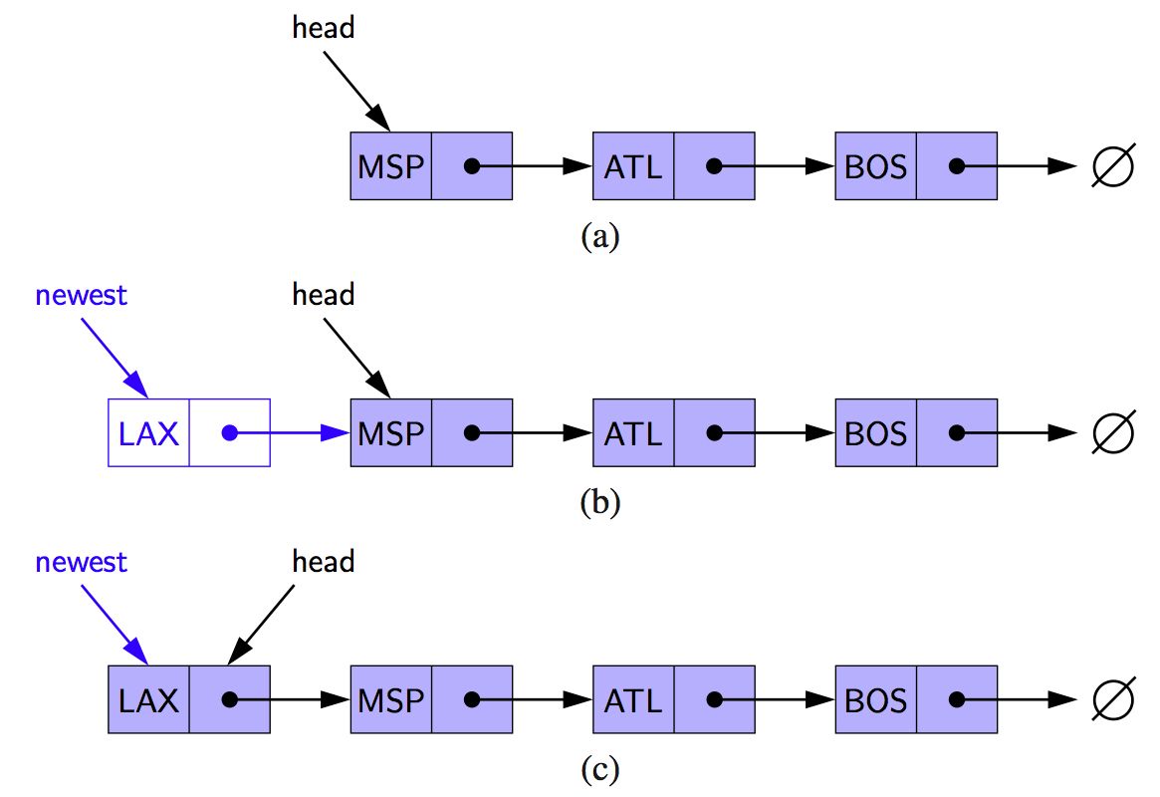
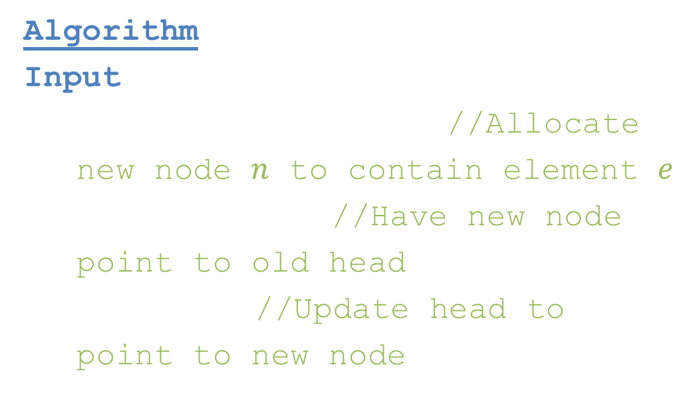
Inserting at the Head
Algorithm AddFirst
Input: List l, Element e
Node $n←$new Node$(e)$ //Allocate new node $n$ to contain element $e$
$n.next←l.head$ //Have new node point to old head
$l.head←n$ //Update head to point to new node
Note, for simplicity, this algorithm assumes the list has elements in it. A special case would need to be introduced for an empty list to set up the tail pointer.

Slide 26
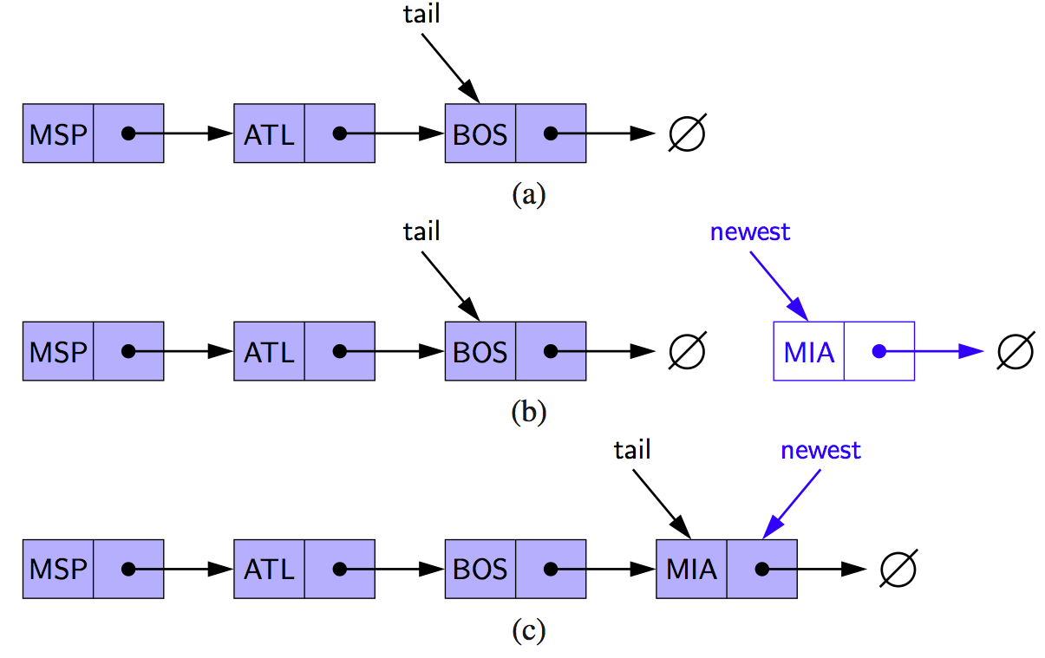
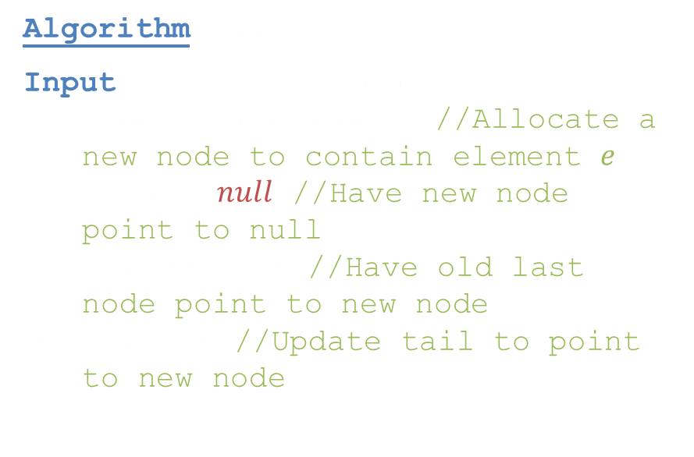
Inserting at the Tail
Algorithm AddLast
Input: List $l$, Element $e$
Node $n←$new Node$\left(e\right)$ //Allocate a new node to contain element $e$
$n.next←null$ //Have new node point to null
$l.tail.next←n$ //Have old last node point to new node
$l.tail←n$ //Update tail to point to new node
Note, for simplicity, this algorithm assumes the list has elements in it. A special case would need to be introduced for an empty list to set up the head pointer.

Slide 27
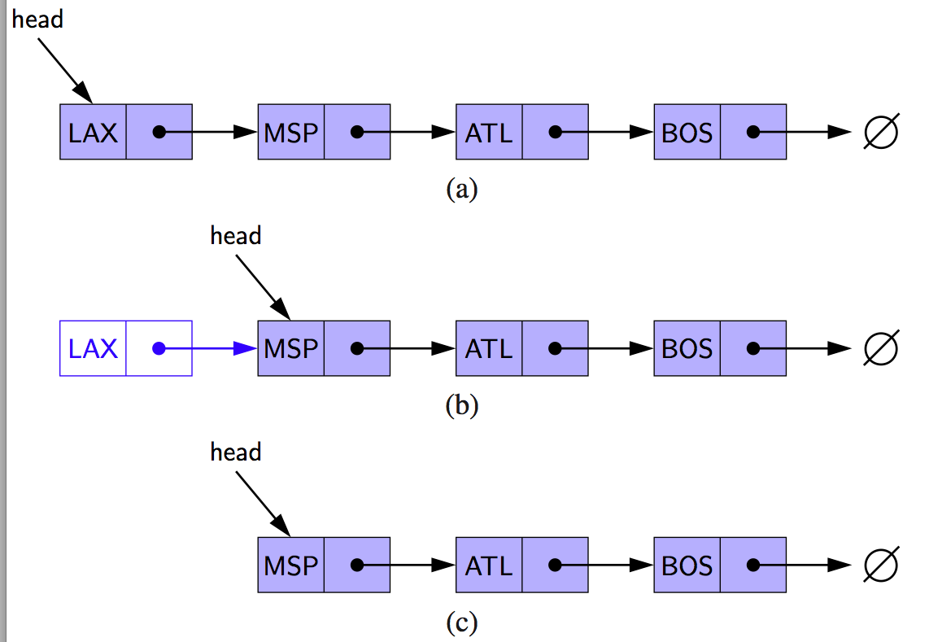
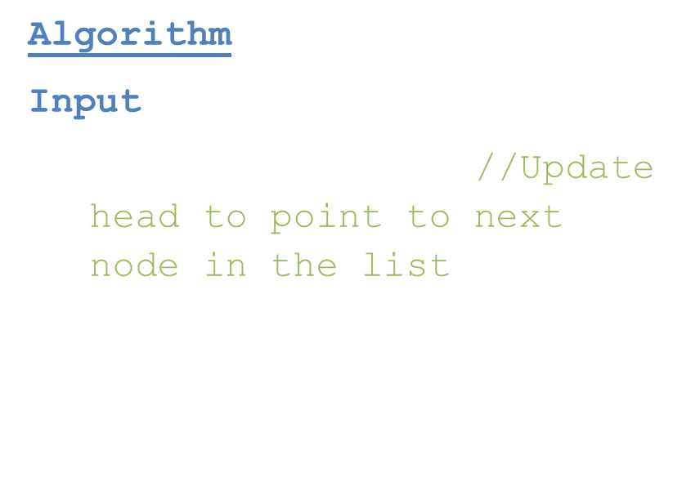
Removing at the Head
Algorithm RemoveFirst
Input: List $l$
$l.head←l.head.next$ //Update head to point to next node in the list
Allow garbage collector to reclaim the former first node
Note, a garbage collector is not found in all languages you may need to deal with memory deallocation yourself. In this class, we will stick to the Java way. However, note, the garbage collector is complex, so to help it perform at its best you typically set all pointers of a node to null.
Note, for simplicity, this algorithm assumes the list has elements in it and does not return the removed element. Extra logic would be added in a real implementation..

Slide 28
Exercise
Write an algorithm for finding the second-to-last node in a singly-linked list. The last node is indicated by a null next reference.

Slide 29
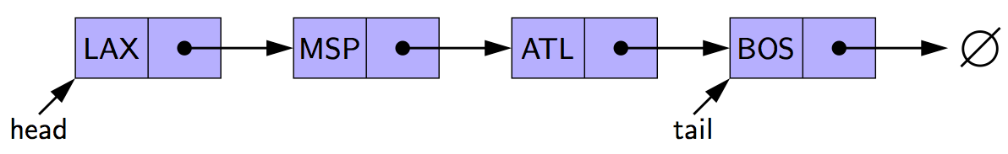
Removing at the Tail
Removing at the tail of a singly linked list is not efficient!
There is no constant-time way to update the tail to point to the previous node

Slide 30
A Java Singly linked list of int
// Nest this class inside of Linked list
private static class Node {
// Private data
private int elem; // Element
private Node next; // Next node (link)
// Constructor
public Node(int e, Node n) {
elem = e;
next = n;
}
// Accessors
public int getElement() {return elem;}
public Node getNext() {return next;}
}
public class LinkedList {
/* Place node class here */
// Private data
private Node head = null; // List head
private Node tail = null; // List tail
private int size = 0; // List size
// Constructor
public LinkedList() {}
// Accessors
public int size() {return size;}
// Modifiers
public void addFirst(int e) {
head = new Node(e, head);
if(size == 0)
tail = head;
++size;
}
/* Other algorithms */
}

Slide 31
Ch 3.4 Doubly Linked Lists

Slide 32
Doubly Linked List
A doubly linked list can be traversed
forward and backward
Nodes store:
  element
  link to the previous node
  link to the next node
Special trailer and
header nodes that
do not store data.
  In linked structures, special nodes
  like this are called sentinels
prev
next
element
node
header
nodes/positions
trailer
elements

Slide 33






Insertion
Insert a new node, $q$, between $p$ and its successor.
$$p$$
A
B
C
$$p$$
A
B
$$q$$
C
X
$$p$$
$$q$$
A
B
X
C

Slide 34



Deletion
Remove a node, $p$, from a doubly linked list.
$$p$$
A
B
C
D
A
B
C
$$p$$
D
A
B
C

Slide 35
Exercise
Write an algorithm for finding the middle node of a doubly linked-list
  With access to a method size()
  Without access to a method size()

Slide 36
Summary
Two major patterns of data storage
  Consecutive memory – localized, through arrays or objects
  Linked memory – not localized, through linked objects

