Slide 1
Chapter 11
Search Trees
<
6
2
>
9
1
4
=
8
Acknowledgement: These slides are adapted from slides provided with Data Structures and Algorithms in Java, Goodrich, Tamassia and Goldwasser (Wiley 2016)
Notes:
1
1

Slide 2

Binary Search Trees
A binary search tree is a binary tree storing entries $(k, e)$ (i.e., key-value pairs) at its internal nodes and satisfying the following property:
  Let $u$, $v$, and $w$ be three nodes such that $u$ is in the left subtree of $v$ and $w$ is in the right subtree of $v$. Then
  $key\left(u\right)≤key\left(v\right)≤key\left(w\right)$
External nodes do not store items
An inorder traversal of a binary search trees visits the keys in increasing order
6
2
9
1
4
8

Slide 3

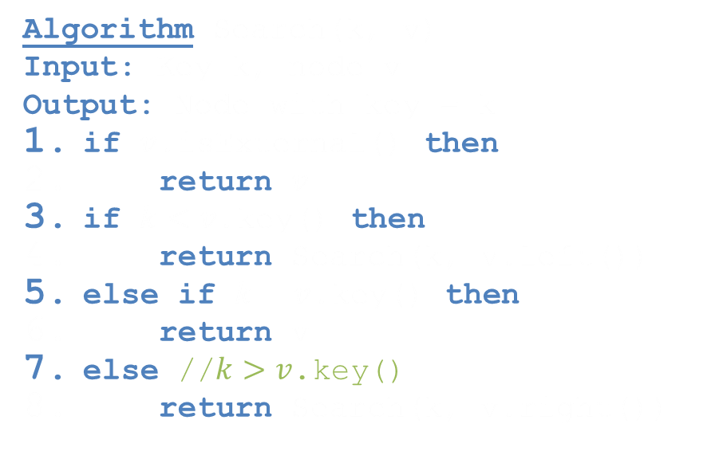
Search
<
6
2
>
9
1
4
=
8
To search for a key $k$, we trace a downward path starting at the root
The next node visited depends on the outcome of the comparison of $k$ with the key of the current node
If we reach a leaf, the key is not found
Example: get(4)
  Call Search(4, root)
Algorithms for nearest neighbor queries are similar
Algorithm Search(k, v)
Input: Key k, node v
Output: Node with key = k
if $v$.isExternal() then
return $v$
if $k<v$.key() then
return Search(k, v.left())
else if $k=v$.key() then
return v
else //$k>v$.key()
return Search(k, v.right())

Slide 4

Insertion
<
6
2
>
9
To perform operation put(k, v), we search for key $k$ (using Search(k))
Assume $k$ is not already in the tree, and let let $w$ be the leaf reached by the search
We insert $k$ at node $w$ and expand $w$ into an internal node
Example: insert 5
1
4
>
8
w
6
2
9
1
4
8
w
5

Slide 5
Exercise
Binary Search Trees
Insert into an initially empty binary search tree items with the following keys (in this order). Draw the resulting binary search tree
  30, 40, 24, 58, 48, 26, 11, 13

Slide 6

Deletion
<
6
2
>
9
To perform operation remove(k), we search for key $k$
Assume key $k$ is in the tree, and let $v$ be the node storing $k$
If node $v$ has a leaf child $w$, we remove $v$ and $w$ from the tree with operation removeExternal(w), which removes $w$ and its parent
Example: remove 4
1
4
v
8
w
5
6
2
9
1
5
8

Slide 7

Deletion (cont.)
1
v
3
We consider the case where the key $k$ to be removed is stored at a node $v$ whose children are both internal
  we find the internal node $w$ that follows $v$ in an inorder traversal
  we copy $w.$key() into node $v$
  we remove node $w$ and its left child $z$ (which must be a leaf) by means of operation removeExternal(z)
Example: remove 3
2
8
6
9
w
5
z
1
v
5
2
8
6
9

Slide 8
Exercise
Binary Search Trees
Insert into an initially empty binary search tree items with the following keys (in this order). Draw the resulting binary search tree
  30, 40, 24, 58, 48, 26, 11, 13
Now, remove the item with key 30. Draw the resulting tree
Now remove the item with key 48. Draw the resulting tree.

Slide 9

Performance
Consider an ordered map with $n$ items implemented by means of a binary search tree of height $h$
  Space used is $O\left(n\right)$
  Methods $get\left(k\right)$, put(k, v), and remove(k) take $O\left(h\right)$ time
The height $h$ is $O(n)$ in the worst case and $O\left(\log{n}\right)$ in the best case

Slide 10
AVL Trees
6
v
3
8
z
4

Slide 11

AVL Tree Definition
AVL trees are balanced
An AVL Tree is a binary search tree such that for every internal node $v$ of $T$, the heights of the children of $v$ can differ by at most 1
An example of an AVL tree where the heights are shown next to the nodes:

Slide 12

Height of an AVL Tree
n(2)
3
4
n(1)
Fact: The height of an AVL tree storing $n$ keys is $O\left(\log{n}\right)$.
Proof: Let us bound $n\left(h\right)$: the minimum number of internal nodes of an AVL tree of height $h$.
We easily see that $n\left(1\right)=1$ and $n\left(2\right)=2$
For $n>2$, an AVL tree of height $h$ contains the root node, one AVL subtree of height $h−1$ and another of height $h−2$.
That is, $n\left(h\right)=1+n\left(h−1\right)+n\left(h−2\right)$
Knowing $n\left(h−1\right)>n\left(h−2\right)$, we get $n\left(h\right)>2n\left(h−2\right)$. So
  $n\left(h\right)>2n\left(h−2\right)>4n\left(h−4\right)>8n\left(n−6\right),…$ (by induction),
  $n\left(h\right)>2^{i}n\left(h−2i\right)$
Solving the base case we get: $n\left(h\right)>2^{\frac{h}{2}−1}$
Taking logarithms: $h<2\log{n(h)}+2$
Thus the height of an AVL tree is $O(\log{n})$

Slide 13
Insertion in an AVL Tree
Insertion is as in a binary search tree
Always done by expanding an external node.
Example insert 54:
44
17
78
44
32
50
88
17
78
48
62
32
50
88
54
48
62
After Insertion
Before Insertion

Slide 14

Trinode Restructuring
let $(a, b, c)$ be an inorder listing of $x, y, z$
perform the rotations needed to make $b$ the topmost node of the three
(other two cases are symmetrical)
a=z
a=z
case 2: double rotation
(a right rotation about c, then a left rotation about a)
b=y
T₀
c=y
T₀
c=x
b=x
T₃
T₁
b=y
T₁
T₂
b=x
T₂
T₃
a=z
c=x
a=z
c=y
case 1: single rotation
(a left rotation about a)
T₀
T₁
T₂
T₃
T₀
T₁
T₂
T₃

Slide 15
Insertion Example, continued
unbalanced...
T
4
1
44
2
3
x
17
y
62
z
1
2
2
32
50
78
1
1
1
48
54
88
T
2
...balanced
T
0
T
1
T
3

Slide 16
Restructuring
Single Rotations

Slide 17
Restructuring
Double Rotations

Slide 18
Exercise
AVL Trees
Insert into an initially empty AVL tree items with the following keys (in this order). Draw the resulting AVL tree
  30, 40, 24, 58, 48, 26, 11, 13

Slide 19

Removal in an AVL Tree
Removal begins as in a binary search tree, which means the node removed will become an empty external node. Its parent, $w$, may cause an imbalance.
Example:
44
remove 32
44
17
62
17
62
32
50
78
50
78
48
54
88
48
54
88
before deletion of 32
after deletion

Slide 20

Rebalancing after a Removal
Let $z$ be the first unbalanced node encountered while travelling up the tree from $w$ (parent of removed node) . Also, let $y$ be the child of $z$ with the larger height, and let $x$ be the child of $y$ with the larger height.
We perform restructure(x) to restore balance at $z$.
62
a=z
44
44
78
w
17
62
b=y
17
50
88
50
78
c=x
48
54
48
54
88

Slide 21

Rebalancing after a Removal
As this restructuring may upset the balance of another node higher in the tree, we must continue checking for balance until the root of $T$ is reached
  This can happen at most $O(\log{n})$ times. Why?
62
a=z
44
44
78
w
17
62
b=y
17
50
88
50
78
c=x
48
54
48
54
88

Slide 22
Exercise
AVL Trees
Insert into an initially empty AVL tree items with the following keys (in this order). Draw the resulting AVL tree
  30, 40, 24, 58, 48, 26, 11, 13
Now, remove the item with key 48. Draw the resulting tree
Now, remove the item with key 58. Draw the resulting tree

Slide 23

Running Times for AVL Trees
A single restructure is $O(1)$ – using a linked-structure binary tree
get(k) takes $O\left(\log{n}\right)$ time – height of tree is $O\left(\log{n}\right)$, no restructures needed
put(k, v) takes $O\left(\log{n}\right)$ time
  Initial find is $O\left(\log{n}\right)$
  Restructuring up the tree, maintaining heights is $O\left(\log{n}\right)$
remove(k) takes $O\left(\log{n}\right)$ time
  Initial find is $O\left(\log{n}\right)$
  Restructuring up the tree, maintaining heights is $O\left(\log{n}\right)$

Slide 24

Other Types of Self-balancing Trees
Splay Trees – A binary search tree which uses an operation $splay\left(x\right)$ to allow for amortized complexity of $O\left(\log{n}\right)$
$\left(2, 4\right)$ Trees – A multiway search tree where every node stores internally a list of entries and has 2, 3, or 4 children. Defines self-balancing operations
Red-Black Trees – A binary search tree which colors each internal node red or black. Self-balancing dictates changes of colors and required rotation operations
9
2 5 7
10 14
9
4
15
2
6
12
21
7

Slide 25
Interview Question 1
Given a sorted array with unique integer elements, write an algorithm to create a binary search tree with minimal height.
  Hint: Recursion

Slide 26
Interview Question 2
Implement a function to check if a binary tree is a binary search tree.

