Slide 1
Development and testing

Slide 2
Development (one out of many perspectives)
Solve
Implement
Write test
Write code
Repeat
Integrate
Release

Slide 3
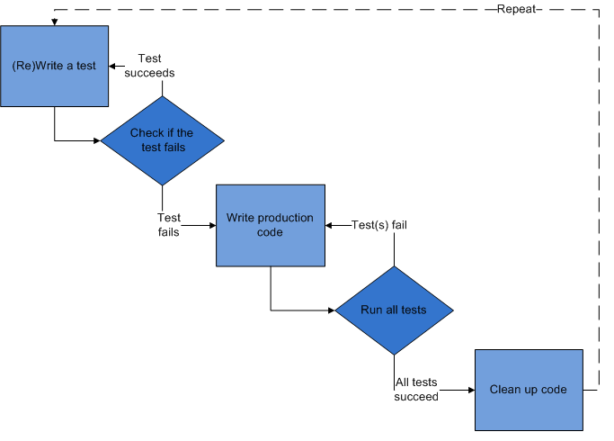
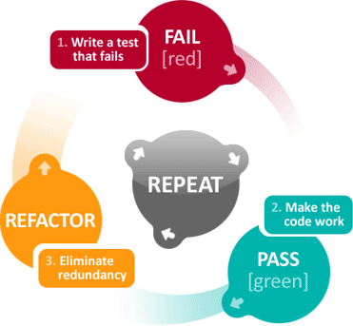
Test Driven Development (TDD)

Slide 4
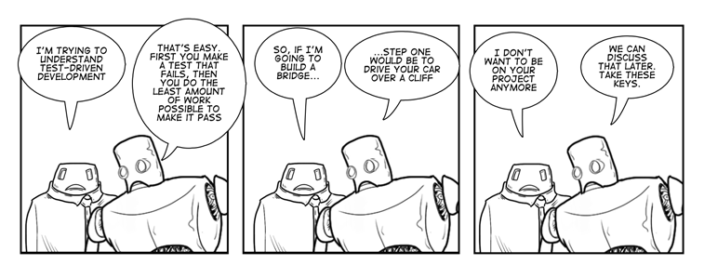

Slide 5
Practical Example
Lets practice some TDD on the following example Your project manager at BusyBody Inc says he needs a feature implemented which determines the total amount of time a worker at the company spends at their desk. He says the number of hours each day is already being measured and is stored in an internal array in the code base.

Slide 6
Practical Example
How do we solve this?
Compute the sum!

Slide 7
Practical Example
First we write a test
in other words, set up the scaffolding of the code instead of a function which you don’t know if it works or not – and continue to struggle finding bugs
public static double sum(double[] arr) {
return Double.POSITIVE_INFINITY; //note this clearly does not work and is thus failing
}
public static void main() {
double[] arr = {0, 1, 1, 2, 3, 5, 8};
if(sum(arr) != 20)
System.out.println("Test failed?!?!?! I suck!"); //you don't, its supposed to fail!
}

Slide 8
Practical Example
Before we continue, lets review
Positives
Scaffolding, function interface, and test all implemented
We know it is good design
Tests to tell if the code is correct, before we struggle with debugging many lines of code
Negatives
Code isn’t written until later…..but is that really that bad? NO
In fact, with TDD you code FASTER and more EFFECTIVELY than without it

Slide 9
Practical Example
Now the code – and then run the test!
public static double sum(double[] arr) {
double s = 0;
for(double x : arr)
s += x;
return s;
}

Slide 10
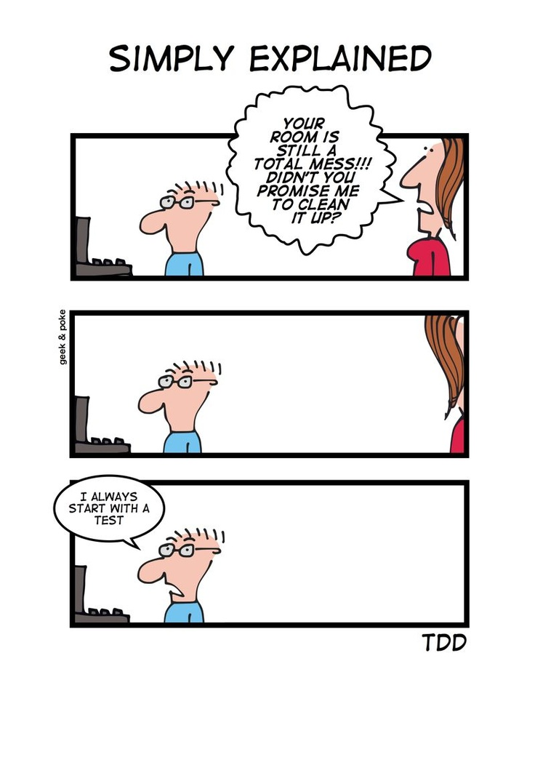
Things to remember
Always have code that compiles
Test writing is an art that takes practice (and more learning!)
Compile and test often!

Slide 11
Testing Frameworks
Many frameworks exist CppUnit, JUnit, etc.
We will be using a much more simple unit testing framework developed by me
A unit test is a check of one behavior of one “unit” (e.g., function) of your code
If you have downloaded the lab zip for today open it and look there
Follows SETT – unit testing paradigm
Setup – create data for input and predetermine the output
Execute – call the function in question
Test – analyze correctness and determine true/false for test
Teardown – cleanup any data, close buffers, etc

Slide 12
Unit test example
public static boolean testSum() {
//setup
double[] arr = {0, 1, 1, 2, 3, 5, 8};
double ans = 20;
//execute
double s = sum(arr);
//test
return s == ans;
//teardown – here is empty
}

Slide 13
TDD - Exercise
Write a Java function to find the median of an array of integers
Do test driven development, starting with a good unit test(s)
After test is created and checked, code the function
Pair program
Once completed, you should use the extra time to work on Programming Assignment 5

