Slide 1
Java Deques

Slide 2
Libraries
A library is a collection of frequently used tools to facilitate programming large applications (or other libraries)
Examples you probably have seen
java.Math
java.util.Scanner
java.util.Random
Other examples
Access to servers/databases
Graphics
Reflection ("self-aware" classes)

Slide 3
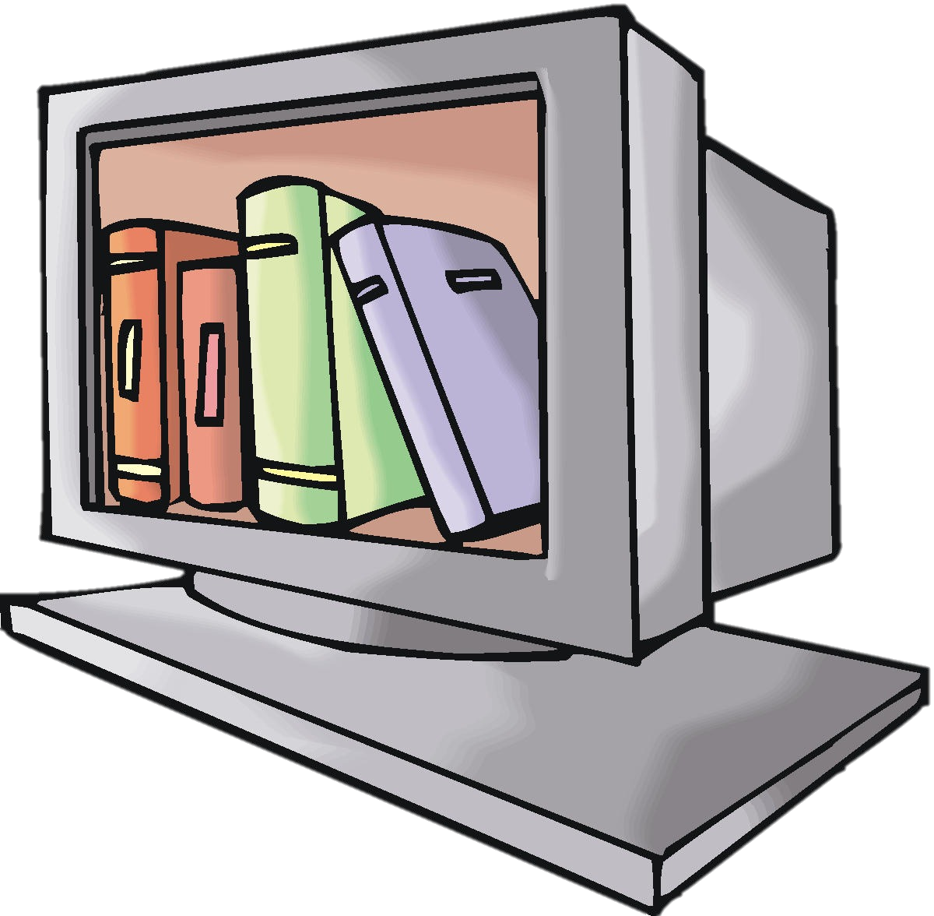
Libraries
“Truly knowing a language requires knowing the library”
“Libraries are languages”
Notes:
Mention that the purpose of the class is not just to understand big-oh and implementing data structures, but it is about expanding your Java/programming knowledge to understand what is out there and when to use it.

Slide 4
Summary of classes Concerning Stacks, Queues, and Deques
Stack<E> - Java documentation says to avoid (sort of deprecated)
ArrayDeque<E> - Growable-array using doubling strategy (supports Deque, Stack, and Queue)
Others outside the scope of this course
To find how to use them, go to the Java API!

Slide 5
Interfaces
Classes
Collection<E>
Queue<E>
Deque<E>
Iterable<E>
ArrayDeque<E>
AbstractCollection<E>
Object

Slide 6
Example of using arrayDeque<E>
Scanner s = new Scanner(new File(“numbers.txt”));
ArrayDeque<Integer> numbers = new ArrayDeque<Integer>();
while(s.hasNextInt())
numbers.add(s.nextInt());
…elsewhere…
int sum = 0;
for(int n = 0; n < numbers.size(); ++n)
sum += numbers.poll(n);

Slide 7
Problems
Rolling average (used to compute statistics for window of streaming data, e.g., miles-per-hour in a car)
Create a stream of numbers using Brownian noise between 0 and 100 (representing speed of a car)
Brownian noise is a random walk. Essentially, randomly move up or down one step ($±$0.2)
Use this to compute the rolling average of the last 100 numbers. Continually output the rolling average to the terminal for 100,000 iterations.

