Slide 1
Chapter 7 Single-Dimensional Arrays Chapter 8 MultiDimensional arrays
ACKNOWLEDGEMENT: THESE SLIDES ARE ADAPTED FROM SLIDES PROVIDED WITH Introduction to Java Programming, Liang (Pearson 2014)

Slide 2
Motivation
Read one hundred numbers, compute their average, and find out how many numbers are above the average.
Store and manipulate large amounts of data
52 playing cards in a deck
3 thousand undergrads at UR
140 characters per Tweet
4 billion nucleotides in a DNA strand
50 trillion cells in the human body
$6.022x{10}^{23}$ particles in a mole

Slide 3
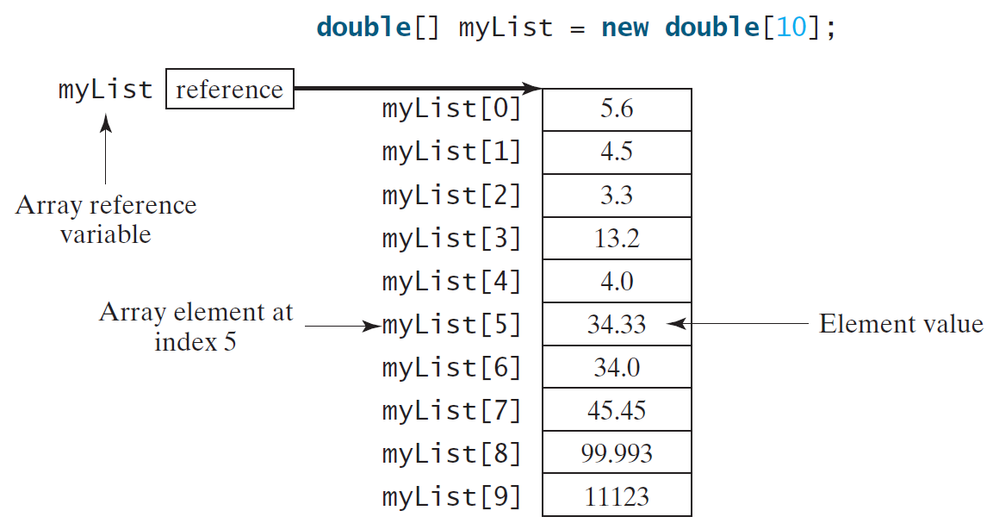
Introducing Arrays
Array is a data structure that represents a collection of the same types of data.
Array variables are references. More on this to come.

Slide 4
Declaring Array Variables
Array declaration datatype[] arrayRefVar;
Example: double[] myList;
Alternate declaration form datatype arrayRefVar[]; // This style is allowed, // but not preferred
Example: double myList[];

Slide 5
Initializing Arrays
Initializing array arrayRefVar = new datatype[arraySize];
Example: myList = new double[10];
The values of the elements are default initialized
false for Boolean types
0 or 0.0 for numeric types (integral or floating-point, respectively)
‘\u0000’ for Characters
null for Strings and object types

Slide 6
Declaring and Initializing in One Step
datatype[] arrayRefVar = new datatype[arraySize];
Example double[] myList = new double[10];
datatype arrayRefVar[] = new datatype[arraySize];
Example double myList[] = new double[10];

Slide 7
The Length of an Array
Once an array is created, its size is fixed. It cannot be changed. You can find its size using arrayRefVar.length
For example, int n = myList.length; //returns 10 based on //prior construction

Slide 8
Indexed Variables
The array elements are accessed through the index. The array indices are 0-based, i.e., it starts from 0 to arrayRefVar.length-1. In our example, myList holds ten double values and the indices are from 0 to 9.
Each element in the array is represented using the following syntax, known as an indexed variable: arrayRefVar[index];

Slide 9
Using Indexed Variables
After an array is created, an indexed variable can be used in the same way as a regular variable. For example, the following code adds the value in myList[0] and myList[1] to myList[2]. myList[2] = myList[0] + myList[1];

Slide 10
Array Initializers
You may also use array initializers to give non-default values to arrays: double[] myList = {1.9, 2.9, 3.4, 3.5};
This shorthand syntax must be in one statement. Splitting it causes a syntax error.
This shorthand notation is equivalent to the following statements:
double[] myList = new double[4];
myList[0] = 1.9;
myList[1] = 2.9;
myList[2] = 3.4;
myList[3] = 3.5;

Slide 11
Trace Problem with Arrays
int[] values = new int[5];
for(int i = 1; i < 5; i++)
values[i] = i + values[i-1];
values[0] = values[1] + values[4];
Memory
values 0xA
0xA
Index | Value
0 | 0
1 | 0
2 | 0
3 | 0
4 | 0
Declare, create, and initialize an array named values of size 5

Slide 12
Trace Problem with Arrays
int[] values = new int[5];
for(int i = 1; i < 5; i++)
values[i] = i + values[i-1];
values[0] = values[1] + values[4];
Memory
values 0xA
i 1
0xA
Index | Value
0 | 0
1 | 0
2 | 0
3 | 0
4 | 0

Slide 13
Trace Problem with Arrays
int[] values = new int[5];
for(int i = 1; i < 5; i++)
values[i] = i + values[i-1];
values[0] = values[1] + values[4];
Memory
values 0xA
i 1
0xA
Index | Value
0 | 0
1 | 0
2 | 0
3 | 0
4 | 0
i < 5 is true

Slide 14
Trace Problem with Arrays
int[] values = new int[5];
for(int i = 1; i < 5; i++)
values[i] = i + values[i-1];
values[0] = values[1] + values[4];
Memory
values 0xA
i 1
0xA
Index | Value
0 | 0
1 | 1
2 | 0
3 | 0
4 | 0
Set values[1] to 1

Slide 15
Trace Problem with Arrays
int[] values = new int[5];
for(int i = 1; i < 5; i++)
values[i] = i + values[i-1];
values[0] = values[1] + values[4];
Memory
values 0xA
i 2
0xA
Index | Value
0 | 0
1 | 1
2 | 0
3 | 0
4 | 0

Slide 16
Trace Problem with Arrays
int[] values = new int[5];
for(int i = 1; i < 5; i++)
values[i] = i + values[i-1];
values[0] = values[1] + values[4];
Memory
values 0xA
i 2
0xA
Index | Value
0 | 0
1 | 1
2 | 0
3 | 0
4 | 0
i < 5 is true

Slide 17
Trace Problem with Arrays
int[] values = new int[5];
for(int i = 1; i < 5; i++)
values[i] = i + values[i-1];
values[0] = values[1] + values[4];
Memory
values 0xA
i 2
0xA
Index | Value
0 | 0
1 | 1
2 | 3
3 | 0
4 | 0
Set values[2] to 3

Slide 18
Trace Problem with Arrays
int[] values = new int[5];
for(int i = 1; i < 5; i++)
values[i] = i + values[i-1];
values[0] = values[1] + values[4];
Memory
values 0xA
i 3
0xA
Index | Value
0 | 0
1 | 1
2 | 3
3 | 0
4 | 0

Slide 19
Trace Problem with Arrays
int[] values = new int[5];
for(int i = 1; i < 5; i++)
values[i] = i + values[i-1];
values[0] = values[1] + values[4];
Memory
values 0xA
i 3
0xA
Index | Value
0 | 0
1 | 1
2 | 3
3 | 0
4 | 0
i < 5 is true

Slide 20
Trace Problem with Arrays
int[] values = new int[5];
for(int i = 1; i < 5; i++)
values[i] = i + values[i-1];
values[0] = values[1] + values[4];
Memory
values 0xA
i 3
0xA
Index | Value
0 | 0
1 | 1
2 | 3
3 | 6
4 | 0
Set values[3] to 6

Slide 21
Trace Problem with Arrays
int[] values = new int[5];
for(int i = 1; i < 5; i++)
values[i] = i + values[i-1];
values[0] = values[1] + values[4];
Memory
values 0xA
i 4
0xA
Index | Value
0 | 0
1 | 1
2 | 3
3 | 6
4 | 0

Slide 22
Trace Problem with Arrays
int[] values = new int[5];
for(int i = 1; i < 5; i++)
values[i] = i + values[i-1];
values[0] = values[1] + values[4];
Memory
values 0xA
i 4
0xA
Index | Value
0 | 0
1 | 1
2 | 3
3 | 6
4 | 0
i < 5 is true

Slide 23
Trace Problem with Arrays
int[] values = new int[5];
for(int i = 1; i < 5; i++)
values[i] = i + values[i-1];
values[0] = values[1] + values[4];
Memory
values 0xA
i 4
0xA
Index | Value
0 | 0
1 | 1
2 | 3
3 | 6
4 | 10
Set values[4] to 10

Slide 24
Trace Problem with Arrays
int[] values = new int[5];
for(int i = 1; i < 5; i++)
values[i] = i + values[i-1];
values[0] = values[1] + values[4];
Memory
values 0xA
i 5
0xA
Index | Value
0 | 0
1 | 1
2 | 3
3 | 6
4 | 10

Slide 25
Trace Problem with Arrays
int[] values = new int[5];
for(int i = 1; i < 5; i++)
values[i] = i + values[i-1];
values[0] = values[1] + values[4];
Memory
values 0xA
i 5
0xA
Index | Value
0 | 0
1 | 1
2 | 3
3 | 6
4 | 10
i < 5 is false

Slide 26
Trace Problem with Arrays
int[] values = new int[5];
for(int i = 1; i < 5; i++)
values[i] = i + values[i-1];
values[0] = values[1] + values[4];
Memory
values 0xA
i 5
0xA
Index | Value
0 | 11
1 | 1
2 | 3
3 | 6
4 | 10
Set values[0] to 11

Slide 27
Exercises As a table
1 – Printing array of integers
2 – Summing an array of integers
3 – Finding the largest element
4 – Finding the largest index of the smallest element
1,3 – Random shuffling
2,4 – Rotate the elements by 1 index

Slide 28
Enhanced for Loop (for-each loop)
JDK 1.5 introduced a new for loop that enables you to traverse the complete array sequentially without using an index variable. For example, the following code displays all elements in the array myList: for(double value : myList) System.out.println(value);
In general, the syntax is for(elementType value : arrayRefVar) { // Process the value }
You still have to use an index variable if you wish to traverse the array in a different order or change the elements in the array.

Slide 29
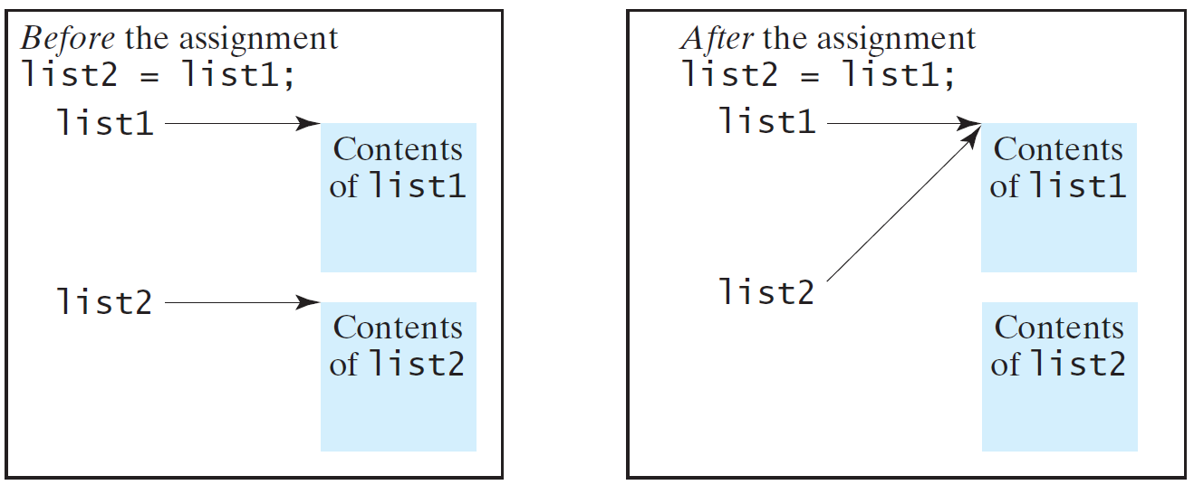
Copying Arrays
Often, in a program, you need to duplicate an array or a part of an array. In such cases you could attempt to use the assignment statement (=), as follows: list2 = list1;

Slide 30
Copying Arrays
Using a loop:
int[] sourceArray = {2, 3, 1, 5, 10};
int[] targetArray = new int[sourceArray.length];
for(int i = 0; i < sourceArrays.length; i++)
targetArray[i] = sourceArray[i];

Slide 31
Passing Arrays to Methods
public static void printArray(int[] array) {
for(int i = 0; i < array.length; i++)
System.out.print(array[i] + " ");
}
Invoke the method
int[] list = {3, 1, 2, 6, 4, 2};
printArray(list);
Invoke the method with anonymous array
printArray(new int[]{3, 1, 2, 6, 4, 2});

Slide 32
Pass By Value
Java uses pass by value to pass arguments to a method. There are important differences between passing a value of variables of primitive data types and passing arrays.
For a parameter of a primitive type value, the actual value is passed. Changing the value of the local parameter inside the method does not affect the value of the variable outside the method.
For a parameter of an array type, the value of the parameter contains a reference to an array; this reference is passed to the method. Any changes to the array that occur inside the method body will affect the original array that was passed as the argument.

Slide 33
Simple Example
public class Test {
public static void main(String[] args) {
int x = 1; // x represents an int value
int[] y = new int[10]; // y represents an array of int values
m(x, y); // Invoke m with arguments x and y
System.out.println("x is " + x);
System.out.println("y[0] is " + y[0]);
}
public static void m(int number, int[] numbers) {
number = 1001; // Assign a new value to local variable number
numbers[0] = 5555; // Assign a new value to numbers[0]
}
}

Slide 34
Call Stack
When invoking m(x, y), the values of x and y are passed to number and numbers. Since y contains the reference value to the array, numbers now contains the same reference value to the same array.

Slide 35
Heap
The JVM stores the array in an area of memory, called heap, which is used for dynamic memory allocation where blocks of memory are allocated and freed in an arbitrary order.

Slide 36
Returning an Array from a Method
int[] list1 =
{1, 2, 3, 4, 5, 6};
int[] list2 = reverse(list1);
Exercise: Trace the code. Show a detailed look at memory and how it changes.
public static int[] reverse(int[] list) {
int[] result = new int[list.length];
for (int i = 0, j = result.length - 1;
i < list.length; i++, j--) {
result[j] = list[i];
}
return result;
}

Slide 37
Exercise – Everyone code along

Slide 38
Exercise
We work for JLDiablo’s National Bank of Tristram.
We manage savings, checking, and loan accounts for the citizens of Tristram, like good ole Wirt with his peg leg.
We have all of the accounts stored in a file (accounts.txt). Each account has an id, a type, and an amount.
We are gonna write a program to compute monthly changes based on the following:
Savings earn interest of 0.01%
Loans accrue interest of 0.4%
Checking accounts hava a monthly fee of 10 gold.
After we are done, we are going to save to a new file
Banker of the Month!

Slide 39
Exercise – Start the program
import java.util.Scanner;
import java.io.File;
import java.io.FileNotFoundException;
import java.io.PrintWriter;
public class Banking {
public static void main(String[] args) throws FileNotFoundException {
String inFileName = “accounts.txt”;
String outFileName = “accounts_new.txt”;
//Read each of the accounts into arrays
//Process the account type
//Output each of the accounts into the new file
}
}

Slide 40
Exercise – Start filling out the comments into code
//Read each account into an array
Scanner in = new Scanner(new File(inFileName));
int numAccounts = in.nextInt();
String[] accountTypes = new String[numAccounts];
double[] accountValues = new double[accountValues];
for(int i = 0; i < numAccounts; ++i) {
in.nextInt();
accountTypes[i] = in.next();
accountValues[i] = in.nextDouble();
}
in.close();

Slide 41
Exercise – Compile, test, and continue
//Output each of the accounts into the new file
PrintWriter out = new PrintWriter(outFileName);
out.println(numAccounts);
for(int i = 0; i < numAccounts; ++i) {
out.printf(“%4d %8s %6.2f\n”, i, accountTypes[i], accountValues[i]);
}
out.flush();
out.close();

Slide 42
Exercise – Compile, test, and continue
//Process the account type
for(int i = 0; i < numAccounts; ++i) {
if(accountTypes[i].equals(“Savings”))
accountValues[i] *= 1.0001; //0.01% interest
else if(accountTypes[i].equals(“Checking”))
accountValues[i] -= 10; //10 gold monthly fee
else if(accountTypes[i].equals(“Loan”))
accountValues[i] *= 1.004; //0.4% interest
}

Slide 43
Exercise in pairs
Write a program that will generates a random polygon of $N=[3, 20]$ sides at random $\left(x, y\right)$ points between $\left(−10, 10\right)$ – i.e., an array. Compute the center of mass $\left({com}_{x}= \frac{Σx_{i}}{N},com_{y}=\frac{Σy_{i}}{N}\right)$. Shift all points of the polygon by $\left(−com_{x}, −com_{y}\right)$. Write the polygon (array) to a file – first line is $N$, each line after is the points (output x y, not (x, y))
Write a program that reads your polygon file and shows it to the user using StdDraw. Use a random color to show the outline and a different random color to fill the polygon.
Make another program to allow a user to draw a polygon. Have them specify the number of points in the polygon. Let the user click in the window to specify the coordinates. Draw the polygon as they go. After they are done, write the polygon to a file and cleanly exit the program. Use #2 to view the polygon again.

Slide 44
Main Method Is Just a Regular Method
You can call a regular method by passing actual parameters. Can you pass arguments to main? Of course, yes. For example, the main method in class B is invoked by a method in A, as shown below:

Slide 45
Command-Line Parameters
public class TestMain {
public static void main(String[] args) {
for(int i = 0; i < args.length; ++i)
System.out.println(
“Argument ” + i + “ is ” + args[i]);
}
}
%java TestMain arg0 arg1 arg2 ... argn

Slide 46
Exercise with a partner
Write a program that will perform binary operations on integers. The program receives three parameters: an operator and two integers.
Support erroneous input and the operators +, -, *, /, %

Slide 47
Strings revisited
Strings are arrays of char! Well sort of…
Strings ‘underneath the hood’ are arrays of char, but we use them differently
Java API for String
Use charAt(i) instead of [i]
Convert to char[] using toCharArray() and back to a String easily String s = “Hello”; char[] c = s.toCharArray(); String s2 = new String(c);
Allows more, e.g., substring() which returns a portion of the String

Slide 48
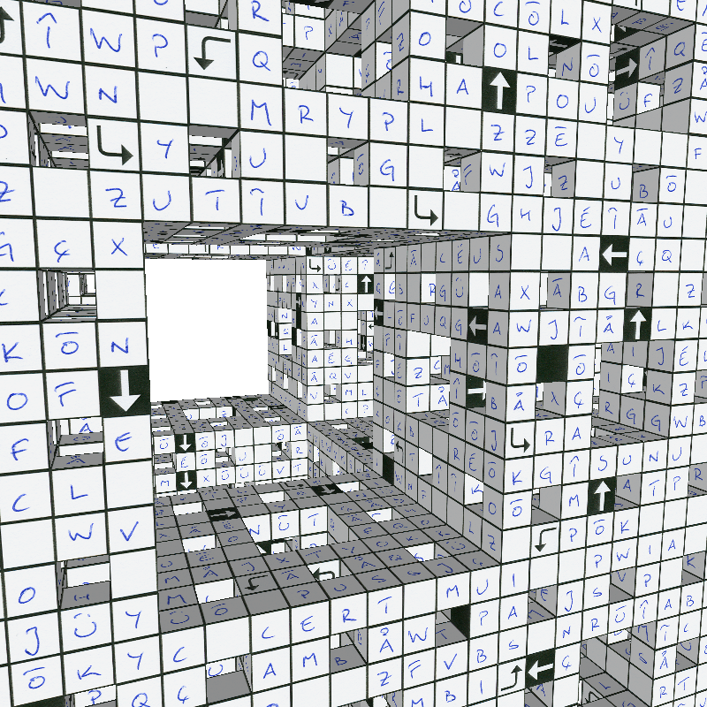
Multidimensional Arrays

Slide 49
Motivations
Thus far, you have used one-dimensional arrays to model linear collections of elements. You can use a two-dimensional array to represent a matrix or a table. For example, the following table that describes the distances between the cities can be represented using a two-dimensional array.

Slide 50
Motivations

Slide 51
Declare/Create Two-dimensional Arrays
// Declare array ref var
dataType[][] refVar;
// Create array and assign its reference to variable
refVar = new dataType[10][10];
// Combine declaration and creation in one statement
dataType[][] refVar = new dataType[10][10];
// Alternative syntax
dataType refVar[][] = new dataType[10][10];

Slide 52
DeclarE/Create Two-dimensional Arrays
int[][] matrix = new int[10][10];
//or int matrix[][] = new int[10][10];
matrix[0][0] = 3;
for(int i = 0; i < matrix.length; i++)
for(int j = 0; j < matrix[i].length; j++)
matrix[i][j] = (int)(Math.random() * 1000);

Slide 53
Two-dimensional Array Illustration
matrix.length? 5
matrix[0].length? 5
array.length? 4
array[0].length? 3

Slide 54
Declaring, Creating, and Initializing Using Shorthand Notations
You can also use an array initializer to declare, create and initialize a two-dimensional array. For example,
int[][] array = {
{ 1, 2, 3},
{ 4, 5, 6},
{ 7, 8, 9},
{10, 11, 12}
};
int[][] array = new int[4][3];
array[0][0] = 1; array[0][1] = 2; array[0][2] = 3;
array[1][0] = 4; array[1][1] = 5; array[1][2] = 6;
array[2][0] = 7; array[2][1] = 8; array[2][2] = 9;
array[3][0] = 10; array[3][1] = 11; array[3][2] = 12;
Equivalent

Slide 55
Lengths of Two-dimensional Arrays
int[][] x = new int[3][4];

Slide 56
Ragged Arrays
Each row in a two-dimensional array is itself an array. So, the rows can have different lengths. Such an array is known as a ragged array. For example,
int[][] matrix = { //matrix.length is 5
{1, 2, 3, 4, 5}, //matrix[0].length is 5
{2, 3, 4, 5}, //matrix[1].length is 4
{3, 4, 5}, //matrix[2].length is 3
{4, 5}, //matrix[3].length is 2
{5} //matrix[4].length is 1
};

Slide 57
Ragged Arrays

Slide 58
Exercise as a table
1 – Printing all elements into organized way
2 – Summing all elements
3 – Summing all elements by column into an array of sums
4 – Finding the maximum of each row into an array of maximums

Slide 59
Exercise with a pair
Write an algorithm to find the two points nearest to each other
Generalize to n-dimensional points

Slide 60
Multidimensional Arrays
Occasionally, you will need to represent n-dimensional data structures. In Java, you can create n-dimensional arrays for any integer n.
The way to declare two-dimensional array variables and create two-dimensional arrays can be generalized to declare n-dimensional array variables and create n-dimensional arrays for n >= 3.

Slide 61
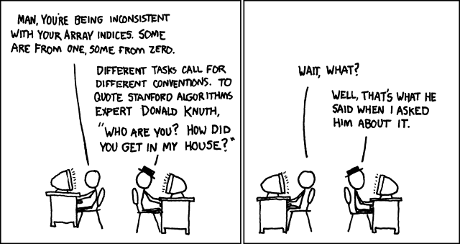
Summary
Arrays.
Organized way to store huge quantities of data.
Almost as easy to use as primitive types.
Can directly access an element given its index.
http://imgs.xkcd.com/comics/donald_knuth.png
Notes:
"You’re always off by 1 in this business." - J. MorrisBush: We're number 0
" . . . By the way, we rank 10th among the industrialized world in broadband technology and its availability. That’s not good enough for America. Tenth is 10 spots too low as far as I’m concerned. " - George W. Bush

