Slide 1
Chapter 18 Recursion
ACKNOWLEDGEMENT: THESE SLIDES ARE ADAPTED FROM SLIDES PROVIDED WITH Introduction to Java Programming, Liang (Pearson 2014)

Slide 2
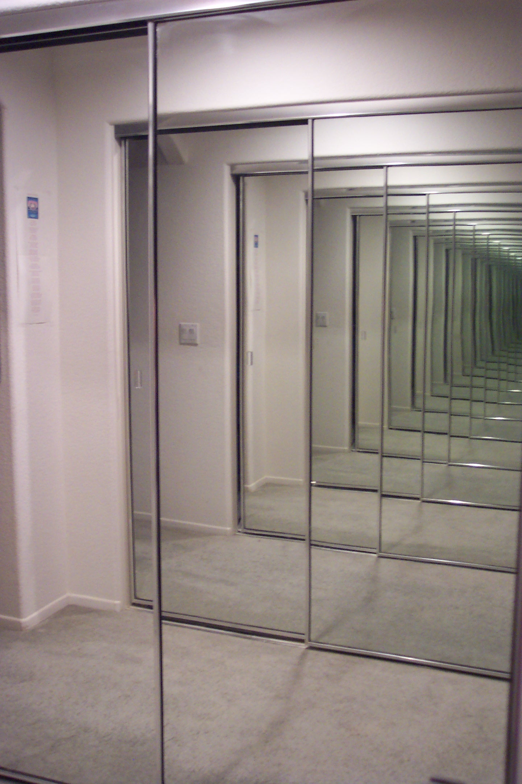
Overview
Recursion is an algorithmic technique where a function calls itself directly or indirectly.
Why learn recursion?
New mode of thinking.
Powerful programming paradigm.
Many computations are naturally self-referential.
A folder containing files and other folders.
Mathematical sequences - $f_{n+1}=f_{n}+1$ (whole numbers)
Exploring mazes – make a step in the maze, then keep exploring the maze
Notes:
Recursion and self reference are hugely important concepts in computer science and the natural world.
Escher. title = "Drawing Hands". We use title (Escher's reproductive parts) due to Bernard Chazelle.

Slide 3
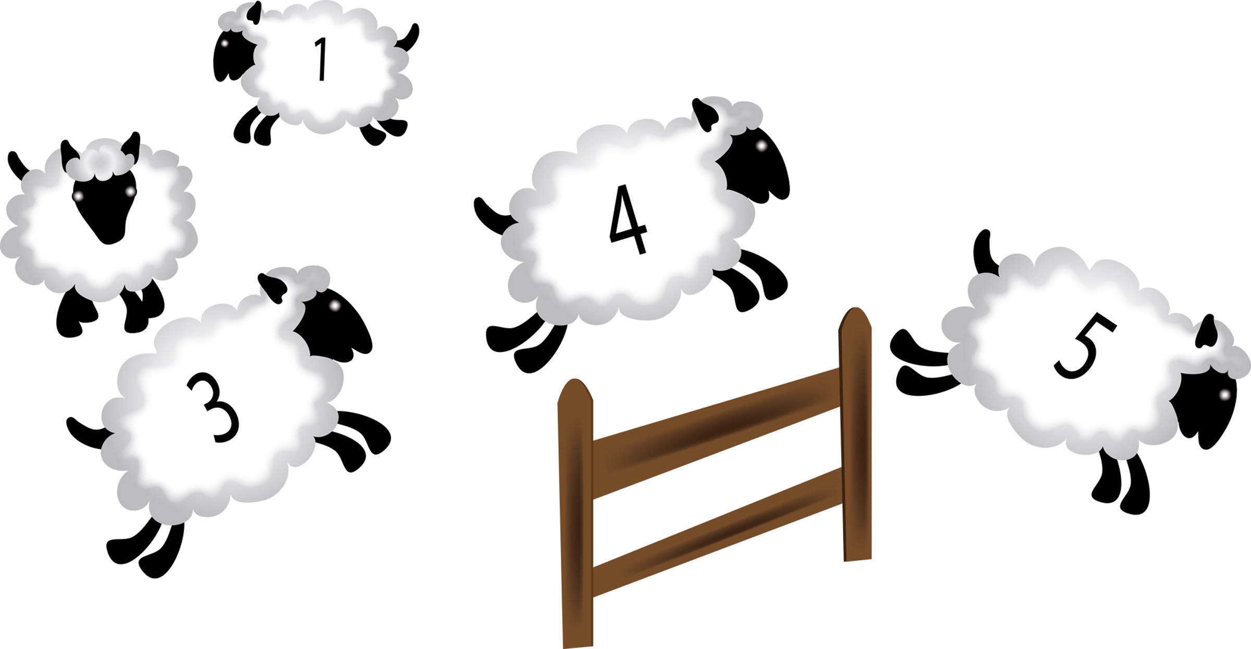
Example Counting
Lets take an example of counting from 0
The next number is the previous number plus 1, or mathematically: $f_{n}=f_{n−1}+1$, where $f_{0}=0$
So lets compute $f_{5}$
$f_{5}=f_{4}+1$, this would be great if we knew $f_{4}$, so lets expand it
$f_{5}=\left(f_{3}+1\right)+1$, then
$f_{5}=\left(\left(f_{2}+1\right)+1\right)+1$, then
$f_{5}=\left(\left(\left(f_{1}+1\right)+1\right)+1\right)+1$, then
$f_{5}=\left(\left(\left(\left(f_{0}+1\right)+1\right)+1\right)+1\right)+1$, then finally
$f_{5}=\left(\left(\left(\left(\left(0\right)+1\right)+1\right)+1\right)+1\right)+1=5$
Notes:
Make sure to explain notation.

Slide 4
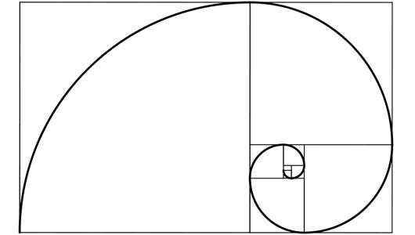
Practice Recursive Formulas Fibonacci Sequence
The Fibonacci Sequence is used in various places in mathematics and computer science $f_{n}=f_{n−1}+f_{n−2}$, where $f_{0}=0, f_{1}=1$
Expand and evaluate $f_{6}$, work with a partner and show your work
Notes:
After draw solution on the board and discuss with class

Slide 5
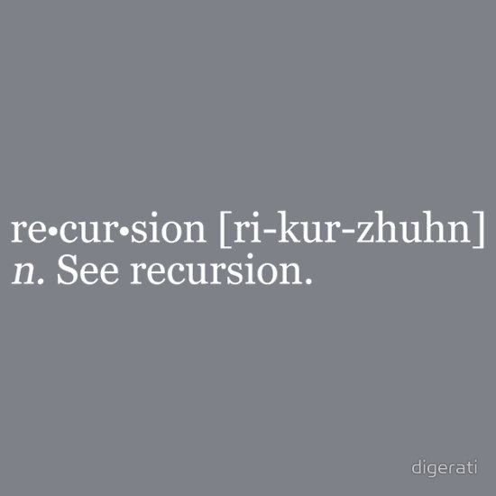
How do we do recursion in code?
Simply call the function within its own body
public static void foo() {
//possibly do some stuff
foo(); //This example of recursion
//prossibly do some more stuff
}

Slide 6
Example Counting
//This function counts using recursion
public static int recursiveCount(int n) {
//$f_{0}=0$
if(n == 0)
return 0;
//$f_{n}=f_{n−1}+1$
return recursiveCount(n-1) + 1;
}
Together lets trace System.out.println(recursiveCount(3));
recursiveCount(3)
return recursiveCount(2) + 1
return recursiveCount(1) + 1;
return recursiveCount(0) + 1;
return 0;
return 0 + 1;
return 1 + 1;
return 2 + 1;
3

Slide 7
Practice Recursive Code Fibonacci Sequence
Write a Java function Fibonacci for $f_{n}=f_{n−1}+f_{n−2}$
public static int Fibonacci(int n) {
if(n == 0) return 0;
if(n == 1) return 1;
return Fibonacci(n-1) + Fibonacci(n-2);
}
Practice tracing Fibonacci(3)
Fibonacci(3)
return Fibonacci(2) + Fibonacci(1);
return Fibonacci(1) + Fibonacci(0);
return 1;
return 1 + Fibonacci(0);
return 0;
return 1 + 0;
return 1 + Fibonacci(1);
return 1;
return 1 + 1;
2
Notes:
Work with them on the board and then go through slides

Slide 8
Characteristics of Recursion
All recursive methods have the following characteristics:
One or more base cases (the simplest case) are used to stop recursion.
Every recursive call reduces the original problem, bringing it increasingly closer to a base case until it becomes that case.
In general, to solve a problem using recursion, you break it into subproblems. If a subproblem resembles the original problem, you can apply the same approach to solve the subproblem recursively. This subproblem is almost the same as the original problem in nature with a smaller size.

Slide 9
Designing Recursive Functions
Identify the base case
The base case is the part of the recursion not defined in terms of itself, e.g., $f_{0}=0, f_{1}=1$
This is when the recursion stops! If you forget your base case, then the world will end
Really an infinite series of function calls until your computer crashes (if it ever does)
Identify the recursive process
This is the algorithmic process or algorithmic formula
Write the code

Slide 10
Practice Designing Recursive Functions Greatest Common Denominator (GCD)
GCD
For two integers $p$ and $q$, if $q$ divides $p$ then the GCD of $p$ and $q$ is q
Otherwise the GCD of $p$ and $q$ is the same as $q$ and $p\%q$
Step 1: Identify the base case
$q=0$ implies that the GCD is $p$
Step 2: Identify the recursive step
$GCD(q, p\%q)$
Step 3: Code
public static int gcd( int p, int q) {
if(q == 0) return p;
return gcd(q, p%q);
}
Notes:
Write mathematical definition of the piecewise function on the board

Slide 11
Recursive GCD Demo
public class Euclid {
public static int gcd(int p, int q) {
if (q == 0) return p;
else return gcd(q, p % q);
}
public static void main(String[] args) {
System.out.println(gcd(1272, 216));
}
}

Slide 12
p = 1272, q = 216
static int gcd(int p, int q) {
if (q == 0) return p;
else return gcd(q, p % q);
}
gcd(1272, 216)
Memory gcd call - 1

Slide 13
p = 1272, q = 216
static int gcd(int p, int q) {
if (q == 0) return p;
else return gcd(q, p % q);
}
gcd(1272, 216)
Memory gcd call - 1

Slide 14
p = 1272, q = 216
static int gcd(int p, int q) {
if (q == 0) return p;
else return gcd(q, p % q);
}
gcd(1272, 216)
Memory gcd call - 1

Slide 15
p = 1272, q = 216
static int gcd(int p, int q) {
if (q == 0) return p;
else return gcd(q, p % q);
}
gcd(1272, 216)
Memory gcd call - 1
1272 = 216 × 5 + 192
p = 216, q = 192
static int gcd(int p, int q) {
if (q == 0) return p;
else return gcd(q, p % q);
}
gcd(216, 192)
Memory gcd call - 2

Slide 16
p = 1272, q = 216
static int gcd(int p, int q) {
if (q == 0) return p;
else return gcd(q, p % q);
}
gcd(1272, 216)
Memory gcd call - 1
p = 216, q = 192
static int gcd(int p, int q) {
if (q == 0) return p;
else return gcd(q, p % q);
}
gcd(216, 192)
Memory gcd call - 2

Slide 17
p = 1272, q = 216
static int gcd(int p, int q) {
if (q == 0) return p;
else return gcd(q, p % q);
}
gcd(1272, 216)
Memory gcd call - 1
p = 216, q = 192
static int gcd(int p, int q) {
if (q == 0) return p;
else return gcd(q, p % q);
}
gcd(216, 192)
Memory gcd call - 2

Slide 18
p = 1272, q = 216
static int gcd(int p, int q) {
if (q == 0) return p;
else return gcd(q, p % q);
}
gcd(1272, 216)
Memory gcd call - 1
p = 216, q = 192
static int gcd(int p, int q) {
if (q == 0) return p;
else return gcd(q, p % q);
}
gcd(216, 192)
Memory gcd call - 2
p = 192, q = 24
static int gcd(int p, int q) {
if (q == 0) return p;
else return gcd(q, p % q);
}
gcd(192, 24)
Memory gcd call - 3

Slide 19
p = 1272, q = 216
static int gcd(int p, int q) {
if (q == 0) return p;
else return gcd(q, p % q);
}
gcd(1272, 216)
Memory gcd call - 1
p = 216, q = 192
static int gcd(int p, int q) {
if (q == 0) return p;
else return gcd(q, p % q);
}
gcd(216, 192)
Memory gcd call - 2
p = 192, q = 24
static int gcd(int p, int q) {
if (q == 0) return p;
else return gcd(q, p % q);
}
gcd(192, 24)
Memory gcd call - 3

Slide 20
p = 1272, q = 216
static int gcd(int p, int q) {
if (q == 0) return p;
else return gcd(q, p % q);
}
gcd(1272, 216)
Memory gcd call - 1
p = 216, q = 192
static int gcd(int p, int q) {
if (q == 0) return p;
else return gcd(q, p % q);
}
gcd(216, 192)
Memory gcd call - 2
p = 192, q = 24
static int gcd(int p, int q) {
if (q == 0) return p;
else return gcd(q, p % q);
}
gcd(192, 24)
Memory gcd call - 3

Slide 21
p = 1272, q = 216
static int gcd(int p, int q) {
if (q == 0) return p;
else return gcd(q, p % q);
}
gcd(1272, 216)
Memory gcd call - 1
p = 216, q = 192
static int gcd(int p, int q) {
if (q == 0) return p;
else return gcd(q, p % q);
}
gcd(216, 192)
Memory gcd call - 2
p = 192, q = 24
static int gcd(int p, int q) {
if (q == 0) return p;
else return gcd(q, p % q);
}
gcd(192, 24)
Memory gcd call - 3
p = 24, q = 0
static int gcd(int p, int q) {
if (q == 0) return p;
else return gcd(q, p % q);
}
gcd(24, 0)
Memory gcd call - 4

Slide 22
p = 1272, q = 216
static int gcd(int p, int q) {
if (q == 0) return p;
else return gcd(q, p % q);
}
gcd(1272, 216)
Memory gcd call - 1
p = 216, q = 192
static int gcd(int p, int q) {
if (q == 0) return p;
else return gcd(q, p % q);
}
gcd(216, 192)
Memory gcd call - 2
p = 192, q = 24
static int gcd(int p, int q) {
if (q == 0) return p;
else return gcd(q, p % q);
}
gcd(192, 24)
Memory gcd call - 3
p = 24, q = 0
static int gcd(int p, int q) {
if (q == 0) return p;
else return gcd(q, p % q);
}
gcd(24, 0)
Memory gcd call - 4

Slide 23
p = 1272, q = 216
static int gcd(int p, int q) {
if (q == 0) return p;
else return gcd(q, p % q);
}
gcd(1272, 216)
Memory gcd call - 1
p = 216, q = 192
static int gcd(int p, int q) {
if (q == 0) return p;
else return gcd(q, p % q);
}
gcd(216, 192)
Memory gcd call - 2
p = 192, q = 24
static int gcd(int p, int q) {
if (q == 0) return p;
else return gcd(q, p % q);
}
gcd(192, 24)
Memory gcd call - 3
p = 24, q = 0
24
static int gcd(int p, int q) {
if (q == 0) return p;
else return gcd(q, p % q);
}
gcd(24, 0)
Memory gcd call - 4

Slide 24
p = 1272, q = 216
static int gcd(int p, int q) {
if (q == 0) return p;
else return gcd(q, p % q);
}
gcd(1272, 216)
Memory gcd call - 1
p = 216, q = 192
static int gcd(int p, int q) {
if (q == 0) return p;
else return gcd(q, p % q);
}
gcd(216, 192)
Memory gcd call - 2
p = 192, q = 24
static int gcd(int p, int q) {
if (q == 0) return p;
else return gcd(q, p % q);
}
gcd(192, 24)
Memory gcd call - 3
24

Slide 25
p = 1272, q = 216
static int gcd(int p, int q) {
if (q == 0) return p;
else return gcd(q, p % q);
}
gcd(1272, 216)
Memory gcd call - 1
p = 216, q = 192
static int gcd(int p, int q) {
if (q == 0) return p;
else return gcd(q, p % q);
}
gcd(216, 192)
Memory gcd call - 2
p = 192, q = 24
24
static int gcd(int p, int q) {
if (q == 0) return p;
else return gcd(q, p % q);
}
gcd(192, 24)
Memory gcd call - 3
24

Slide 26
p = 1272, q = 216
static int gcd(int p, int q) {
if (q == 0) return p;
else return gcd(q, p % q);
}
gcd(1272, 216)
Memory gcd call - 1
p = 216, q = 192
static int gcd(int p, int q) {
if (q == 0) return p;
else return gcd(q, p % q);
}
gcd(216, 192)
Memory gcd call - 2
24

Slide 27
p = 1272, q = 216
static int gcd(int p, int q) {
if (q == 0) return p;
else return gcd(q, p % q);
}
gcd(1272, 216)
Memory gcd call - 1
p = 216, q = 192
24
static int gcd(int p, int q) {
if (q == 0) return p;
else return gcd(q, p % q);
}
gcd(216, 192)
Memory gcd call - 2
24

Slide 28
p = 1272, q = 216
static int gcd(int p, int q) {
if (q == 0) return p;
else return gcd(q, p % q);
}
gcd(1272, 216)
Memory gcd call - 1
24

Slide 29
p = 1272, q = 216
static int gcd(int p, int q) {
if (q == 0) return p;
else return gcd(q, p % q);
}
gcd(1272, 216)
Memory gcd call - 1
24
public class Euclid {
public static int gcd(int p, int q) {
if (q == 0) return p;
else return gcd(q, p % q);
}
public static void main(String[] args) {
System.out.println(gcd(p, q));
}
}
24
24

Slide 30
Recursive Helper methods
Many of the problems presented in the early chapters can be solved using recursion if you think recursively. For example, the palindrome problem can be solved recursively as follows:
public static boolean isPalindrome(String s) {
if (s.length() <= 1) // Base case
return true;
else if (s.charAt(0) != s.charAt(s.length() - 1)) // Base case
return false;
else
return isPalindrome(s.substring(1, s.length() - 1));
}

Slide 31
Recursive Helper Methods
The preceding recursive isPalindrome method is not efficient, because it creates a new string for every recursive call. To avoid creating new strings, use a helper method:
public static boolean isPalindrome(String s) {
return isPalindrome(s, 0, s.length() - 1);
}
public static boolean isPalindrome(String s, int low, int high) {
if (high <= low) // Base case
return true;
else if (s.charAt(low) != s.charAt(high)) // Base case
return false;
else
return isPalindrome(s, low + 1, high - 1);
}

Slide 32
Exercise – Program Together
Download StdDraw – lets draw a tree!

Slide 33
Code
import java.util.Scanner;
public class Tree {
public static void drawTree(int o) {
drawTree(o, 0., 0., 60, Math.PI/2, 35*Math.PI/180);
}
public static void drawTree( int o, double x, double y, double l,
double t1, double t2) {
if(o < 0) return;
double x2 = x + l * Math.cos(t1);
double y2 = y + l * Math.sin(t1);
StdDraw.line(x, y, x2, y2);
drawTree(o - 1, x2, y2, l*0.6, t1 + t2, t2);
drawTree(o - 1, x2, y2, l*0.6, t1 - t2, t2);
}
public static void main(String args[]) {
Scanner in = new Scanner(System.in);
System.out.print("Enter an order: ");
int order = in.nextInt();
StdDraw.setXscale(-200, 200);
StdDraw.setYscale(0, 400);
StdDraw.enableDoubleBuffering();
drawTree(order);
StdDraw.show();
}
}

Slide 34
Downside of Recursion
F(50)
Recursion is not always efficient!
Take for instance, the Fibonacci sequence
public static long F(int n) {
if (n == 0) return 0;
if (n == 1) return 1;
return F(n-1) + F(n-2);
}
F(49)
F(48)
F(48)
F(47)
F(47)
F(46)
F(47)
F(46)
F(46)
F(45)
F(46)
F(45)
F(45)
F(44)
recursion tree for naïve Fibonacci function
F(50) is called once.
F(49) is called once.
F(48) is called 2 times.
F(47) is called 3 times.
...
F(1) is called 12,586,269,025 times.
Notes:
Ask students how many calls to different F() values there are.

Slide 35
Best Practice Convert Recursive Algorithms to Iterative Ones
Try to do this whenever possible
Example Fibonacci Sequence
//This is an example conversion. You can be even more efficient!
public static long F(int n) {
if (n == 0) return 0;
if (n == 0) return 1;
int fn2 = 0;
int fn1 = 1;
int fn = 1;
// Iterative means repetition until failure condition,
// typically done with loops and not recursion
for (int i = 2; i <= n; i++) {
fn = fn1 + fn2;
fn2 = fn1;
fn1 = fn;
}
return fn;
}
Notes:
Example reusing computed values. Explain what iterative means. Trace through code with students.

Slide 36
OR Do tail recursion
Tail recursion is when the last operation of a function is the recursive call
Example with factorial: $f_{n}=n∗f_{n−1}$
public static long factorial( int n) {
if(n == 0) return 1;
else
return n*factorial(n-1);
}
public static long factorial( int n) {
return factorial(n, 1);
}
public static long factorial( int n, int result) {
if(n == 0) return result;
else
return factorial( n – 1, n * result);
}

Slide 37
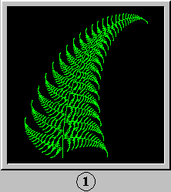
Summary
How to write simple recursive programs?
Base case, reduction step.
Trace the execution of a recursive program.
Why learn recursion?
New mode of thinking.
Powerful programming tool

Slide 38
Towers of Hanoi
http://en.wikipedia.org/wiki/Image:Hanoiklein.jpg

Slide 39
Practice Towers of Hanoi
Design recursive algorithm to move all the discs from the leftmost peg to the rightmost one.
Only one disc may be moved at a time.
A disc can be placed either on empty peg or on top of a larger disc.
start
finish
Notes:
Edouard Lucas invented Towers of Hanoi puzzle (1883)

Slide 40
Solution Towers of Hanoi
Move n-1 smallest discs right.
Move largest disc right.
Move n-1 smallest discs right.
Notes:
After this slide, let them try to write code.

Slide 41
Code Towers of Hanoi
public class TowersOfHanoi {
public static void moves(int n,
char from, char to, char aux) {
if (n == 0) return;
moves(n-1, from, aux, to);
System.out.printf(“Move disk %d from peg %c to peg %c”, n, from, to);
moves(n-1, aux, to, from);
}
public static void main(String[] args) {
moves(3, ‘A’, ‘C’, ‘B’);
}
}
Notes:
The task of moving n discs from between two different poles is similar but requires ability to move stack in either direction.
Note also that placement of bigger discs does not interfere with movement of smaller discs

Slide 42
Recursion Tree (Function trace) Towers of Hanoi
3, true
1
14
15
28
2, false
2, false
2
7
8
13
16
21
22
27
1, true
1, true
1, true
1, true
3
4
5
6
9
10
11
12
17
18
19
20
23
24
25
26
1 left
2 right
1 left
3 left
1 left
2 right
1 left

