Slide 1
Chapter 5 Loops
ACKNOWLEDGEMENT: THESE SLIDES ARE ADAPTED FROM SLIDES PROVIDED WITH Introduction to Java Programming, Liang (Pearson 2014)

Slide 2
Control Flow
Control flow.
Sequence of statements that are actually executed in a program.
Conditionals and loops: enable us to choreograph control flow.
boolean 1
statement 1
true
false
statement 2
statement 1
boolean 2
true
statement 2
statement 3
false
statement 4
statement 3
straight-line control flow
control flow with conditionals and loops
Notes:
straight-line programs: akin to calculator

Slide 3
Motivations
Suppose that you need to print a string (e.g., "Welcome to Java!") a hundred times. It would be tedious to have to write the following statement a hundred times: System.out.println("Welcome to Java!"); So, how do you solve this problem?
How about altering our guessing game program to allow 20 tries?

Slide 4
Opening Problem
System.out.println("Welcome to Java!");
System.out.println("Welcome to Java!");
System.out.println("Welcome to Java!");
System.out.println("Welcome to Java!");
System.out.println("Welcome to Java!");
System.out.println("Welcome to Java!");
…
System.out.println("Welcome to Java!");
System.out.println("Welcome to Java!");
100 times

Slide 5
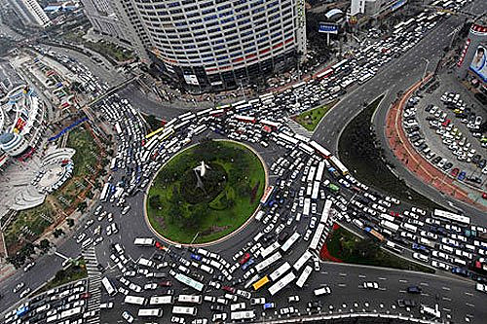
The While Loop

Slide 6
Introducing while Loops
int count = 0;
while(count < 100) {
System.out.println("Welcome to Java");
count++;
}

Slide 7
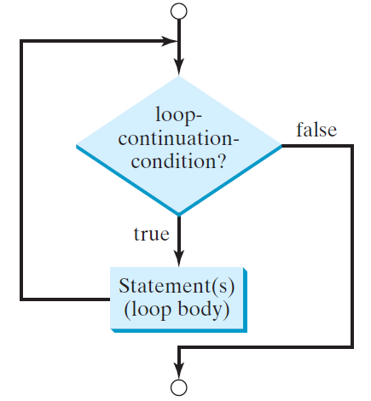
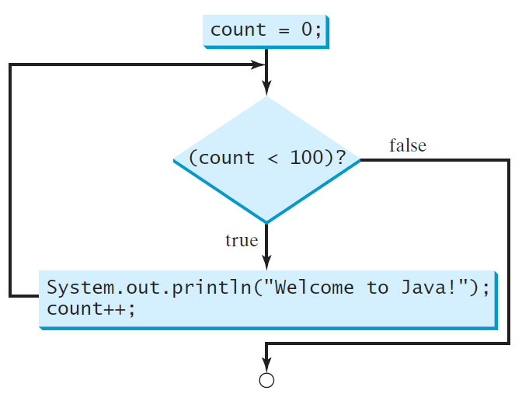
while Loop Flow Chart
while (loop-continuation-condition) {
// loop-body;
Statement(s);
}
int count = 0;
while(count < 100) {
System.out.println("Welcome to Java!");
count++;
}

Slide 8
While loop in Pseudocode
while loop-continuation-condition do
loop-body

Slide 9
Tracing While loops
int count = 0;
while(count < 2) {
System.out.println("Welcome to Java");
count++;
}
Initialize Count
Memory
Count 0

Slide 10
Tracing While loops
int count = 0;
while(count < 2) {
System.out.println("Welcome to Java");
count++;
}
Count < 2 is true
Memory
Count 0

Slide 11
Tracing While loops
int count = 0;
while(count < 2) {
System.out.println("Welcome to Java");
count++;
}
Output
Memory
Count 0

Slide 12
Tracing While loops
int count = 0;
while(count < 2) {
System.out.println("Welcome to Java");
count++;
}
Increment count
Memory
Count 1

Slide 13
Tracing While loops
int count = 0;
while(count < 2) {
System.out.println("Welcome to Java");
count++;
}
Count < 2 is true
Memory
Count 1

Slide 14
Tracing While loops
int count = 0;
while(count < 2) {
System.out.println("Welcome to Java");
count++;
}
Output
Memory
Count 1

Slide 15
Tracing While loops
int count = 0;
while(count < 2) {
System.out.println("Welcome to Java");
count++;
}
Increment count
Memory
Count 2

Slide 16
Tracing While loops
int count = 0;
while(count < 2) {
System.out.println("Welcome to Java");
count++;
}
Count < 2 is false
Memory
Count 2

Slide 17
Tracing While loops
int count = 0;
while(count < 2) {
System.out.println("Welcome to Java");
count++;
}
Continue after closing }
Memory
Count 2

Slide 18
Examples – With A partner
What does are the values of $n$ and $m$ after this: int n = 1234567; int m = 0; while(n != 0) { m = (10*m) + (n % 10); n /= 10; }
Show the trace of the program at each step

Slide 19
Question
What is wrong with the following code?
What happens?
Fix it and explain what the code outputs
int i = 0;
while (i <= N)
System.out.println(i);
i = i + 5;
Notes:
YES. Need braces around statements in while loop.
Indentation does not imply braces!Without braces, program enters an infinite loop printing "0 1"s.
Beginning programmer's first moment of panic: how to stop it?

Slide 20
Activity
Write an algorithm (in pseudocode! NOT JAVA) to compute the number of digits an integer has.
Example: input – 34567 output – 5
Bonus: modify your algorithm to compute the number of “digits” for any base, e.g., binary, octal, or hexadecimal

Slide 21
Exercise – Fix the Guessing Game
Lets fix our guessing game program to allow 20 correct guess. We will protect against bad input!
Program this together
If you get lost program is on following slides (split into multiple slides)

Slide 22
Exercise – Fix the guessing game
import java.util.Scanner;
import java.util.Random;
public class GuessingGame {
public static void main(String[] args) {
Scanner in = new Scanner(System.in);
Random rand = new Random();
int r = rand.nextInt(100) + 1;
int guess = -1;
int guesses = 0;
//… continue on next slide
}
}

Slide 23
Exercise – Fix the guessing game
while(guess != r && guesses < 20) {
//… Continue on next slide
}
if(guesses >= 20)
System.out.println(“You lost. ” +
“Out of guesses. ” +
“The correct number is ” + r + “.”);

Slide 24
Exercise – Fix the guessing game
System.out.print(“Enter a guess: ”);
if(in.hasNextInt()) {
//… Continued on next slide
}
else {
System.out.println(“Please enter a number.”);
in.next();
}

Slide 25
Exercise – Fix the guessing game
guess = in.nextInt();
if(guess < 1 || guess > 100)
System.out.println(“Invalid guess.”);
else if(guess == r)
System.out.println(“You won.”);
else if(guess < r) {
System.out.println(“Too low.”);
++guesses;
}
else {
System.out.println(“Too high.”);
++guesses;
}

Slide 26
Caution
Don’t use floating-point values for equality checking in a loop control. Since floating-point values are approximations for some values, using them could result in imprecise counter values and inaccurate results. Consider the following code for computing 1 + 0.9 + 0.8 + ... + 0.1:
double item = 1; double sum = 0;
while (item != 0) { // No guarantee item will be 0
sum += item;
item -= 0.1;
}
System.out.println(sum);

Slide 27
Exercise – with a partner
Random walk. You begin standing at the center of a disk of radius $r$. At each time-step you pick a random direction in with respect to the $x$-axis and take a step of 1 meter. How many steps did it take you to fall off?
Start at $\left(x, y\right)=\left(0, 0\right)$; *YES DECIMAL PLACES ARE ALLOWED*
Randomly generate theta $θ∈\left[0,2π\right)$
Then your new position $\left(x, y\right)=\left(x+\cos\left(θ\right), y+\sin\left(θ\right)\right)$
Start by planning you algorithm. Then implement it.
This question has applications to simulating cellular and molecular systems.

Slide 28
Aside - Formatting output
There is too much to cover in one slide, so here is a link to help
Basics
Use System.out.printf() or System.out.format()
Their first argument is a string. Each time a % appears in the string, it is a directive to substitute it for a variable value. Attach each value after the string (comma separated) System.out.printf(“Hello %s”, “World”);
Use \n in the string to add a new line
%
%s – String
%b – Boolean
%d – Integer
%f – Float/double
Etc.
Examples
System.out.printf(“My int: %d”, a);
System.out.printf(“My float: %f”, d);

Slide 29
Aside - Formatting output
The power of printf!
Can control field width – how many characters are used to output item
Can right justify text
Example %5d – always uses 5 characters to output an integer. Beginning would be white space, not zeroes
Can also do the same on other types. Floats can determine number of decimal places: %5.7f means 5 characters before the decimal and 7 after
The possibilities become infinite
public class PlayWithFormat {
public static void main(String args[]) {
System.out.printf(“%5.7f\n”, 3.14159);
}
}

Slide 30
Exercise – Together
Starters: You work for JLDiablo Consultants Inc., which specializes in making software for Casino games (Cha-ching! $$$$). A new casino in Reno needs a slot game called Binary Slots 101010.
How it works:
A player enters a bet of their choice
Three Boolean values are randomly generated
If they are all true, then the player earns twice their money back!

Slide 31
Exercise – Where to begin
When developing programs
Always think first!
Sketch out solution, i.e., plan
Implement solution
Test solution
Repeat!
Called iterative development
Plan
Implement
Test

Slide 32
Exercise – Start the program
public class BinarySlots101010 {
public static void main(String[] args) {
System.out.println(
“Welcome to Binary Slots 101010!\n\n\n”);
}
}

Slide 33
Exercise – Get bet
import java.util.Scanner;
public class BinarySlots101010 {
public static void main(String[] args) {
System.out.println(“Welcome to Binary Slots 101010!\n\n\n”);
System.out.print(“Please enter your bet: ”);
Scanner in = new Scanner(System.in);
double bet = in.nextDouble();
System.out.printf(“Your bet is $.2f\n\n”, bet);
}
}

Slide 34
Exercise – Get bet robustly
import java.util.Scanner;
public class BinarySlots101010 {
public static void main(String[] args) {
System.out.println(“Welcome to Binary Slots 101010!\n\n\n”);
System.out.print(“Please enter your bet: ”);
Scanner in = new Scanner(System.in);
while(!in.hasNextDouble()) {
System.out.println(“Please enter a valid bet: ”);
in.next(); //Remember to eat up (read) bad input…
}
double bet = in.nextDouble();
System.out.printf(“Your bet is $.2f\n\n”, bet);
//… continued on next slide
}
}

Slide 35
Exercise – Game logic
System.out.println(“Spinning….match all to win!\n”);
boolean a = Math.random() < 0.5,
b = Math.random() < 0.5,
c = Math.random() < 0.5;
System.out.println(“Binary slots: ” + a + “ ” + b + “ ” + c + “\n”);
if(a && b && c)
System.out.printf(“You win 2x your bet! You won $%.2f\n”, 2*bet);
else
System.out.println(“Sorry you lose…”);

Slide 36
Visual Display for Slot machine

Slide 37
Animation
(1, 1)
Animation loop. Repeat the following:
Clear the screen.
Move the object.
Draw the object.
Display and pause for a short while.
Ex. Bouncing ball.
Ball has position (rx, ry) and constant velocity (vx, vy).
Detect collision with wall and reverse velocity.
(vx, vy)
(rx, ry)
(-1, -1)
Notes:
apply a standard graphics technique to create the illusion of movement

Slide 38
Bouncing Ball
public class BouncingBall {
public static void main(String[] args) {
double rx = .480, ry = .860; //x, y position
double vx = .015, vy = .023; //x, y velocity
double radius = .05; //radius of ball
StdDraw.setXscale(-1.0, 1.0);
StdDraw.setYscale(-1.0, 1.0); //Set coordinate system
while(true) { //Simulation loop
if (Math.abs(rx + vx) + radius > 1.0) vx = -vx; //Update ball velocity if at the boundary
if (Math.abs(ry + vy) + radius > 1.0) vy = -vy;
rx = rx + vx; ry = ry + vy; //Update position (add velocity)
StdDraw.setPenColor(StdDraw.GRAY); //Clear screen
StdDraw.filledSquare(0.0, 0.0, 1.0);
StdDraw.setPenColor(StdDraw.BLACK); //Render ball
StdDraw.filledCircle(rx, ry, radius);
StdDraw.show(); StdDraw.pause(20); //Pause for 20ms so that we can see it nicely
}
}
}
Notes:
Doug suggests running with Color.black instead of Color.gray. Since the ball is drawn in black, nothing will appear to move. Then add System.out.println to show ball is moving, and finally add StdDraw.play("audio debug") to show ball is colliding. At this point ask students why it is broken?

Slide 39
Exercise – Initialization step
//Initialization. Add this before anything
StdDraw.setCanvasSize(600, 600); // Resize the window
StdDraw.setXscale(-100, 100); //Redefine coordinate system
StdDraw.setYscale(-100, 100);
StdDraw.enableDoubleBuffering(); //Allows for smooth animation

Slide 40
Exercise – Game loop
//Play game until quit ‘p’ is pressed. We will inject game logic into this
while(true) {
//Wait for key press
while(!StdDraw.hasNextKeyTyped()) {
StdDraw.show();
StdDraw.pause(33);
}
char key = StdDraw.nextKeyTyped();
if(key == 'q')
break;
}
System.exit(0);

Slide 41
Exercise – Before the key pressed. Show a message for user to start the game
//Draw slot machine.
StdDraw.textRight(90, -70, "Binary Slots 101!");
StdDraw.textRight(90, -80, "Match 3 to win");
StdDraw.textRight(90, -90, "Press a key to play. Q to quit.");
StdDraw.circle(-55, -5, 10);
StdDraw.circle(-5, -5, 10);
StdDraw.circle(45, -5, 10);

Slide 42
Exercise – Now we can do our main game loop
//Simulate spin. Randomly switch color of circles
boolean a = false, b = false, c = false; int i = 1;
while(i <= 30) {
StdDraw.clear(); //Clear
StdDraw.textRight(90, -70, "Binary Slots 101!"); //Redraw text
StdDraw.textRight(90, -80, "Match 3 to win");
a = Math.random() < 0.5; b = Math.random() < 0.5; c = Math.random() < 0.5; //Simulate game
if(a) StdDraw.setPenColor(StdDraw.BLUE); //Draw all the circles
else StdDraw.setPenColor(StdDraw.RED);
StdDraw.filledCircle(-55, -5, 10);
if(b) StdDraw.setPenColor(StdDraw.BLUE);
else StdDraw.setPenColor(StdDraw.RED);
StdDraw.filledCircle(-5, -5, 10);
if(c) StdDraw.setPenColor(StdDraw.BLUE);
else StdDraw.setPenColor(StdDraw.RED);
StdDraw.filledCircle(45, -5, 10);
StdDraw.setPenColor(StdDraw.BLACK);
StdDraw.circle(-55, -5, 10); StdDraw.circle(-5, -5, 10); StdDraw.circle(45, -5, 10);
StdDraw.show(); //Render
StdDraw.pause(i++*10); //Pause
}

Slide 43
Exercise – Finish off with a final message
//Draw final slot machine
StdDraw.pause(1000);
if(a && b && c)
StdDraw.text(-20, 50, "You win!");
else
StdDraw.text(-20, 50, "You lose :(");
StdDraw.show();

Slide 44
The do-While Loop

Slide 45
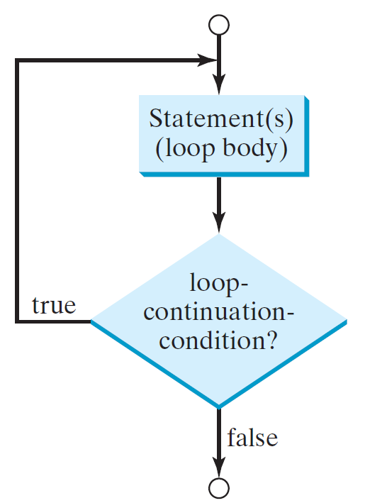
do-while Loop
In Java
do {
// Loop body;
Statement(s);
} while (loop-continuation-condition);
In pseudocode
repeat
loop-body
until loop-continuation-condition

Slide 46
The For Loop

Slide 47
for Loops
for (initial-action; loop-continuation-condition; action-after-each-iteration) {
// loop body;
Statement(s);
}
for(int i = 0; i < 100; i++) {
System.out.println("Welcome to Java!");
}

Slide 48
For loops in pseudocode
With variable
for $i←1…n$ do
loop body
Over all elements of set
for $e∈E$ do
loop body

Slide 49
Tracing for loops
for(int i = 0; i < 2; i++) {
System.out.println("Welcome to Java!");
}
Initialize Count
Memory
Count 0

Slide 50
Tracing for loops
for(int i = 0; i < 2; i++) {
System.out.println("Welcome to Java!");
}
i < 2 is true
Memory
Count 0

Slide 51
Tracing for loops
for(int i = 0; i < 2; i++) {
System.out.println("Welcome to Java!");
}
Output
Memory
Count 0

Slide 52
Tracing for loops
for(int i = 0; i < 2; i++) {
System.out.println("Welcome to Java!");
}
Increment i
Memory
Count 1

Slide 53
Tracing for loops
for(int i = 0; i < 2; i++) {
System.out.println("Welcome to Java!");
}
i < 2 is true
Memory
Count 1

Slide 54
Tracing for loops
for(int i = 0; i < 2; i++) {
System.out.println("Welcome to Java!");
}
Output
Memory
Count 1

Slide 55
Tracing for loops
for(int i = 0; i < 2; i++) {
System.out.println("Welcome to Java!");
}
Increment i
Memory
Count 2

Slide 56
Tracing for loops
for(int i = 0; i < 2; i++) {
System.out.println("Welcome to Java!");
}
i < 2 is false
Memory
Count 2

Slide 57
Tracing for loops
for(int i = 0; i < 2; i++) {
System.out.println("Welcome to Java!");
}
Continue after closing }
Memory
Count 1

Slide 58
Practice
Table 1: Write a for loop to output all numbers between integers $a$ and $b$
Table 2: Write a for loop to output all powers of two up to a number $N$
Table 3: Write a for loop to output the multiples of an integer $a$ up to $N$
Table 4: Write a for loop to output all the even numbers from 100 to 999 in reverse order.

Slide 59
Note
The initial-action in a for loop can be a list of zero or more comma-separated expressions. The action-after-each-iteration in a for loop can be a list of zero or more comma-separated statements. Therefore, the following two for loops are correct. The first is never used in practice, however.
for(int i = 1; i < 100; System.out.println(i++));
for(int i = 0, j = 0; (i + j < 10); i++, j++) {
// Do something
}

Slide 60
Note
If the loop-continuation-condition in a for loop is omitted, it is implicitly true. Thus the statement given below in (a), which is an infinite loop, is correct. Nevertheless, it is better to use the equivalent loop in (b) to avoid confusion:

Slide 61
Caution
Adding a semicolon at the end of the for (or while) clause before the loop body is a common mistake, as shown below:
for(int i=0; i<10; i++);
{
System.out.println("i is " + i);
}

Slide 62
Which Loop to Use?
The three forms of loop statements, while, do-while, and for, are expressively equivalent; that is, you can write a loop in any of these three forms. For example, a while loop in (a) in the following figure can always be converted into the following for loop in (b):
A for loop in (a) in the following figure can generally be converted into the following while loop in (b) except in certain special cases (see Review Question 3.19 for one of them):

Slide 63
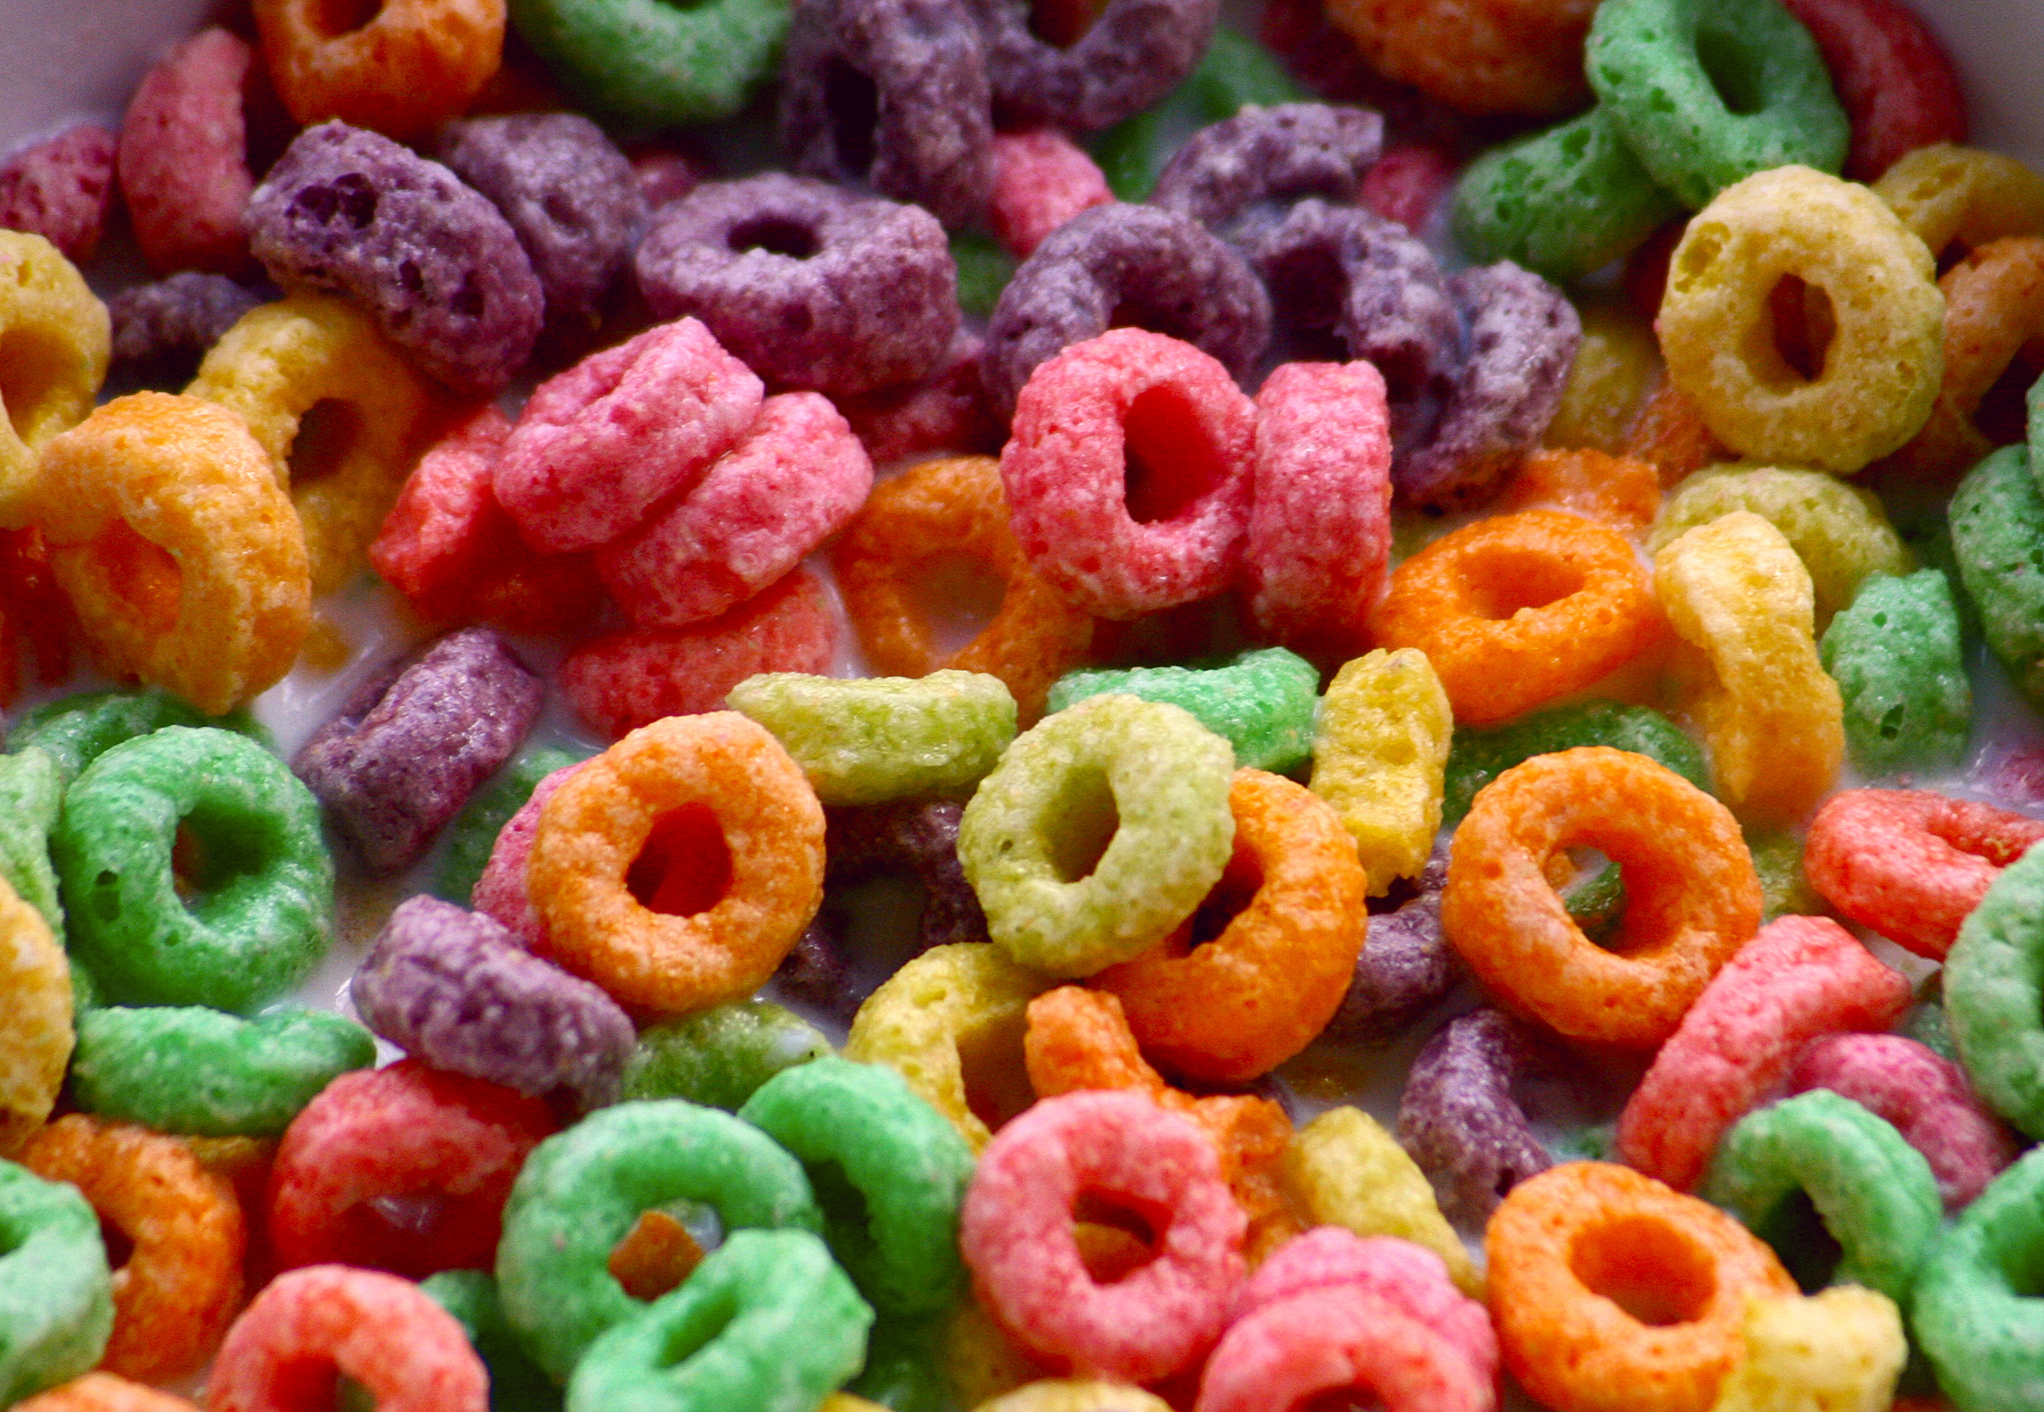
Comparison of loops
for loop – used when you know how many times to execute or each iteration has a natural increment
while loop – used to execute 0 or more times. Pre-condition check.
do-while loop – used to execute 1 or more time. Post-condition check.

Slide 64
Nesting

Slide 65
Nesting
In control flow, nesting is where you place a control structure inside of another
Example: 2 for loops to print a multiplication table
for(int i = 0; i < 10; ++i) {
for(int j = 0; j < 10; ++j)
System.out.printf(“%d*%d = %2d\t”, i, j, i*j);
System.out.println();
}

Slide 66
Monte Carlo Simulation

Slide 67
Gambler's Ruin
Gambler's ruin. Gambler starts with $stake and places $1 fair bets until going broke or reaching $goal.
What are the chances of winning?
How many bets will it take?
One approach. Monte Carlo simulation.
Flip digital coins and see what happens.
Repeat and compute statistics.
Notes:
discrete analog of Brownian motion (applications to stock market – Black-Scholes, behavior of atomic particles predicted by quantum physics, dispersion of ink flowing in water)
Simulations of this sort are widely used in economics, science and engineering
Monte Carlo simulation = use randomness to perform scientific experiment on a computer
Von Neumann (who declared that anyone considering generating random number on a computer is in a state of sin) was one of the pioneers of monte carlo simulation

Slide 68
Gambler's Ruin
public class Gambler {
public static void main(String[] args) {
int stake = Integer.parseInt(args[0]), goal = Integer.parseInt(args[1]); T = Integer.parseInt(args[2]);
int wins = 0;
// repeat experiment T times
for (int t = 0; t < T; t++) {
// do one gambler's ruin experiment
int cash = stake;
while (cash > 0 && cash < goal) {
// flip coin and update
if (Math.random() < 0.5) cash++;
else cash--;
}
if (cash == goal) wins++;
}
System.out.println(wins + " wins of " + T);
}
}
% java Gambler 5 25 1000
191 wins of 1000
% java Gambler 5 25 1000
203 wins of 1000
% java Gambler 500 2500 1000
197 wins of 1000
Notes:
This program is worthy of careful study.
Conditional within a while loop within a for loop.
Inner loop uses && to continue as long as gambler is not broke and didn't reach goal

Slide 69
Other Control flow statements

Slide 70
Other Helpful statements for loops
break – immediately exit the loop. Do not continue executing any more of the loop: while(true) { if(q-key-is-pressed()) //quit the game break; Game-loop(); }
continue – immediately skip to the end of the body of the loop, i.e., start next iteration (checking the condition): for(int i = 0; i < 10; ++i) { if(isPrime(i)) //OCD against prime numbers continue; HandleNotPrimes(); }

Slide 71
Scope

Slide 72
Scope of Local Variables
Scope – the "lifetime" of a variable
The part of the program where the variable can be referenced.
The scope of a variable starts from its declaration and continues to the end of the block that contains the variable.
for(int i = 0; i < n; ++i) { //Can refer to i here } //Cannot refer to i here

Slide 73
Scope of Local Variables
The scope of a variable declared in the initial action part of a for loop is the entire loop. But a variable declared inside a for loop body has its scope limited in the loop body from its declaration and to the end of the block that contains the variable.
public static void main( String[] args) {
// stuff
for (int i = 1; i < 10; i++) {
// more stuff
int j;
// even more stuff
}
}
Scope of j
Scope of i

Slide 74
Scope of Local Variables
You can declare a variable with the same name multiple times in different non-nesting blocks in a method, but you cannot declare a local variable twice in nested blocks (…in Java).

Slide 75
Control Flow Summary
Control flow.
Sequence of statements that are actually executed in a program.
Conditionals and loops: enable us to choreograph the control flow.
Control Flow | Description | Examples
Straight-line programs | All statements are executed in the order given
Conditionals | Certain statements are executed depending on the values of certain variables | if; if-else; switch
Loops | Certain statements are executed repeatedly until certain conditions are met | while; for; do-while
Notes:
Loops save ink

