Slide 1
Chapter 4 Mathematical Functions, Characters, Strings
ACKNOWLEDGEMENT: THESE SLIDES ARE ADAPTED FROM SLIDES PROVIDED WITH Introduction to Java Programming, Liang (Pearson 2014)

Slide 2
Mathematical Functions
Java provides many useful methods in the Math class for performing common mathematical functions.
In order to use them we need to understand:
What a method is
How to use methods
Where we look up possible functions to use

Slide 3
Methods
Methods are subroutines that we would like to (re)use again and again in code
For example, would you like a method to compute $\sqrt{x}$ or write a lengthy algorithm every time you wish to use it?
The Java library provides many useful methods. Some we have seen:
Scanner
If you have read - Math

Slide 4
Interpreting methods
Consider the following from the Math library: double sqrt(double x);
sqrt is an identifier, i.e., a name, for this method
double x is called a parameter, or an argument. This is the input to the method.
double is the type of data output by the method
In a few weeks, we will learn to write our own methods. For now, we need to know how to use them.

Slide 5
Invoking a method
A method is invoked, or called/used, in code:
double x = Math.sqrt(2); //invoke/call and save result
double y = Math.sqrt(2)/2; //use inside of an expression

Slide 6
Invoking a method
Difference between Math and Scanner
Methods sometimes depend on the value of an object/class and sometimes they do not. Common math functions, like sqrt, do not need to know anything besides the parameter. However, other things like Scanner needs to know what it is scanning, so we invoke methods from a variable instead:
Scanner in = new Scanner(System.in); //Make a variable
double x = in.nextDouble(); //Use the variable

Slide 7
Reading an API
API or Application Program Interface tells a programmer how to use a class or piece of code
Look at one and let us interpret
Java Math API

Slide 8
The Math Class
Class constants:
PI (with Math.PI)
E
Class methods:
Trigonometric Methods (examples: Math.sin(x), Math.cos(x))
Exponent Methods (examples: Math.log(x), Math.pow(x, y))
Rounding Methods (examples: Math.floor(x), Math.round(x))
min, max, abs, and random Methods (examples: Math.min(x, y), Math.random())

Slide 9
Math.Random()
Generates a random double value greater than or equal to 0.0 and less than 1.0 ($0≤$ Math.random()$<1.0$).
a + Math.random() * b – Returns a random number between $a$ and $a+b$, excluding $a+b$.
(int) (Math.random() * 10) – Returns a random integer between 0 and 9.
50 + (int)(Math.random() * 50) – Returns a random integer between 50 and 99.

Slide 10
Exercise
With a partner, lets make a program that draws a pentagon or pentagram inscribed in a circle
Recall the coordinate system in StdDraw is a box from (0, 0) to (1, 1). Change with:
StdDraw.setXscale(-1.5*r, 1.5*r)
StdDraw.setYscale(-1.5*r, 1.5*r)
To draw a circle use: StdDraw.circle(x, y, r);
Recall for a point on a circle at angle $θ$, $x=r\cos{θ}$ and $y=r\sin{θ}$

Slide 11
Character Data Type
Characters are symbols used predominantly for textual information
char letter = 'A'; //ASCII
char numChar = '4'; //ASCII, ASCII is one mapping from binary value to symbols. Found in Appendix B of book
char letter = '\u0041'; //Unicode, mapping that supports other languages characters
char numChar = '\u0034'; //Unicode
Literals are denoted with a single quote

Slide 12
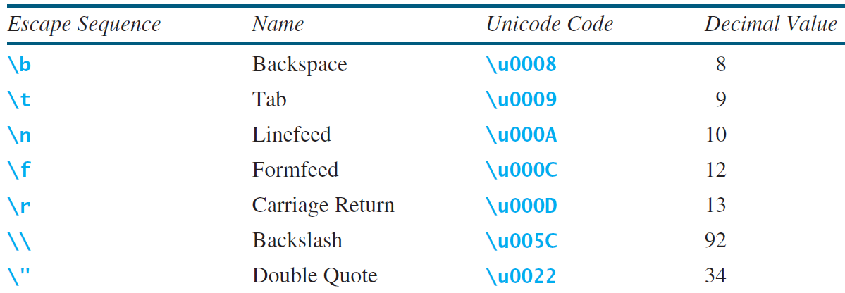
Escape Sequences for Special Characters

Slide 13
Methods in the Character Class

Slide 14
The String Type
The char type only represents one character. To represent a message (string of characters), use the data type called String. For example, String message = "Welcome to Java";
Note - String is actually a predefined class in the Java library just like the System class and Scanner class. The String type is not a primitive type. It is known as a reference type. Any Java class can be used as a reference type for a variable. Reference data types will be thoroughly discussed in Chapter 9, “Objects and Classes.” For the time being, you just need to know how to declare a String variable, how to assign a string to the variable, how to concatenate strings, and to perform simple operations for strings.

Slide 15
Simple Methods for String Objects

Slide 16
Getting String Length
String message = "Welcome to Java";
System.out.println("The length of " + message + " is " + message.length());

Slide 17
Getting Characters from a String

Slide 18
String Concatenation
//String s3 = s1.concat(s2); or String s3 = s1 + s2;
// Three strings are concatenated
String message = "Welcome " + "to " + "Java";
// String Chapter is concatenated with number 2
String s = "Chapter" + 2; // s becomes Chapter2
// String Supplement is concatenated with character B
String s1 = "Supplement" + 'B'; // s1 becomes SupplementB

Slide 19
Reading a String from the Console
Scanner input = new Scanner(System.in);
System.out.print("Enter three words separated by spaces: ");
String s1 = input.next();
String s2 = input.next();
String s3 = input.next();
System.out.println("s1 is " + s1);
System.out.println("s2 is " + s2);
System.out.println("s3 is " + s3);

Slide 20
Obtaining Substrings

Slide 21
Conversion between Strings and Numbers
//String to a number
int intValue = Integer.parseInt(intString);
double doubleValue = Double.parseDouble(doubleString);
//Number to a string
String s = String.valueOf(number);

