Slide 1
Interactive learning
In this class, we will sometimes work in tandem between programming and discussion
If you get lost, I will have the programs written in the slides, or you can ask
To facilitate:
Make a new directory for the day
Open sublime and the terminal and be ready to go

Slide 2
Chapter 2 Elementary Programming
ACKNOWLEDGEMENT: THESE SLIDES ARE ADAPTED FROM SLIDES PROVIDED WITH Introduction to Java Programming, Liang (Pearson 2014)

Slide 3
Next step in programming
Computations! Support for basic mathematics
In pseudocode, we might write the following
$x←0$
$a←πr^{2}$
Here we make variables (store data) and give values ($←$ means “gets”, note I do not use “equals” in pseudocode)

Slide 4
Example: Computing the area
public class ComputeArea {
public static void main(String[] args) {
double radius; // Declare radius
double area; // Declare area
// Assign a radius
radius = 20; // New value is radius
// Compute area
area = radius * radius * 3.14159;
// Display results
System.out.println("The area for the circle of radius " +
radius + " is " + area);
}
}

Slide 5
Tracing
Tracing is an activity used by computer scientists to follow a piece of code to check correctness, find errors, etc
We will learn how to trace programs and follow execution of code exactly as a computer might
But first, a note on memory

Slide 6
Memory
Memory is storage for data and programs
We will pretend that memory is an infinitely long piece of tape separated into different cells
Each cell has an address, i.e., a location, and a value
In the computer these values are represented in binary (0s and 1s) and addresses are located in hexadecimal (base 16, 0x)
x
y
z
…
…
0x0
0x1
0x2
0xA

Slide 7
Example: Computing the area
No value yet!
Memory
…
public class ComputeArea {
public static void main(String[] args) {
double radius; // Declare radius
double area; // Declare area
// Assign a radius
radius = 20; // New value is radius
// Compute area
area = radius * radius * 3.14159;
// Display results
System.out.println("The area for the circle of radius " +
radius + " is " + area);
}
}
radius
0xA
?
…
0xB
?
…

Slide 8
Example: Computing the area
Memory
…
public class ComputeArea {
public static void main(String[] args) {
double radius; // Declare radius
double area; // Declare area
// Assign a radius
radius = 20; // New value is radius
// Compute area
area = radius * radius * 3.14159;
// Display results
System.out.println("The area for the circle of radius " +
radius + " is " + area);
}
}
radius
0xA
?
…
area
0xB
?
…

Slide 9
Example: Computing the area
Special symbol = means assignment, or giving a value to a variable
Memory
…
public class ComputeArea {
public static void main(String[] args) {
double radius; // Declare radius
double area; // Declare area
// Assign a radius
radius = 20; // New value is radius
// Compute area
area = radius * radius * 3.14159;
// Display results
System.out.println("The area for the circle of radius " +
radius + " is " + area);
}
}
radius
0xA
20
…
area
0xB
?
…

Slide 10
Example: Computing the area
Certain symbols, e.g., *, compute new values. It is like a calculator!
Memory
…
public class ComputeArea {
public static void main(String[] args) {
double radius; // Declare radius
double area; // Declare area
// Assign a radius
radius = 20; // New value is radius
// Compute area
area = radius * radius * 3.14159;
// Display results
System.out.println("The area for the circle of radius " +
radius + " is " + area);
}
}
radius
0xA
20
…
area
0xB
1256.636
…

Slide 11
Example: Computing the area
Memory
…
public class ComputeArea {
public static void main(String[] args) {
double radius; // Declare radius
double area; // Declare area
// Assign a radius
radius = 20; // New value is radius
// Compute area
area = radius * radius * 3.14159;
// Display results
System.out.println("The area for the circle of radius " +
radius + " is " + area);
}
}
radius
0xA
20
…
area
0xB
1256.636
…
Print values to terminal

Slide 12
Reading Input from the Console
import java.util.Scanner; //Tell java you want to use a Scanner
public class ComputeArea {
public static void main(String[] args) {
System.out.print(“Enter a radius: ”); //Message to “prompt” the user
Scanner in = new Scanner(System.in); //Scanner gathers input
double radius = in.nextDouble(); // Declare radius and assign a new value is from user!
double area = radius * radius * 3.14159; // Declare and Compute area
System.out.println("The area for the circle of radius " +
radius + " is " + area); // Display results
}
}
Use a Scanner to gather input from a user!

Slide 13
Programming with Data
The details

Slide 14
Hold on a sec! I thought computers were all 0's and 1's?

Slide 15
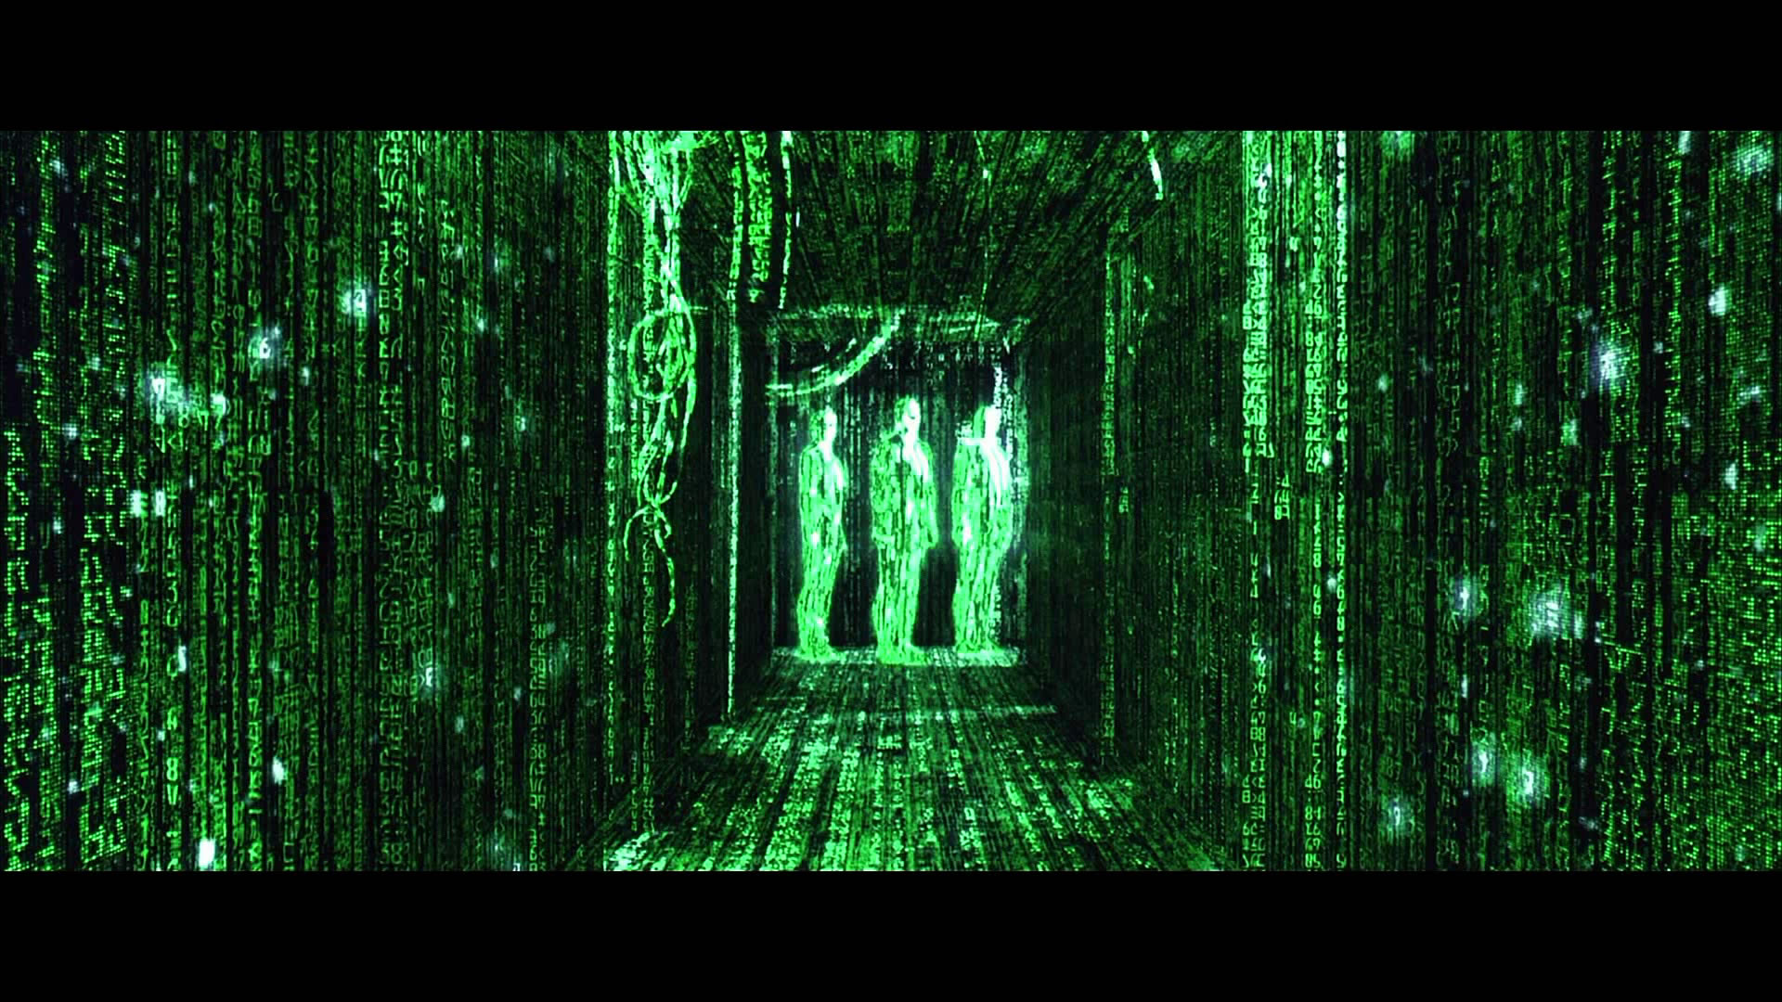
0's and 1's
Yes, computers operate in 0's and 1's. So first off, javac (our compiler) converts our text into commands of 0's and 1's the computer can understand
java (executing) interprets the 0's and 1's
Memory also stores entirely 0's and 1's
So what we need to know is how computers do this

Slide 16
Integer Representation
First, a look at our number system. It is base 10, meaning we use 10 different symbols (the digits). Lets look at an example number: 1037.
And adding we use carry-and-add
1
0
3
7
$${10}^{3}=1000$$
$${10}^{2}=100$$
$${10}^{1}=10$$
$${10}^{0}=1$$
$$1∗{10}^{3}+$$
$$0∗{10}^{2}+$$
$$3∗{10}^{1}+$$
$$7∗{10}^{0}=1037$$
 | $$1$$ | $$0$$ | $$3$$ | $$7$$
$$+$$ | $$0$$ | $$0$$ | $$4$$ | $$9$$
 | $$1$$ | $$0$$ | $$8$$ | $$6$$

Slide 17
Integer Representation
Synonymously, binary numbers work the same way. Except instead of base 10, it is base 2. A digit can only be 0 or 1. Example: 0010 0101
And adding 0010 1010 + 0000 0101
Note there are other common number systems: Octal (base 8, digits 0-7) and Hexadecimal (base 16, digits 0-9 and A-F, used for memory addresses)
 | $$0$$ | $$0$$ | $$1$$ | $$0$$ | $$0$$ | $$1$$ | $$0$$ | $$1$$
$$+$$ | $$0$$ | $$0$$ | $$0$$ | $$0$$ | $$0$$ | $$1$$ | $$0$$ | $$1$$
 | $$0$$ | $$0$$ | $$1$$ | $$0$$ | $$1$$ | $$0$$ | $$1$$ | $$0$$

Slide 18
Integer Representation
By limiting the number of bits, we limit the expressiveness of the data type
Means that if we only have 2 bits, we can only represent 4 numbers: 00, 01, 10, 11
In programming, we must make conscious decisions about this otherwise there can be severe consequences

Slide 19
Numerical Data Types
We will use int and double most often in this class.

Slide 20
Activity
With a partner
Convert the binary number 1001 1001 to decimal
Add the binary number 0101 0101 to 1001 1001 (DO NOT DO THIS IN DECIMAL) and then convert to a decimal number
Bonus: 0xA1 to decimal, add 0x0E to it and convert to decimal. Hint: 0x means that the number is a hexadecimal (base 16)

Slide 21
Variables and naming

Slide 22
Identifiers (names)
An identifier is a sequence of characters that consist of letters, digits, underscores (_), and dollar signs ($).
An identifier must start with a letter, an underscore (_), or a dollar sign ($). It cannot start with a digit.
An identifier cannot be a reserved word. (See Appendix A, “Java Keywords,” for a list of reserved words). An identifier cannot be true, false, or null.
An identifier can be of any length.

Slide 23
Declaring Variables
A variable is a named piece of data (memory). It stores a value!
It has a type that defines how the memory is interpreted and what operations are allowed
A declaration states the existence of a variable for use in the program. It defines the type and an identifier (name) for a variable.
int x; // Declare x to be an integer variable
double radius; // Declare radius to be a double variable
char a; // Declare a to be a character variable
In pseudocode (just $x$, to say a variable) we often exclude the type for numeric variables

Slide 24
Assignment Statements
Assignment statements give values to a variable
The type defines what possible values are allowable
x = 1; // Assign 1 to x;
radius = 1.0; // Assign 1.0 to radius;
a = 'A'; // Assign 'A' to a;
In contrast to pseudocode, java uses $=$, not $←$ for assignment!

Slide 25
Declaring and Initializing in One Step
Initialization is how we refer to the very first assignment of a variable’s value
Declarations and initialization are allowed in one step
int x = 1;
double d = 1.4;

Slide 26
Named Constants
Often, we need constants in programs, e.g., $π$. Use the keyword final to specify a variable can ONLY be initialized.
final double PI = 3.14159;
final int SIZE = 3;

Slide 27
Naming Conventions
Choose meaningful and descriptive names.
Variables and method names: Use lowercase. If the name consists of several words, concatenate all in one, use lowercase for the first word, and capitalize the first letter of each subsequent word in the name, called camelCasing.
radius
area
computeArea

Slide 28
Naming Conventions
Class names: Capitalize the first letter of each word in the name
ComputeArea.
Constants: Capitalize all letters in constants, and use underscores to connect words
PI
MAX_VALUE

Slide 29
Literals
A literal is a constant value that appears directly in the program. For example, 34, 1,000,000, and 5.0 are literals in the following statements:
int i = 34;
long x = 1000000;
double d = 5.0;

Slide 30
Integer Literals
An integer literal can be assigned to an integer variable as long as it can fit into the variable. A compilation error would occur if the literal were too large for the variable to hold. For example, the statement byte b = 1000 would cause a compilation error, because 1000 cannot be stored in a variable of the byte type.
An integer literal is assumed to be of the int type, whose value is between ${−2}^{31}$ (-2147483648) to $2^{31}−1$ (2147483647). To denote an integer literal of the long type, append it with the letter L or l. L is preferred because l (lowercase L) can easily be confused with 1 (the digit one).

Slide 31
Floating-Point Literals
Floating-point literals are written with a decimal point. By default, a floating-point literal is treated as a double type value. For example, 5.0 is considered a double value, not a float value. You can make a number a float by appending the letter f or F, and make a number a double by appending the letter d or D. For example, you can use 100.2f or 100.2F for a float number, and 100.2d or 100.2D for a double number.

Slide 32
Scientific Notation
Floating-point literals can also be specified in scientific notation, for example, 1.23456e+2, same as 1.23456e2, is equivalent to 123.456, and 1.23456e-2 is equivalent to 0.0123456. E (or e) represents an exponent and it can be either in lowercase or uppercase.

Slide 33
Reading Numbers from the Keyboard
Scanner input = new Scanner(System.in);
int value = input.nextInt();

Slide 34
Expressions

Slide 35
Numeric Operators

Slide 36
Arithmetic Expressions
Expressions are combinations of literals, variables, operations, and method calls that generate new values
$\frac{3+4x}{5}−\frac{10\left(y−5\right)\left(a+b+c\right)}{x}+9\left(\frac{4}{x}+\frac{9+x}{y}\right)$
is translated to
(3+4*x)/5 – 10*(y-5)*(a+b+c)/x + 9*(4/x + (9+x)/y)

Slide 37
How to Evaluate an Expression
Though Java has its own way to evaluate an expression behind the scene, the result of a Java expression and its corresponding arithmetic expression are the same. Therefore, you can safely apply the arithmetic rules for evaluating a Java expression.

Slide 38
Exercise
Write a program to compute the average of three numbers
Make the numbers integers to see what happens?
Make the numbers floats to see what happens?
Trace the execution in memory if the user enters 3, 5, 7
Write a program to draw a circle based on user input!

Slide 39
Integers Division
Integers do not store decimals
Division computes how many times a divisor evenly goes into a number
Remainder (modulus) computes what is left over
5 / 2 yields an integer 2
5 % 2 yields 1 (the remainder of the division)
Practice: What is 3456421 % 2? 25%3? 87%4?

Slide 40
Floating-point numbers (double)
Calculations involving floating-point numbers are approximated because these numbers are not stored with complete accuracy. For example,
System.out.println(1.0 - 0.1 - 0.1 - 0.1 - 0.1 - 0.1);
displays 0.5000000000000001, not 0.5, and
System.out.println(1.0 - 0.9);
displays 0.09999999999999998, not 0.1. Integers are stored precisely. Therefore, calculations with integers yield a precise integer result.

Slide 41
double vs. float
The double type values are more accurate than the float type values. For example,
System.out.println("1.0 / 3.0 is " + 1.0 / 3.0);
System.out.println("1.0F / 3.0F is " + 1.0F / 3.0F);

Slide 42
Augmented Assignment Operators

Slide 43
Increment and Decrement Operators

Slide 44
Increment and Decrement Operators

Slide 45
Increment and Decrement Operators
Using increment and decrement operators makes expressions short, but it also makes them complex and difficult to read. Avoid using these operators in expressions that modify multiple variables, or the same variable for multiple times such as this:
int k = ++i + i++ - --i;

Slide 46
Assignment Expressions and Assignment Statements
variable = expression;
variable op= expression; // Where op is +, -, *, /, or %
++variable; //preincrement
variable++; //postincrement
--variable; //predecrement
variable--; //postdecrement

Slide 47
Type Conversion

Slide 48
Numeric Type Conversion
Consider the following statements:
int i = 5;
double d = i;
double f = i*d;

Slide 49
Conversion Rules
When performing an operation involving two operands of different types, Java can automatically converts the operand based on the following rules:
1. If one of the operands is double, the other is converted into double.
2. Otherwise, if one of the operands is float, the other is converted into float.
3. Otherwise, if one of the operands is long, the other is converted into long.
4. Otherwise, both operands are converted into int.

Slide 50
Type Casting
Implicit casting is done when the range of the data increases, e.g., int to double. Implicit means automatic by Java
double d = 3; //type widening
Explicit casting is done when the range of the data decreases, e.g., double to int. Explicit must be stated by the programmer
int i = (int)3.9; (type narrowing, fraction will be truncated not rounded!)
What is wrong?
int x = 5 / 2.0;

Slide 51
Temporaries – Unseen “variables”
Temporarily computed values are also stored in memory, but do not have a name
Important to note – they have a type. It is the type of the final result of the (sub)expression
Example
double x = 1.5;
int y = 2;
double z = y*y/3 + 1.5;
Determine the type of each subcomponent of the exression:
y*y?
y*y/3?
y*y/3 + 1.5?
Practice labeling the following for any line of code: kind of (sub)statement, type of (sub)expressions

Slide 52
Exercise
Write a program to compute sales tax for a purchase.
How could you alter your program to only store 2 decimal places? Try it!

Slide 53
Common Errors and Pitfalls
Common Error 1: Undeclared/Uninitialized/Unused Variables
Common Error 2: Integer Overflow
Common Error 3: Round-off Errors
Common Error 4: Unintended Integer Division
Common Pitfall 1: Redundant Input Objects

Slide 54
Common Error 1 Undeclared/Uninitialized/unused Variables
double interestRate = 0.05;
double interest = interestrate * 45;
Here, interestrate is undeclared to the compiler and interestRate is unused. The programmer just made a “spelling” mistake!
Following naming conventions help

Slide 55
Common Error 2 Integer Overflow
int value = 2147483647 + 1;
// value will actually be -2147483648

Slide 56
Common Error 3 Round-off Errors
System.out.println(1.0 - 0.1 - 0.1 - 0.1 - 0.1 - 0.1);
System.out.println(1.0 - 0.9);

Slide 57
Common Error 4 Unintended Integer Division

Slide 58
Common Pitfall 1 Redundant Input Objects
Scanner input = new Scanner(System.in);
System.out.print("Enter an integer: ");
int v1 = input.nextInt();
Scanner input1 = new Scanner(System.in);
System.out.print("Enter a double value: ");
double v2 = input1.nextDouble();

