Slide 1
Ch7.
List and Iterator ADTs
Acknowledgement: These slides are adapted from slides provided with Data Structures and Algorithms in Java, Goodrich, Tamassia and Goldwasser (Wiley 2016)

Slide 2
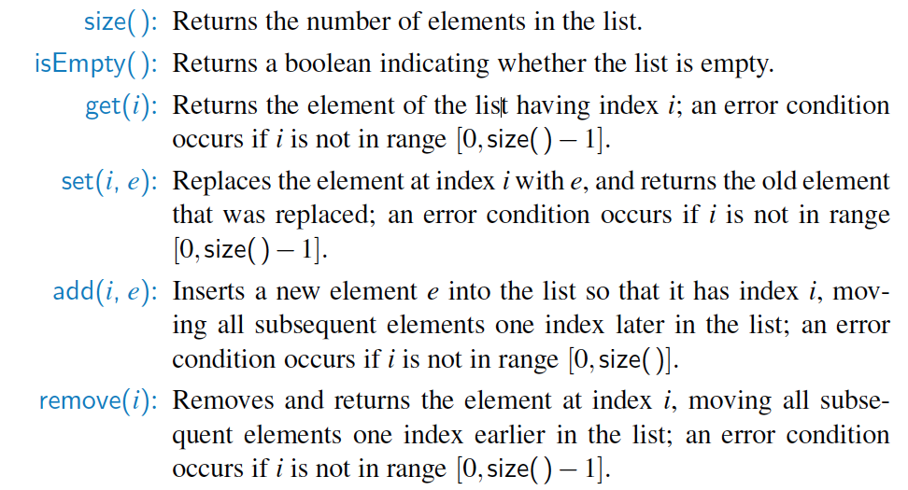
List ADT

Slide 3
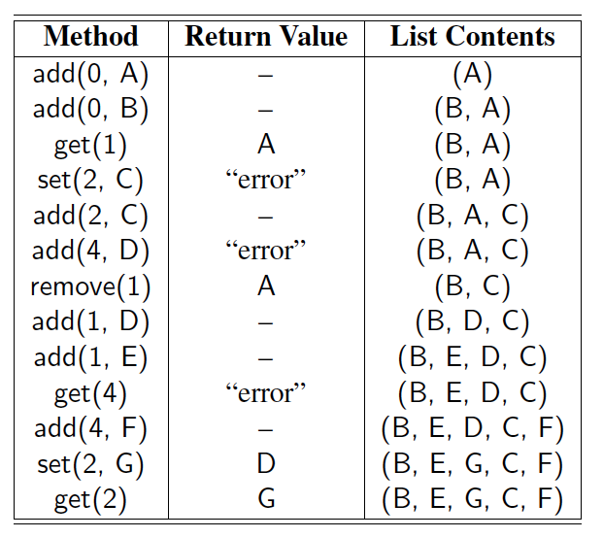
Example
A sequence of List operations:

Slide 4



Array Lists
An obvious choice for implementing the list ADT is to use an array, $A$, where $A\left[i\right]$ stores (a reference to) the element with index $i$.
With a representation based on an array $A$, the get($i$) and set($i$, $e$) methods are easy to implement by accessing $A[i]$ (assuming $i$ is a legitimate index).
0
$$N−1$$
$$A$$
0
1
2
i
n

Slide 5

Insertion
In an operation add($i$, $o$), we need to make room for the new element by shifting forward the $n−i$ elements $A\left[i\right], …,A\left[n−1\right]$
In the worst case ($i=0$), this takes $O\left(n\right)$ time
A
0
1
2
i
n
A
0
1
2
i
n
A
o
0
1
2
i
n

Slide 6

Element Removal
In an operation remove($i$), we need to fill the hole left by the removed element by shifting backward the $n−i−1$ elements $A\left[i+1\right],…,A\left[n−1\right]$
In the worst case ($i=0$), this takes $O\left(n\right)$ time
A
o
0
1
2
i
n
A
0
1
2
i
n
A
0
1
2
r
n

Slide 7

Performance
In an array-based implementation of a dynamic list:
  The space used by the data structure is $O\left(n\right)$
  Indexing the element (get/set) at $i$ takes $O\left(1\right)$ time
  add and remove run in $O\left(n\right)$ time
In an add operation, when the array is full, instead of throwing an exception, we can replace the array with a larger one …

Slide 8
Exercise:
Implement the Deque ADT update functions using List functions
  Deque update functions:
    first(), last(), addFirst(e), addLast(e), removeFirst(), removeLast(), size(), isEmpty()
  List functions:
    get(i), set(i, e), add(i, e), remove(i), size(), isEmpty()

Slide 9
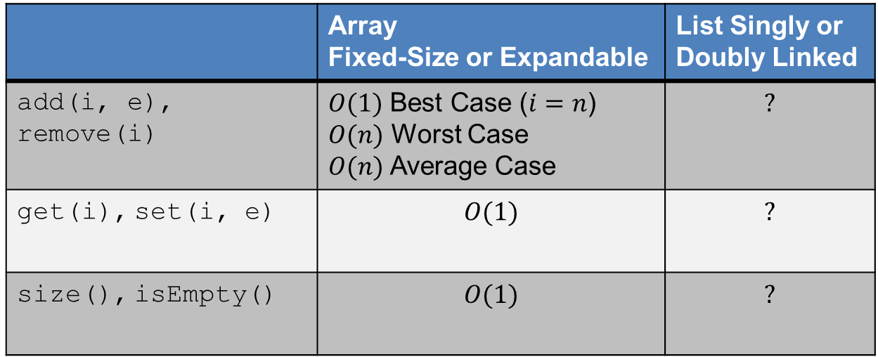
List Summary
 | Array Fixed-Size or Expandable | List Singly or Doubly Linked
add(i, e), remove(i) | $O(1)$ Best Case ($i=n$) $O(n)$ Worst Case $O(n)$Average Case | $$?$$
get(i), set(i, e) | $$O(1)$$ | $$?$$
size(), isEmpty() | $$O(1)$$ | $$?$$

Slide 10

Positional Lists
To provide for a general abstraction of a sequence of elements with the ability to identify the location of an element, we define a positional list ADT.
A position acts as a marker or token within the broader positional list.
A position $p$ is unaffected by changes elsewhere in a list; the only way in which a position becomes invalid is if an explicit command is issued to delete it.
A position instance is a simple object, supporting only the following method:
  p.getElement(): Return the element stored at position $p$.

Slide 11
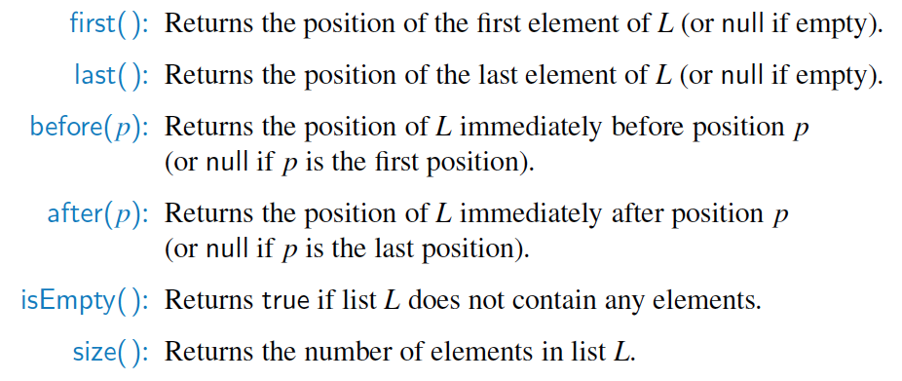
Positional List ADT
Accessor methods:

Slide 12
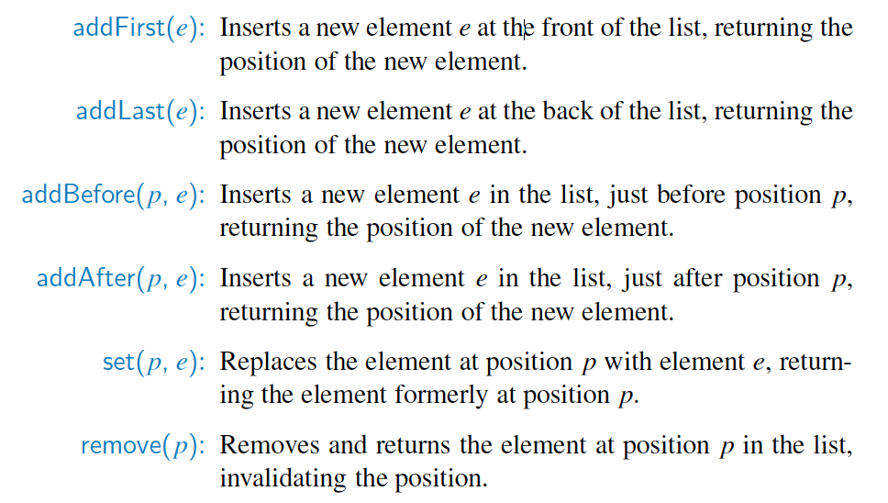
Positional List ADT, 2
Update methods:

Slide 13
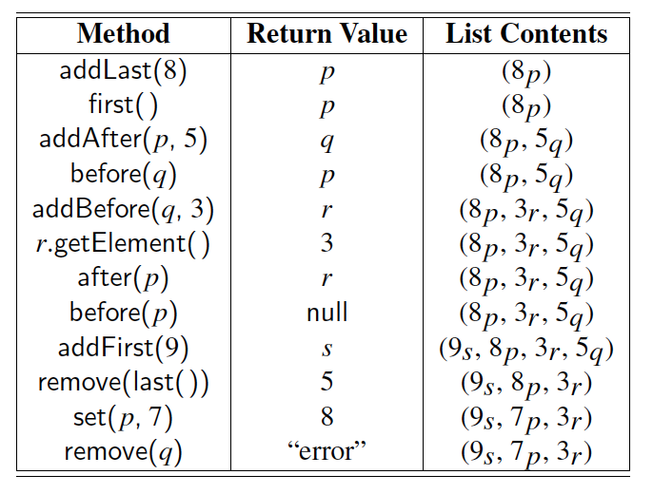
Example
A sequence of Positional List operations:

Slide 14
Positional List Implementation
prev
next
The most natural way to implement a
positional list is with a doubly-linked list.
element
node
header
nodes/positions
trailer
elements

Slide 15
Insertion, e.g., addafter(p, e)
p
A
B
C
p
A
B
q
C
X
p
q
A
B
X
C

Slide 16
Remove(p)
p
A
B
C
D
A
B
C
p
D
A
B
C

Slide 17

Performance
Assume doubly-linked list implementation of Positional List ADT
  The space used by a list with $n$ elements is $O(n)$
  The space used by each position of the list is $O(1)$
  All the operations of the List ADT run in $O(1)$time

Slide 18
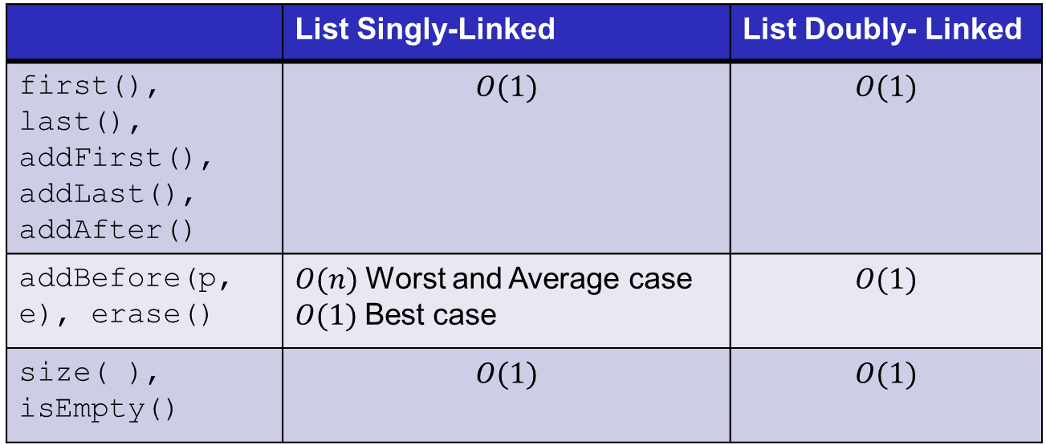
Positional List Summary
 | List Singly-Linked | List Doubly- Linked
first(), last(), addFirst(), addLast(), addAfter() | $$O(1)$$ | $$O(1)$$
addBefore(p, e), erase() | $O(n)$Worst and Average case $O(1)$Best case | $$O(1)$$
size( ), isEmpty() | $$O(1)$$ | $$O(1)$$

Slide 19
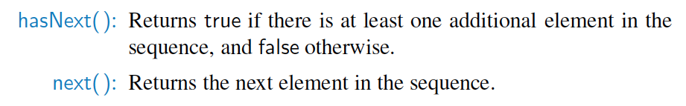
Iterators
An iterator is a software design pattern that abstracts the process of scanning through a sequence of elements, one element at a time.

Slide 20
The Iterable Interface
Java defines a parameterized interface, named Iterable, that includes the following single method:
  iterator(): Returns an iterator of the elements in the collection.
An instance of a typical collection class in Java, such as an ArrayList, is Iterable (but not itself an iterator); it produces an iterator for its collection as the return value of the iterator() method.
Each call to iterator() returns a new iterator instance, thereby allowing multiple (even simultaneous) traversals of a collection.

Slide 21
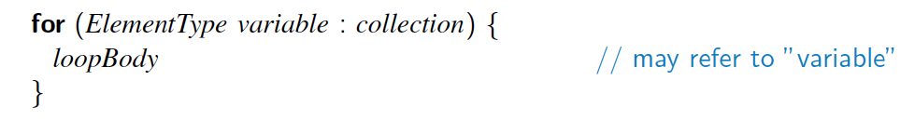
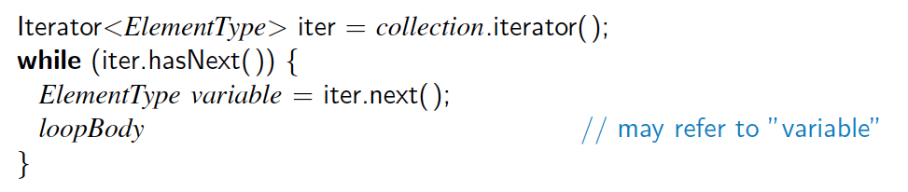
The for-each Loop
Java’s Iterable class also plays a fundamental role in support of the “for-each” loop syntax:
  is equivalent to:

Slide 22
Interview Question 1
Write code to partition a list around a value x, such that all nodes less than x come before all nodes greater than or equal to x.

Slide 23
Interview Question 2
Implement a function to check if a list is a palindrome.

