Slide 1
Advanced Techniques
Integrated Development Environments
Java Generics
ArrayList, Map
Lambdas

Slide 2
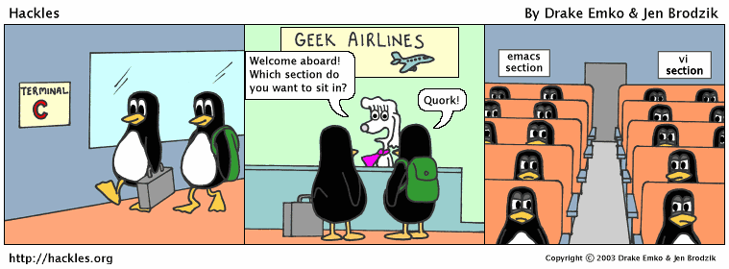
Integrated Development Environments
IDEs combine the compiler with the text editor
Many also provide a symbolic debugger to facilitate finding errors
Lets try HelloWorld together in one, Eclipse

Slide 3
Generic Programming
Generic programming – programming in terms of operations of types only. Any type that satisfies the operational constraints may be used.
In Java – Multiple methods to do this. Polymorphism (at runtime) and Generics (at compile time)
A note on Java…no primitive types can be used in generic programming. This is not true of something like C++

Slide 4
Piece of cake…just treat everything as an object!
public class GenericArray {
Object[] objs;
…
/* Other stuff.
But it is limited because Object doesn’t offer much.
Still…we can store anything!
*/
…
}

Slide 5
Java Generics
Can be better using “Generics”:
public class GenericArray<T> { //T is an non primitive type
T[] objs;
/* Make assumptions on the operations of T, e.g.,
all T have function draw(). Now any type that
satisfies this requirement may be used, regardless of
inheritance tree.
*/
}
Use like: GenericArray<String> = new GenericArray<String>();
Types are explicitly written by the programmer

Slide 6
Java Generics
Can also be used in functions:
public static <T, S> int compare(T t, S s) {
//make assumptions on the types.
//Any type that satisfies operation constraints may be used!
return t.compareTo(s);
}
Used like:
MyObject1 a;
MyObject2 b; //MyObject1 has function “compareTo(MyObject2)”
int c = compareTo(a, b);
Types are implicitly determined by compiler

Slide 7
Data structures
Data types specifically designed to have “flexible” storage and to do so efficiently
Here I define some common ones. CMSC 221 delves into how these would be implemented.

Slide 8
Arraylist
A “growable” array
Generic class
Found in java.util.ArrayList (use import)
Common functions: add, remove, size, contains
Can also use related classes Vector, LinkedList
import java.util.ArrayList;
…/*in the code somewhere*/…
ArrayList<String> list = new ArrayList<String>();
list.add(“Hello”);
list.add(“There”);
list.remove(“Hello”);

Slide 9
Maps
Associative containers relate pairs of data, referred to as key, value pairs
Example: student id to student record
Provides very fast lookup!
Can use HashMap or TreeMap (remember to import)
Common functions: put, get, remove, size, containsKey, containsValue, etc.
import java.util.HashMap;
…/*Somewhere in the code*/…
HashMap<Integer, String> h = new HashMap<Integer, String>();
h.put(4, “JLDiablo”);
h.put(2, “HelloWorld!”);
String x = h.get(2);

Slide 10
Java wildcards
A very related note, wildcards… “?” represents an unknown type. You can put extends or super constraints on ?, “? extends X” or “? super Y”, then:
public static void printArrayList(ArrayList<?> l) {
for(Object e : l)
System.out.print(e + “ ”);
}

Slide 11
Lambda functions
Nameless functions, written directly where they are used
Example:
ArrayList<Integer> numbers = new ArrayList<Integer>();
for(int i = 0; i < 1000; ++i)
numbers.add((int)(Math.random()*10000));
Collections.sort(numbers, (Integer i1, Integer i2) -> i1.compareTo(i2));
Parameters
Body

Slide 12
Much, Much, more
Threading/parallel computation
Networking
Databases
Other libraries (e.g., advanced graphics)
Etc., etc.

