Slide 1
Chapter 9 Objects and Classes Chapter 10 Object-Oriented Thinking
ACKNOWLEDGEMENT: THESE SLIDES ARE ADAPTED FROM SLIDES PROVIDED WITH Introduction to Java Programming, Liang (Pearson 2014)

Slide 2
Motivations
Suppose you want to develop a graphical user interface as shown below. How do you program it?
Facebook?
Simulation/animation for Pixar movies?

Slide 3
A Foundation for Programming
Any program you want!
Objects
Create your own data types
Allows scaling to large programs!
Functions and Modules
Arrays
Input and Output
Conditionals and Loops
Primitive data, Expressions, Math, String
Notes:
You've been writing one big function main. It's getting longer each time: harder to read, harder to understand, easier to introduce bugs.
Answer: divide program up into many functions.

Slide 4
What isn’t “new” in “objects”?
Some things we have seen and are familiar with, but do not fully understand the details:
public class MyProgram //Seen this every program
String s; //not an integer, character, boolean, or floating-point number
Scanner in = new Scanner(System.in); //Making variables of complex types
s.charAt(5); //using methods tied to a variable’s value

Slide 5
Data Types
Data type. Set of values and operations on those values.
Primitive types. Values directly map to machine representation; operations directly map to machine instructions.
We want to write programs that process other types of data.
Colors, pictures, strings, vectors, polygons, input streams, …
Data Type | Set of Values | Operations
boolean | true, false | not, and, or, xor
int | $$[−2^{31}, 2^{31})$$ | add, subtract, multiply
double | any of $2^64$ real numbers | add, subtract, multiply
Notes:
Organizing a big software project is a highly nontrivial task. What would you do to manage dozens of programmers working on the same project? Creating medium or large pieces of software requires careful organization and structure. Our goal will be to divide the project into smaller independent modules with clean and simple interfaces.
more data types: Lists, playing cards, datasets, particles, sound waves, GUIs, . . .

Slide 6
Object-oriented Programming Concepts
Object-oriented programming (OOP) involves programming using objects
An object represents an entity in the real world that can be distinctly identified. For example, a student, a desk, a circle, a button, and even a loan can all be viewed as objects. An object has a unique identity, state, and behaviors.
The state of an object consists of a set of data fields (also known as properties) with their current values.
The behavior of an object is defined by a set of methods.
Data Type | Set of Values | Operations
Color | 24 bits | getRed(), brighten()
Picture | 2D array of Colors | getPixel(i, j), setPixel(i, j)
String | Sequence of characters | length(), substring(), compare()

Slide 7
Objects
An object has both a state and behavior. The state defines the object, and the behavior defines what the object does.
An object class defines its possible states and its behaviors
An object instance is a variable of the object type, i.e., it is a specific “value” or state

Slide 8
Classes
Classes are constructs that define objects of the same type
A Java class uses
Variables to define data fields
Methods to define behaviors
A special type of methods, known as constructors, which are invoked to construct instances (objects) from the class

Slide 9
UML Class Diagram
Circle
radius: double
Circle()
Circle(newRadius: double)
getArea(): double
Class name
Data fields
Constructors and methods
circle1: Circle
radius: 10
circle2: Circle
radius: 25
circle3: Circle
radius: 125
UML notation for instances (objects)

Slide 10
Example UML Diagram Defining a TV object

Slide 11
Object-Oriented Programming
Object-oriented Programming – design principle for large programs
Abstraction – Modeling objects
Composition – Modeling object associations (HAS-A relationship)
Encapsulation – combining data and operations (methods); data hiding from misuse (private vs public)
Inheritance – Types and sub-types (IS-A relationship)
Polymorphism – Abstract types that can act as other types (for algorithm design)

Slide 12
Abstraction and Encapsulation
Abstraction means to separate class implementation from the use of the class.
A description of the class lets the user know how the class can be used (class contract)
Thus, the user of the class does not need to know how the class is implemented
The detail of implementation is encapsulated and hidden from the user.

Slide 13
Object Composition
Composition/Aggregation models has-a relationships and represents an ownership relationship between two objects
The owner object is called an aggregating object and its class an aggregating class. The subject object is called an aggregated object and its class an aggregated class.
Typically represented as a data field in the aggregating object

Slide 14
Aggregation or Composition
Many texts don’t differentiate between the two, calling them both compositions – the idea of an object owning another object
However, the technical difference is:
Composition – a relationship where the owned object cannot exist independent of the owner
Aggregation – a relationship where the owned object can exist independent of the owner

Slide 15
Aggregation Between Same Class
Aggregation may exist between objects of the same class. For example, a person may have a supervisor.
Aggregation of a single Person owning a person
Aggregation of a single Person owning multiple persons

Slide 16
Example The Course Class

Slide 17
Practice
Describe objects (data and functions) for an Aquarium
Be descriptive
Objects can contain other objects!
Objects interact with other objects!

Slide 18
Exercise
Describe objects (data and functions) for the world of Harry Potter
Be descriptive
Objects can contain other objects!
Objects interact with other objects!

Slide 19
Classes
public class Circle {
/** Radius of the circle */
private double radius = 1.0;
/** Default construct a circle of radius 1 */
public Circle() {
}
/** Contruct a circle of desired radius */
public Circle(double r) {
radius = r;
}
/** Compute the area of the circle */
public double getArea() {
return radius*radius*Math.PI;
}
}
Data fields
Constructors
Methods

Slide 20
Using Classes
Circle c1 = new Circle(); //declare and instantiate a circle //with the default constructor
Circle c2 = new Circle(5); //declare and instantiate a circle //with radius 5
System.out.println(c2.getArea()); //Use the circle
//System.out.println(c1.radius); //Compiler error! //Cannot access radius.

Slide 21
Defining classes
Fields, methods, and constructors can appear in any order. However, to make life easy, use the following template:
public class ClassName {
/** First, place all public data fields (usually static, this is rare) */
/** Next, place all private fields here */
/** Next, define a default constructor followed by non-default constructors */
/** Next, define all public methods */
/** Next, define all private methods (helpers */
/** Last, define all static methods */
}
Example:
public class Color {
private int red = 0, green = 0, blue = 0;
public Color() {}
public Color(int r, int g, int b) {
red = r; green = g; blue = b;
}
public int getRed() {return red;}
public int getGreen() {return green;}
public int getBlue() {return blue;}
}

Slide 22
Constructors
Constructors are a special kind of methods that are invoked to construct objects.
This is where you describe how memory for an object is initialized
Circle() {
}
Circle(double newRadius) {
radius = newRadius;
}

Slide 23
Constructors
A constructor with no parameters is referred to as a no-arg constructor
Constructors must have the same name as the class itself
Constructors do not have a return type, not even void
Constructors are invoked using the new operator when an object is created. Constructors play the role of initializing objects.
new ClassName();
Example: new Circle(2.3);

Slide 24
Default Constructor
A class may be defined without constructors
In this case, a no-arg constructor with an empty body is implicitly defined in the class.
This constructor, called a default constructor, is provided automatically only if no constructors are explicitly defined in the class.

Slide 25
Declaring Object Reference Variables
To reference an object, assign the object to a reference variable (we saw the same when discussing arrays)
To declare a reference variable, use the syntax: ClassName objectRefVar;
Example: Circle myCircle;
Like everything else, you may declare and initialize (create) in the same step ClassName objectRefVar = new ClassName();
Example:
Circle myCircle = new Circle(5);

Slide 26
Accessing Object’s Members
Referencing the object’s data:
objectRefVar.data
e.g., myCircle.radius
Invoking the object’s method:
objectRefVar.methodName(arguments)
e.g., myCircle.getArea()

Slide 27
Tracing
Circle myCircle = new Circle(5.0);
Circle yourCircle = new Circle();
yourCircle.radius = 100;
Memory

Slide 28
Tracing
Circle myCircle = new Circle(5.0);
Circle yourCircle = new Circle();
yourCircle.radius = 100;
Declare myCircle
Memory
myCircle
null

Slide 29
Tracing
Circle myCircle = new Circle(5.0);
Circle yourCircle = new Circle();
yourCircle.radius = 100;
Create a circle
Memory
myCircle
null
0xA
Circle
radius | 5

Slide 30
Tracing
Circle myCircle = new Circle(5.0);
Circle yourCircle = new Circle();
yourCircle.radius = 100;
Assign memory location to reference variable
Memory
myCircle
0xA (reference)
0xA
Circle
radius | 5

Slide 31
Tracing
Circle myCircle = new Circle(5.0);
Circle yourCircle = new Circle();
yourCircle.radius = 100;
Declare yourCircle
Memory
myCircle yourCircle
0xA (reference) null
0xA
Circle
radius | 5

Slide 32
Tracing
Circle myCircle = new Circle(5.0);
Circle yourCircle = new Circle();
yourCircle.radius = 100;
Create a circle
Memory
myCircle yourCircle
0xA (reference) null
0xA 0xB
Circle
radius | 5
Circle
radius | 1

Slide 33
Tracing
Circle myCircle = new Circle(5.0);
Circle yourCircle = new Circle();
yourCircle.radius = 100;
Assign memory location to reference variable
Memory
myCircle yourCircle
0xA (reference) 0xB
0xA 0xB
Circle
radius | 5
Circle
radius | 1

Slide 34
Tracing
Circle myCircle = new Circle(5.0);
Circle yourCircle = new Circle();
yourCircle.radius = 100;
Change radius in your circle
(code assumes radius is public)
Memory
myCircle yourCircle
0xA (reference) 0xB
0xA 0xB
Circle
radius | 5
Circle
radius | 100

Slide 35
Caution
Recall that you use the following to invoke a method in the Math class
Math.methodName(arguments) (e.g., Math.pow(3, 2.5))
Can you invoke getArea() using Circle.getArea()?
The answer is no. All the methods used before this chapter are static methods, which are defined using the static keyword. However, getArea() is non-static. It must be invoked from an object using
objectRefVar.methodName(arguments) (e.g., myCircle.getArea()).
More on this later

Slide 36
Data Fields
Unlike local variables, data fields are initialized with default values (if nothing else is specified)
The data fields can be of reference types. For example, the following Student class contains a data field name of the String type.
What would this look like in memory?
public class Student {
String name; //default value null
int age; //default value 0
boolean isScienceMajor; //default value false
char gender; //default value '\u0000'
}

Slide 37
The null Value
When a reference variable does not reference any object, the data field holds a special literal value, null.
Null is typically the literal memory address 0x0 or integer value 0

Slide 38
Example Bouncing Ball
Program Along

Slide 39
Example: Bouncing Ball in Unit Square
Bouncing ball. Model a bouncing ball moving in the unit square with constant velocity.
Position x, y
Velocity x, y
Radius
Simple movement model
position’ = position + velocity
Notes:
Class to represent a moving ball in the unit square (between 0.0 and 1.0). Bounces upon collision with the boundary.
[Simplified version of Body from N-body assignment]
Note: method does not use static keyword. Don't worry about public/private. We'll talk about those later.
How do we define a set of values? Use other types, but declare outside any function or block. double px means any of 2^64 real numbers, double px, py, vx, by means any of 2^(5*64) tuples of real numbers (set of values can be huge)
How do we define operations? Use functions.
constructor looks like a method with same name as class, but does not have a return type
Default no-argument constructor initializes variables to 0 (which is why call to new Ball() worked before)
constructor does not have a return type, not even void. (Also constructors are not inherited, but we haven't introduced inheritance)

Slide 40
Example: Bouncing Ball in Unit Square
public class Ball {
private double rx, ry;
private double vx, vy;
private double radius;
public Ball() {
rx = ry = 0.5;
vx = 0.015 - Math.random() * 0.03;
vy = 0.015 - Math.random() * 0.03;
radius = 0.01 + Math.random() * 0.01;
}
public void move() {
if ((rx + vx > 1.0) || (rx + vx < 0.0)) vx = -vx;
if ((ry + vy > 1.0) || (ry + vy < 0.0)) vy = -vy;
rx = rx + vx; ry = ry + vy;
}
public void draw() {
StdDraw.filledCircle(rx, ry, radius);
}
}
Notes:
Class to represent a moving ball in the unit square (between 0.0 and 1.0). Bounces upon collision with the boundary.
[Simplified version of Body from N-body assignment]
Note: method does not use static keyword. Don't worry about public/private. We'll talk about those later.
How do we define a set of values? Use other types, but declare outside any function or block. double px means any of 2^64 real numbers, double px, py, vx, by means any of 2^(5*64) tuples of real numbers (set of values can be huge)
How do we define operations? Use functions.
constructor looks like a method with same name as class, but does not have a return type
Default no-argument constructor initializes variables to 0 (which is why call to new Ball() worked before)
constructor does not have a return type, not even void. (Also constructors are not inherited, but we haven't introduced inheritance)

Slide 41
Object Pointers – “References”
Address | Value
0x0 | 0
0x1 | 0
0x2 | 0
0x3 | 0
0x4 | 0
0x5 | 0
0x6 | 0
0x7 | 0
0x8 | 0
0x9 | 0
0xA | 0
0xB | 0
0xC | 0
Object reference.
Allow client to manipulate an object as a single entity.
Essentially a machine address (pointer).
Ball b1 = new Ball();
b1.move();
b1.move();
Ball b2 = new Ball();
b2.move();
b2 = b1;
b2.move();
Notes:
Main memory (on 64-bit machine since double is 64 bits).

Slide 42
Tracing
Address | Value
0x0 | 0.5
0x1 | 0.5
0x2 | 0.05
0x3 | 0.01
0x4 | 0.03
0x5 | 0
0x6 | 0
0x7 | 0
0x8 | 0
0x9 | 0
0xA | 0
0xB | 0
0xC | 0
Ball b1 = new Ball();
b1.move();
b1.move();
Ball b2 = new Ball();
b2.move();
b2 = b1;
b2.move();
b1
0x0
Notes:
Main memory (on 64-bit machine since double is 64 bits).

Slide 43
Tracing
Address | Value
0x0 | 0.55
0x1 | 0.51
0x2 | 0.05
0x3 | 0.01
0x4 | 0.03
0x5 | 0
0x6 | 0
0x7 | 0
0x8 | 0
0x9 | 0
0xA | 0
0xB | 0
0xC | 0
Ball b1 = new Ball();
b1.move();
b1.move();
Ball b2 = new Ball();
b2.move();
b2 = b1;
b2.move();
b1
0x0
Notes:
Main memory (on 64-bit machine since double is 64 bits).

Slide 44
Tracing
Address | Value
0x0 | 0.60
0x1 | 0.52
0x2 | 0.05
0x3 | 0.01
0x4 | 0.03
0x5 | 0
0x6 | 0
0x7 | 0
0x8 | 0
0x9 | 0
0xA | 0
0xB | 0
0xC | 0
Ball b1 = new Ball();
b1.move();
b1.move();
Ball b2 = new Ball();
b2.move();
b2 = b1;
b2.move();
b1
0x0
Notes:
Main memory (on 64-bit machine since double is 64 bits).

Slide 45
Tracing
Address | Value
0x0 | 0.60
0x1 | 0.52
0x2 | 0.05
0x3 | 0.01
0x4 | 0.03
0x5 | 0
0x6 | 0
0x7 | 0.5
0x8 | 0.5
0x9 | 0.07
0xA | 0.04
0xB | 0.04
0xC | 0
Ball b1 = new Ball();
b1.move();
b1.move();
Ball b2 = new Ball();
b2.move();
b2 = b1;
b2.move();
b1
0x0
B2
0x7
Notes:
Main memory (on 64-bit machine since double is 64 bits).

Slide 46
Tracing
Address | Value
0x0 | 0.60
0x1 | 0.52
0x2 | 0.05
0x3 | 0.01
0x4 | 0.03
0x5 | 0
0x6 | 0
0x7 | 0.57
0x8 | 0.54
0x9 | 0.07
0xA | 0.04
0xB | 0.04
0xC | 0
Ball b1 = new Ball();
b1.move();
b1.move();
Ball b2 = new Ball();
b2.move();
b2 = b1;
b2.move();
b1
0x0
B2
0x7
Notes:
Main memory (on 64-bit machine since double is 64 bits).

Slide 47
Tracing
Address | Value
0x0 | 0.60
0x1 | 0.52
0x2 | 0.05
0x3 | 0.01
0x4 | 0.03
0x5 | 0
0x6 | 0
0x7 | 0.57
0x8 | 0.54
0x9 | 0.07
0xA | 0.04
0xB | 0.04
0xC | 0
Ball b1 = new Ball();
b1.move();
b1.move();
Ball b2 = new Ball();
b2.move();
b2 = b1;
b2.move();
b1
0x0
B2
0x0
Notes:
Main memory (on 64-bit machine since double is 64 bits).

Slide 48
Tracing
Address | Value
0x0 | 0.65
0x1 | 0.53
0x2 | 0.05
0x3 | 0.01
0x4 | 0.03
0x5 | 0
0x6 | 0
0x7 | 0.57
0x8 | 0.54
0x9 | 0.07
0xA | 0.04
0xB | 0.04
0xC | 0
Ball b1 = new Ball();
b1.move();
b1.move();
Ball b2 = new Ball();
b2.move();
b2 = b1;
b2.move();
b1
0x0
B2
0x0
Notes:
Main memory (on 64-bit machine since double is 64 bits).

Slide 49
New abstraction Vector
We can modify our code to create an abstraction for vector
public class Vector {
private double x, y;
public Vector(double a, double b) {
x = a; y = b;
}
public Vector(Vector other) { //Note. This is a copy constructor
x = other.x; y = other.y;
}
public double x() {return x;}
public double y() {return y;}
public Vector add(Vector other) {
return new Vector(x + other.x, y + other.y);
}
public void addeq(Vector other) {
x += other.x; y += other.y;
}
}

Slide 50
Updated Ball
public class Ball {
private Vector pos; //points are vectors from the origin
private Vector vel;
private double radius;
public Ball() {
pos = new Vector(0.5, 0.5);
vel = new Vector(0.015 – Math.random() * 0.03, 0.015 – Math.random() * 0.03);
radius = 0.01 + Math.random() * 0.01;
}
public void move() {
if (pos.x()+vel.x() > 1.0 || pos.x()+vel.x() < 0.0) vel = new Vector(-vel.x(), vel.y());
if (pos.y()+vel.y() > 1.0 || pos.y()+vel.y() < 0.0) vel = new Vector(vel.x(), -vel.y());
pos.addeq(vel);
}
public void draw() {
StdDraw.filledCircle(pos.x(), pos.y(), radius);
}
}
Notes:
Class to represent a moving ball in the unit square (between 0.0 and 1.0). Bounces upon collision with the boundary.
[Simplified version of Body from N-body assignment]
Note: method does not use static keyword. Don't worry about public/private. We'll talk about those later.
How do we define a set of values? Use other types, but declare outside any function or block. double px means any of 2^64 real numbers, double px, py, vx, by means any of 2^(5*64) tuples of real numbers (set of values can be huge)
How do we define operations? Use functions.
constructor looks like a method with same name as class, but does not have a return type
Default no-argument constructor initializes variables to 0 (which is why call to new Ball() worked before)
constructor does not have a return type, not even void. (Also constructors are not inherited, but we haven't introduced inheritance)

Slide 51
Assignment Primitive Data Types vs reference variable Types

Slide 52
Garbage Collection
As shown in the previous figure, after the assignment statement c1 = c2, c1 points to the same object referenced by c2. The object previously referenced by c1 is no longer referenced. This object is known as garbage. Garbage is automatically collected by JVM.
TIP: If you know that an object is no longer needed, you can explicitly assign null to a reference variable for the object. The JVM will automatically collect the space if the object is not referenced by any variable.

Slide 53
Instance vs Static
Instance – a, or relating to a, specific object’s value
Instance variables belong to a specific instance.
Instance methods are invoked by an instance of the class.
Static – not a, or relating to a, specific object’s value (related to the type). Uses the static keyword
Static variables are shared by all the instances of the class.
Static methods are not tied to a specific object.

Slide 54
Visibility Modifiers and Accessor/Mutator Methods
A visibility modifier defines the scope of a variable/method and enforces encapsulation (data hiding) in objects
public – the class, data, or method is visible to any class in any package.
private – the data or methods can be accessed only by the declaring class.
By default (no modifier), the class, variable, or method can be accessed by any class in the same package (in between public and private)
Typically, get and set methods are provided to read and modify private properties.

Slide 55
Example of Private visibility
An object cannot access its private members, as shown in (b). It is OK, however, if the object is declared in its own class, as shown in (a).

Slide 56
Why Data Fields Should Be private?
Promotes encapsulation
To protect data.
To make code easy to maintain.

Slide 57
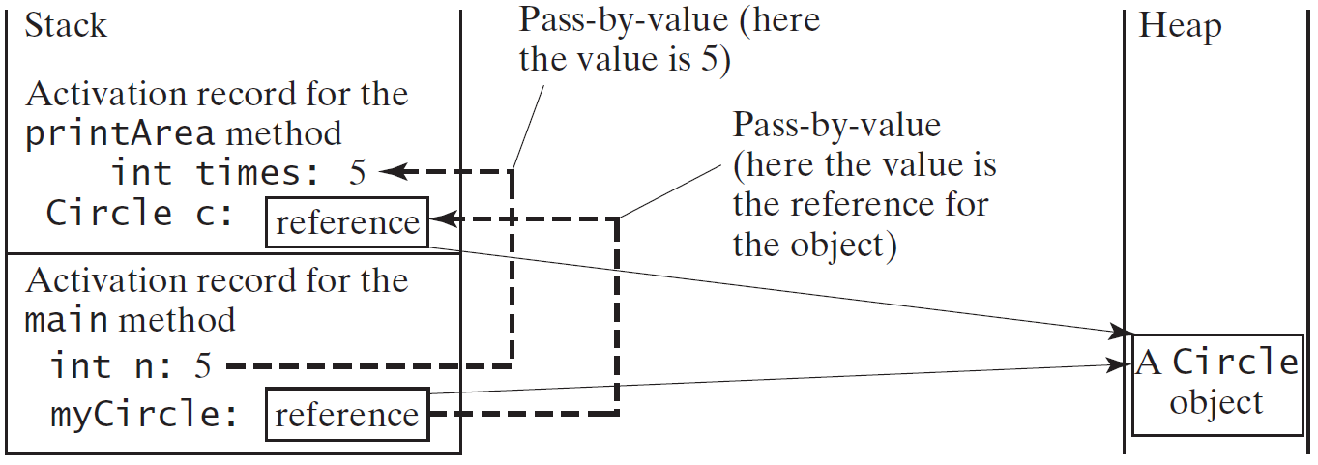
Passing Objects to Methods
Recall – all parameters to functions are passed-by-value in Java
Passing-by-value for primitive type value (the value is copied to the parameter)
Passing-by-value for reference type value (the value is the reference to the object)
public static void printArea( Circle c, int times) {
for(int i = 0; i < times; ++i)
System.out.println( c.getArea());
}
public static void main( String[] args) {
Circle myCircle = new Circle();
printArea(5, myCircle);
}

Slide 58
Array of Objects
Circle[] circleArray = new Circle[10];
An array of objects is actually an array of reference variables
Invoking circleArray[1].getArea() involves two levels of referencing. circleArray references to the entire array. circleArray[1] references to a Circle object.

Slide 59
Example Bouncing Ball
Program Along

Slide 60
Creating Many Objects
Each object is a data type value.
Use new to invoke constructor and create each one.
Ex: create N bouncing balls and animate them.
public class BouncingBalls {
public static void main(String[] args) {
int N = Integer.parseInt(args[0]);
Ball balls[] = new Ball[N];
for (int i = 0; i < N; i++)
balls[i] = new Ball();
while(true) {
StdDraw.clear();
for (int i = 0; i < N; i++) {
balls[i].move();
balls[i].draw();
}
StdDraw.show(20);
}
}
}
Notes:
This program reads in a command line parameter N and creates N bouncing balls, and then animates them.
Note: need to use new to create the array (since array is an object!).
Client program is in a separate file. Need to have Ball.java in current directory.

Slide 61
Add Gravity!
Alter velocity by an acceleration due to gravity before the position:
public void move() {
if (pos.x()+vel.x() > 1.0 || pos.x()+vel.x() < 0.0)
vel = new Vector(-vel.x(), vel.y());
if (pos.y()+vel.y() > 1.0 || pos.y()+vel.y() < 0.0)
vel = new Vector(vel.x(), -vel.y());
vel.addeq(new Vector(0.0, -0.05));
pos.addeq(vel);
}

Slide 62
Scope of Variables
Recall – scope is the lifetime of a variable. It dictates where you as the programmer may refer to the identifier (name) in code
Rule – The scope of instance and static variables is the entire class (including inside of any method). They can be declared anywhere inside a class.
Rule – The scope of a local variable starts from its declaration and continues to the end of the block that contains the variable. A local variable must be initialized explicitly before it can be used.

Slide 63
The this Keyword
The this keyword is the name of a reference that refers to an object itself. One common use of the this keyword is reference a class’s hidden data fields.
Another common use of the this keyword to enable a constructor to invoke another constructor of the same class.
this
Circle
radius: 10

Slide 64
Example Reference the Hidden Data Fields

Slide 65
Calling Overloaded Constructor
Or rename the parameter!

Slide 66
Immutable Objects and Classes
If the contents of an object cannot be changed once the object is created, the object is immutable and its class is called an immutable class.
If you delete the set method in the Circle class in Listing 8.10, the class would be immutable because radius is private and cannot be changed without a set method.
A class with all private data fields and without mutators is not necessarily immutable. For example, the following class Student has all private data fields and no mutators, but it is mutable.

Slide 67
Example student is still mutable, how?
public class Student {
private int id;
private BirthDate birthdate;
public Student(int ssn, int year,
int month, int day) {
id = ssn;
birthDate = new BirthDate( year, month, day);
}
public int getId() {
return id;
}
public BirthDate getBirthDate() {
return birthDate;
}
}
public class BirthDate {
private int year;
private int month;
private int day;
public BirthDate(int newYear,
int newMonth, int newDay) {
year = newYear;
month = newMonth;
day = newDay;
}
public void setYear(int newYear) {
year = newYear;
}
}

Slide 68
What Class is Immutable?
For a class to be immutable, it must mark all data fields private and provide no mutator methods and no accessor methods that would return a reference to a mutable data field object.

Slide 69
Immutable Wrapper Classes
Boolean
Character
Short
Byte
Integer
Long
Float
Double
String
All are immutable without a no-arg constructor
All provide limits of their data types (e.g., Integer.MAX_VALUE and Double.POSITIVE_INFINITY)
All provide functions to convert between each other (e.g., Integer.parseInt() and String.valueOf())
Since Java 5, primitive types can be automatically be converted to their immutable class counterpart (called boxing)
69

Slide 70
Example Turtle Graphics

Slide 71
Turtle Graphics
Goal. Create a data type to manipulate a turtle moving in the plane.
Set of values. Location and orientation of turtle.
API.
// draw a square
Turtle turtle = new Turtle(0.0, 0.0, 0.0);
turtle.goForward(1.0);
turtle.turnLeft(90.0);
turtle.goForward(1.0);
turtle.turnLeft(90.0);
turtle.goForward(1.0);
turtle.turnLeft(90.0);
turtle.goForward(1.0);
turtle.turnLeft(90.0);

Slide 72
Turtle Graphics
public class Turtle {
private double x, y; // turtle is at (x, y)
private double angle; // facing this direction
public Turtle(double x0, double y0, double a0) {
x = x0; y = y0; angle = a0;
}
public void turnLeft(double delta) {
angle += delta;
}
public void goForward(double d) {
double oldx = x, oldy = y;
x += d * Math.cos(Math.toRadians(angle));
y += d * Math.sin(Math.toRadians(angle));
StdDraw.line(oldx, oldy, x, y);
}
}

Slide 73
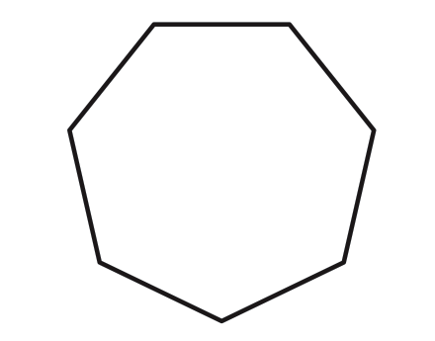
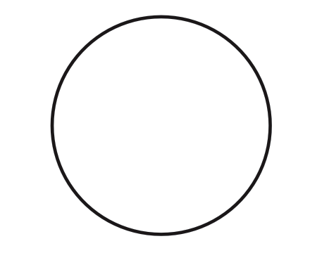
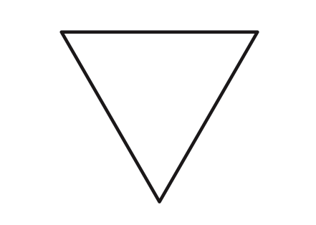
N-gon
public class Ngon {
public static void main(String[] args) {
int N = Integer.parseInt(args[0]);
double angle = 360.0 / N;
double step = Math.sin(Math.toRadians(angle/2.0));
Turtle turtle = new Turtle(0.5, 0, angle/2.0);
for (int i = 0; i < N; i++) {
turtle.goForward(step);
turtle.turnLeft(angle);
}
}
}
3
7
1440

Slide 74
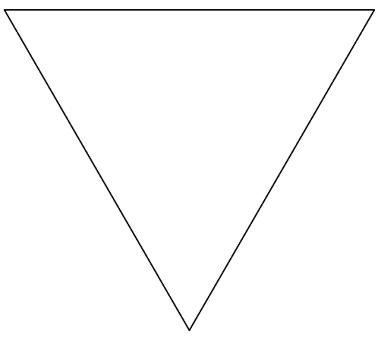
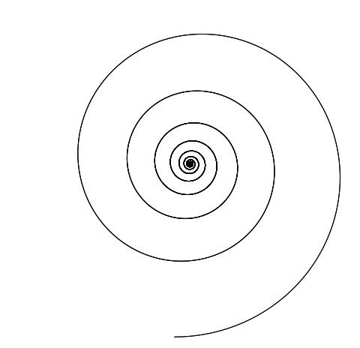
Spiral
public class Spiral {
public static void main(String[] args) {
int N = Integer.parseInt(args[0]);
double decay = Double.parseDouble(args[1]);
double angle = 360.0 / N;
double step = Math.sin(Math.toRadians(angle/2.0));
Turtle turtle = new Turtle(0.5, 0, angle/2.0);
for (int i = 0; i < 10 * N; i++) {
step /= decay;
turtle.goForward(step);
turtle.turnLeft(angle);
}
}
}
3 1.0
3 1.2
1440 1.00004
1440 1.0004
Notes:
produces a logarithmic spiral (or spira mirabilis) if N is infinity, or, in practice, sufficiently large

Slide 75
Practice
a | a | P | a | a | a | a | a
Grid world!
Create an object for a player which has an image and a position
Can only move in the cardinal directions
Create an object for a Grid world
Manages the players movements
Allow the player to enter a key (a,s,d,w) to walk within the grid
If you finish, show me and then work on the next homework assignment.
You have ~1hour for this.

