Slide 1
Chapter 3 Selections
ACKNOWLEDGEMENT: THESE SLIDES ARE ADAPTED FROM SLIDES PROVIDED WITH Introduction to Java Programming, Liang (Pearson 2014)

Slide 2
Motivation
If you assigned a negative value for radius in $πr^{2}$, the program would print an invalid result. If the radius is negative, you don't want the program to compute the area. How can you deal with this situation?
Say you run a casino, how would you determine if a slot machine yielded a win or a loss?
You work for the government, how might you decide if a person is eligible for a tax refund or not?
Moreover, how would you make a program do something over-and-over, like maintain a set of accounts for a bank?

Slide 3
Control Flow
Notation
Block – statement of code
Diamond – conditional
Open circle – start/end of algorithm
Control flow.
Sequence of statements that are actually executed in a program.
Conditionals and loops: enable us to choreograph control flow.
boolean 1
statement 1
true
false
statement 2
statement 1
boolean 2
true
statement 2
statement 3
false
statement 4
statement 3
straight-line control flow
control flow with conditionals and loops
Notes:
straight-line programs: akin to calculator

Slide 4
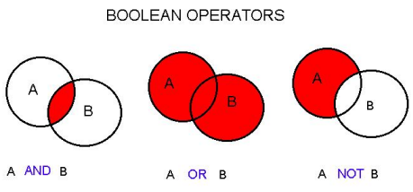
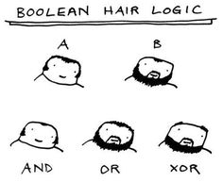
booleans

Slide 5
The boolean Type and Operators
Often in a program you need to compare two values, such as whether $i$ is greater than $j$. Java provides six comparison operators (also known as relational operators) that can be used to compare two values. The result of the comparison is a Boolean value: true or false.
boolean b = (1 > 2);

Slide 6
Relational Operators
This is what you write in pseudocode!

Slide 7
Logical Operators
Java Operator | Math Symbol | Name | Description
! | $$¬$$ | not | logical negation
&& | $$∧$$ | and | logical conjunction
|| | $$∨$$ | or | logical disjunction
^ | $⊕$ or $\underline{∨}$ | exclusive or | logical exclusion
This is what you write in pseudocode!

Slide 8
Truth Table for Operator $¬$
$$p$$ | $$¬p$$ | Example (assume age = 24, weight = 140)
true | false | $¬\left(age>18\right)$ is false, because $\left(age>18\right)$ is true.
false | true | $¬\left(weight=150\right)$ is true, because $\left(weight=150\right)$is false.

Slide 9
Truth Table for Operator $∧$
$$p_{1}$$ | $$p_{2}$$ | $$p_{1}∧p_{2}$$ | Example (assume age = 24, weight = 140)
false | false | false | $\left(age≤18\right)∧\left(weight<140\right)$ is false
false | true | false | $\left(age≤18\right)∧\left(weight≤140\right)$ is false
true | false | false | $\left(age>18\right)∧\left(weight<140\right)$ is false
true | true | true | $\left(age>18\right)∧\left(weight≤140\right)$ is true

Slide 10
Truth Table for Operator $∨$
$$p_{1}$$ | $$p_{2}$$ | $$p_{1}∨p_{2}$$ | Example (assume age = 24, weight = 140)
false | false | false | $\left(age≤18\right)∨\left(weight<140\right)$ is false
false | true | true | $\left(age≤18\right)∨\left(weight≤140\right)$ is true
true | false | true | $\left(age>18\right)∨\left(weight<140\right)$ is true
true | true | true | $\left(age>18\right)∨\left(weight≤140\right)$ is true

Slide 11
Exercise
Draw the truth table for exclusive or ($⊕$)

Slide 12
Truth Table for Operator $⊕$
$$p_{1}$$ | $$p_{2}$$ | $$p_{1}⊕p_{2}$$ | Example (assume age = 24, weight = 140)
false | false | false | $\left(age≤18\right)⊕\left(weight<140\right)$ is false
false | true | true | $\left(age≤18\right)⊕\left(weight≤140\right)$ is true
true | false | true | $\left(age>18\right)⊕\left(weight<140\right)$ is true
true | true | false | $\left(age>18\right)⊕\left(weight≤140\right)$ is false

Slide 13
Example program
Here is a program that check divisision by 2 and 3, 2 or 3, and 2 or 3 exclusive
public class TestBoolean {
public static void main(String[] args) {
Scanner s = new Scanner(System.in);
System.out.print(“Enter a number: ”);
int x = s.nextInt();
boolean divBy2 = x % 2 == 0;
boolean divBy3 = x % 3 == 0;
System.out.println(x + “ divisible by 2 and 3: ” + divBy2 && divBy3);
System.out.println(x + “ divisible by 2 and 3: ” + divBy2 || divBy3);
System.out.println(x + “ divisible by 2 and 3: ” + divBy2 ^ divBy3);
}
}
Recall you can make combined statements like: (x % 2 == 0) && (x % 3 == 0)

Slide 14
Exercise
Let a user enter a year, and output whether or not it is a leap year. A year is a leap year if it is
Divisible by 4 but not by 100
OR
Divisible by 400

Slide 15
Operator Precedence
() (expressions in parenthesis)
var++, var--
+, - (Unary plus and minus), ++var,--var
(type) Casting
! (Not)
*, /, % (Multiplication, division, and remainder)
+, - (Binary addition and subtraction)
<, <=, >, >= (Relational operators)
==, !=; (Equality)
^ (Exclusive OR)
&& (Conditional AND) Short-circuit AND
|| (Conditional OR) Short-circuit OR
=, +=, -=, *=, /=, %= (Assignment operator)

Slide 16
Operator Precedence and Associativity
The expression in the parentheses is evaluated first. (Parentheses can be nested, in which case the expression in the inner parentheses is executed first.) When evaluating an expression without parentheses, the operators are applied according to the precedence rule and the associativity rule.
If operators with the same precedence are next to each other, their associativity determines the order of evaluation. All binary operators except assignment operators are left-associative.

Slide 17
Example
Applying the operator precedence and associativity rule, the expression 3 + 4 * 4 > 5 * (4 + 3) - 1 is evaluated as follows:

Slide 18
Selections AKA Conditionals

Slide 19
Conditionals in pseudocode
if $booleanCondition$ then
Perform some operation
if $booleanCondition$ then
Perform some operation
else
Perform some other operation
if $booleanCondition$ then
Perform some operation
else if $booleanCondition2$ then
Perform some other operation
…
else
Perform final option of operation

Slide 20
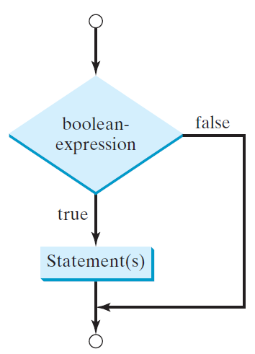
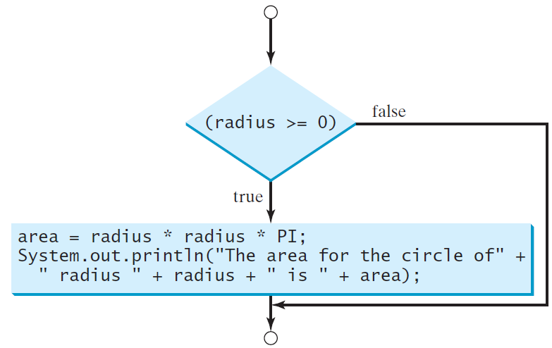
One-way if Statements in Java
if (boolean-expression) {
statement(s);
}
if (radius >= 0) {
area = radius * radius * PI;
System.out.println("The area"
+ " for the circle of radius "
+ radius + " is " + area);
}

Slide 21
Note
Parenthesis are required!
Curly braces are optional ONLY FOR single statement blocks

Slide 22
The Two-way if Statement
if (boolean-expression) {
statement(s)-for-the-true-case;
}
else {
statement(s)-for-the-false-case;
}

Slide 23
if-else Example
if (radius >= 0) {
area = radius * radius * 3.14159;
System.out.println(“The area for the ”
+ “circle of radius ” + radius +
" is " + area);
}
else {
System.out.println("Negative input");
}

Slide 24
Exercise: Guessing game
Use Math.random() to generate a random number between 1 and 100: (int)(Math.random()*99 + 1);
Have a user guess the number. If the user is correct output a winning message, otherwise output a losing message
Lets solve together. Program along with me.

Slide 25
Multiple Alternative if Statements
Note the syntax for else-if statements

Slide 26
Multi-Way if-else Statements

Slide 27
Trace if-else statement
Suppose score is 72.3
if (score >= 90.0)
System.out.print("A");
else if (score >= 80.0)
System.out.print("B");
else if (score >= 70.0)
System.out.print("C");
else if (score >= 60.0)
System.out.print("D");
else
System.out.print("F");
Condition is false

Slide 28
Trace if-else statement
Suppose score is 72.3
if (score >= 90.0)
System.out.print("A");
else if (score >= 80.0)
System.out.print("B");
else if (score >= 70.0)
System.out.print("C");
else if (score >= 60.0)
System.out.print("D");
else
System.out.print("F");
Condition is false

Slide 29
Trace if-else statement
Suppose score is 72.3
if (score >= 90.0)
System.out.print("A");
else if (score >= 80.0)
System.out.print("B");
else if (score >= 70.0)
System.out.print("C");
else if (score >= 60.0)
System.out.print("D");
else
System.out.print("F");
Condition is true

Slide 30
Trace if-else statement
Suppose score is 72.3
if (score >= 90.0)
System.out.print("A");
else if (score >= 80.0)
System.out.print("B");
else if (score >= 70.0)
System.out.print("C");
else if (score >= 60.0)
System.out.print("D");
else
System.out.print("F");
Output “C”

Slide 31
Trace if-else statement
Suppose score is 72.3
if (score >= 90.0)
System.out.print("A");
else if (score >= 80.0)
System.out.print("B");
else if (score >= 70.0)
System.out.print("C");
else if (score >= 60.0)
System.out.print("D");
else
System.out.print("F");
Exit the block

Slide 32
Note
The else clause matches the most recent if clause in the same block.

Slide 33
Note, cont.
Nothing is printed from the preceding statement. To force the else clause to match the first if clause, you must add a pair of curly braces:
int i = 1, j = 2, k = 3;
if (i > j) {
if (i > k)
System.out.println("A");
}
else
System.out.println("B");
This statement prints B.

Slide 34
Common Errors
Adding a semicolon at the end of an if clause is a common mistake.
if (radius >= 0);
{
area = radius*radius*PI;
System.out.println(
"The area for the circle of radius " +
radius + " is " + area);
}
This mistake is hard to find, because it is not a compilation error or a runtime error, it is a logic error.
This error often occurs when you use the next-line block style.
Wrong!

Slide 35
TIP
Hint 1: If you LIKE getting big points off of style. I recommend writing (a)!
Hint 2: Hint 1 is sarcasm…

Slide 36
CAUTION
Hint 1: If you LIKE getting big points off of style. I recommend writing (a)!
Hint 2: Hint 1 is sarcasm…

Slide 37
Exercise: Guessing game
Extend the previous guessing game example to allow two guesses, and descriptive messages of a guess being correct, over, or under.
Hint: We have 3 conditions per guess…
Lets solve together. Program along with me.

Slide 38
Advanced Conditionals

Slide 39
Problem: Computing Taxes
The US federal personal income tax is calculated based on the filing status and taxable income. There are four filing statuses: single filers, married filing jointly, married filing separately, and head of household. The tax rates for 2009 are shown below.

Slide 40
Problem: Computing Taxes, cont.
if (status == 0) {
// Compute tax for single filers
}
else if (status == 1) {
// Compute tax for married file jointly
// or qualifying widow(er)
}
else if (status == 2) {
// Compute tax for married file separately
}
else if (status == 3) {
// Compute tax for head of household
}
else {
// Display wrong status
}

Slide 41
switch Statements
switch (status) {
case 0: //compute taxes for single filers;
break;
case 1: //compute taxes for married file jointly;
break;
case 2: //compute taxes for married file separately;
break;
case 3: //compute taxes for head of household;
break;
default: System.out.println(
"Errors: invalid status");
System.exit(1);
}

Slide 42
switch Statement Flow Chart

Slide 43
switch Statement Rules
The switch-expression must yield a value of char, byte, short, or int type and must always be enclosed in parentheses.
The value, ..., and valueN must have the same data type as the value of the switch-expression.
The resulting statements in the case statement are executed when the value in the case statement matches the value of the switch-expression.
Note that value1, ..., and valueN are constant expressions, meaning that they cannot contain variables in the expression, such as 1 + x.
switch (switch-expression) {
case value1: statement(s)1;
break;
case value2: statement(s)2;
break;
…
case valueN: statement(s)N;
break;
default: statement(s)-for-default;
}

Slide 44
switch Statement Rules
The keyword break is optional, but it should be used at the end of each case in order to terminate the remainder of the switch statement. If the break statement is not present, the next case statement will be executed.
The default case, which is optional, can be used to perform actions when none of the specified cases matches the switch-expression.
When the value in a case statement matches the value of the switch-expression, the statements starting from this case are executed until either a break statement or the end of the switch statement is reached.
switch (switch-expression) {
case value1: statement(s)1;
break;
case value2: statement(s)2;
break;
…
case valueN: statement(s)N;
break;
default: statement(s)-for-default;
}

Slide 45
Conditional Expressions
if (x > 0)
y = 1;
else
y = -1;
is equivalent to a special ternary operator
y = (x > 0) ? 1 : -1;
(boolean-expression) ? expression1 : expression2;

