Slide 1
CMSC 150 Introduction to Computing ACKNOWLEDGEMENT: THESE SLIDES ARE ADAPTED FROM SLIDES PROVIDED WITH Introduction to Java Programming, Liang (Pearson 2014)
Lecture 1
Introduction to Course
Computer Science
Hello World

Slide 2
Welcome
Questions?

Slide 3
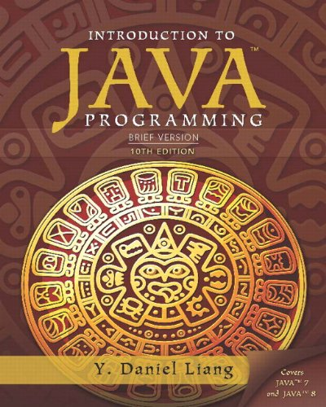
Syllabus
Questions?

Slide 4
What is computer science and computing?
Your thoughts?
Google: “The study of the principles and use of computers”
Wikipedia: “The scientific and practical approach to computation and its applications”
Dictionary.com: “The science that deals with the theory and methods of processing information in digital computers, the design of computer hardware and software, and the applications of computers”
Edsgar Dijkstra: “Computer Science is no more about computers than astronomy is about telescopes”

Slide 5
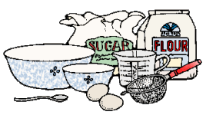
What is computer science and computing?
Input
Algorithm
Output
Study of algorithms
Study of computing tools
It is not just:
Programming
Microsoft office
Typing
Electronics
Etc.

Slide 6
Problem!
Work in pairs/triplets
Create a methodology to perform some task, e.g.,
Cook something
Play a game
Buy/sell on the stock market
Put another way…tell a computer how to do this task

Slide 7
What is computer science and computing?

Slide 8
Computer Organization
Central Processing Unit
(CPU)
Processes commands as 0’s and 1’s
Requests (reads) and writes to/from memory
Performs arithmetic (+, -, *, /, %)
Input
Files
Keyboard
Mouse
Etc.
Output
Monitor
Force feedback
Files
Etc.
Memory
Data encoded as 0s and 1s
Cache
“RAM” – Random Access Memory
Hard drive

Slide 9
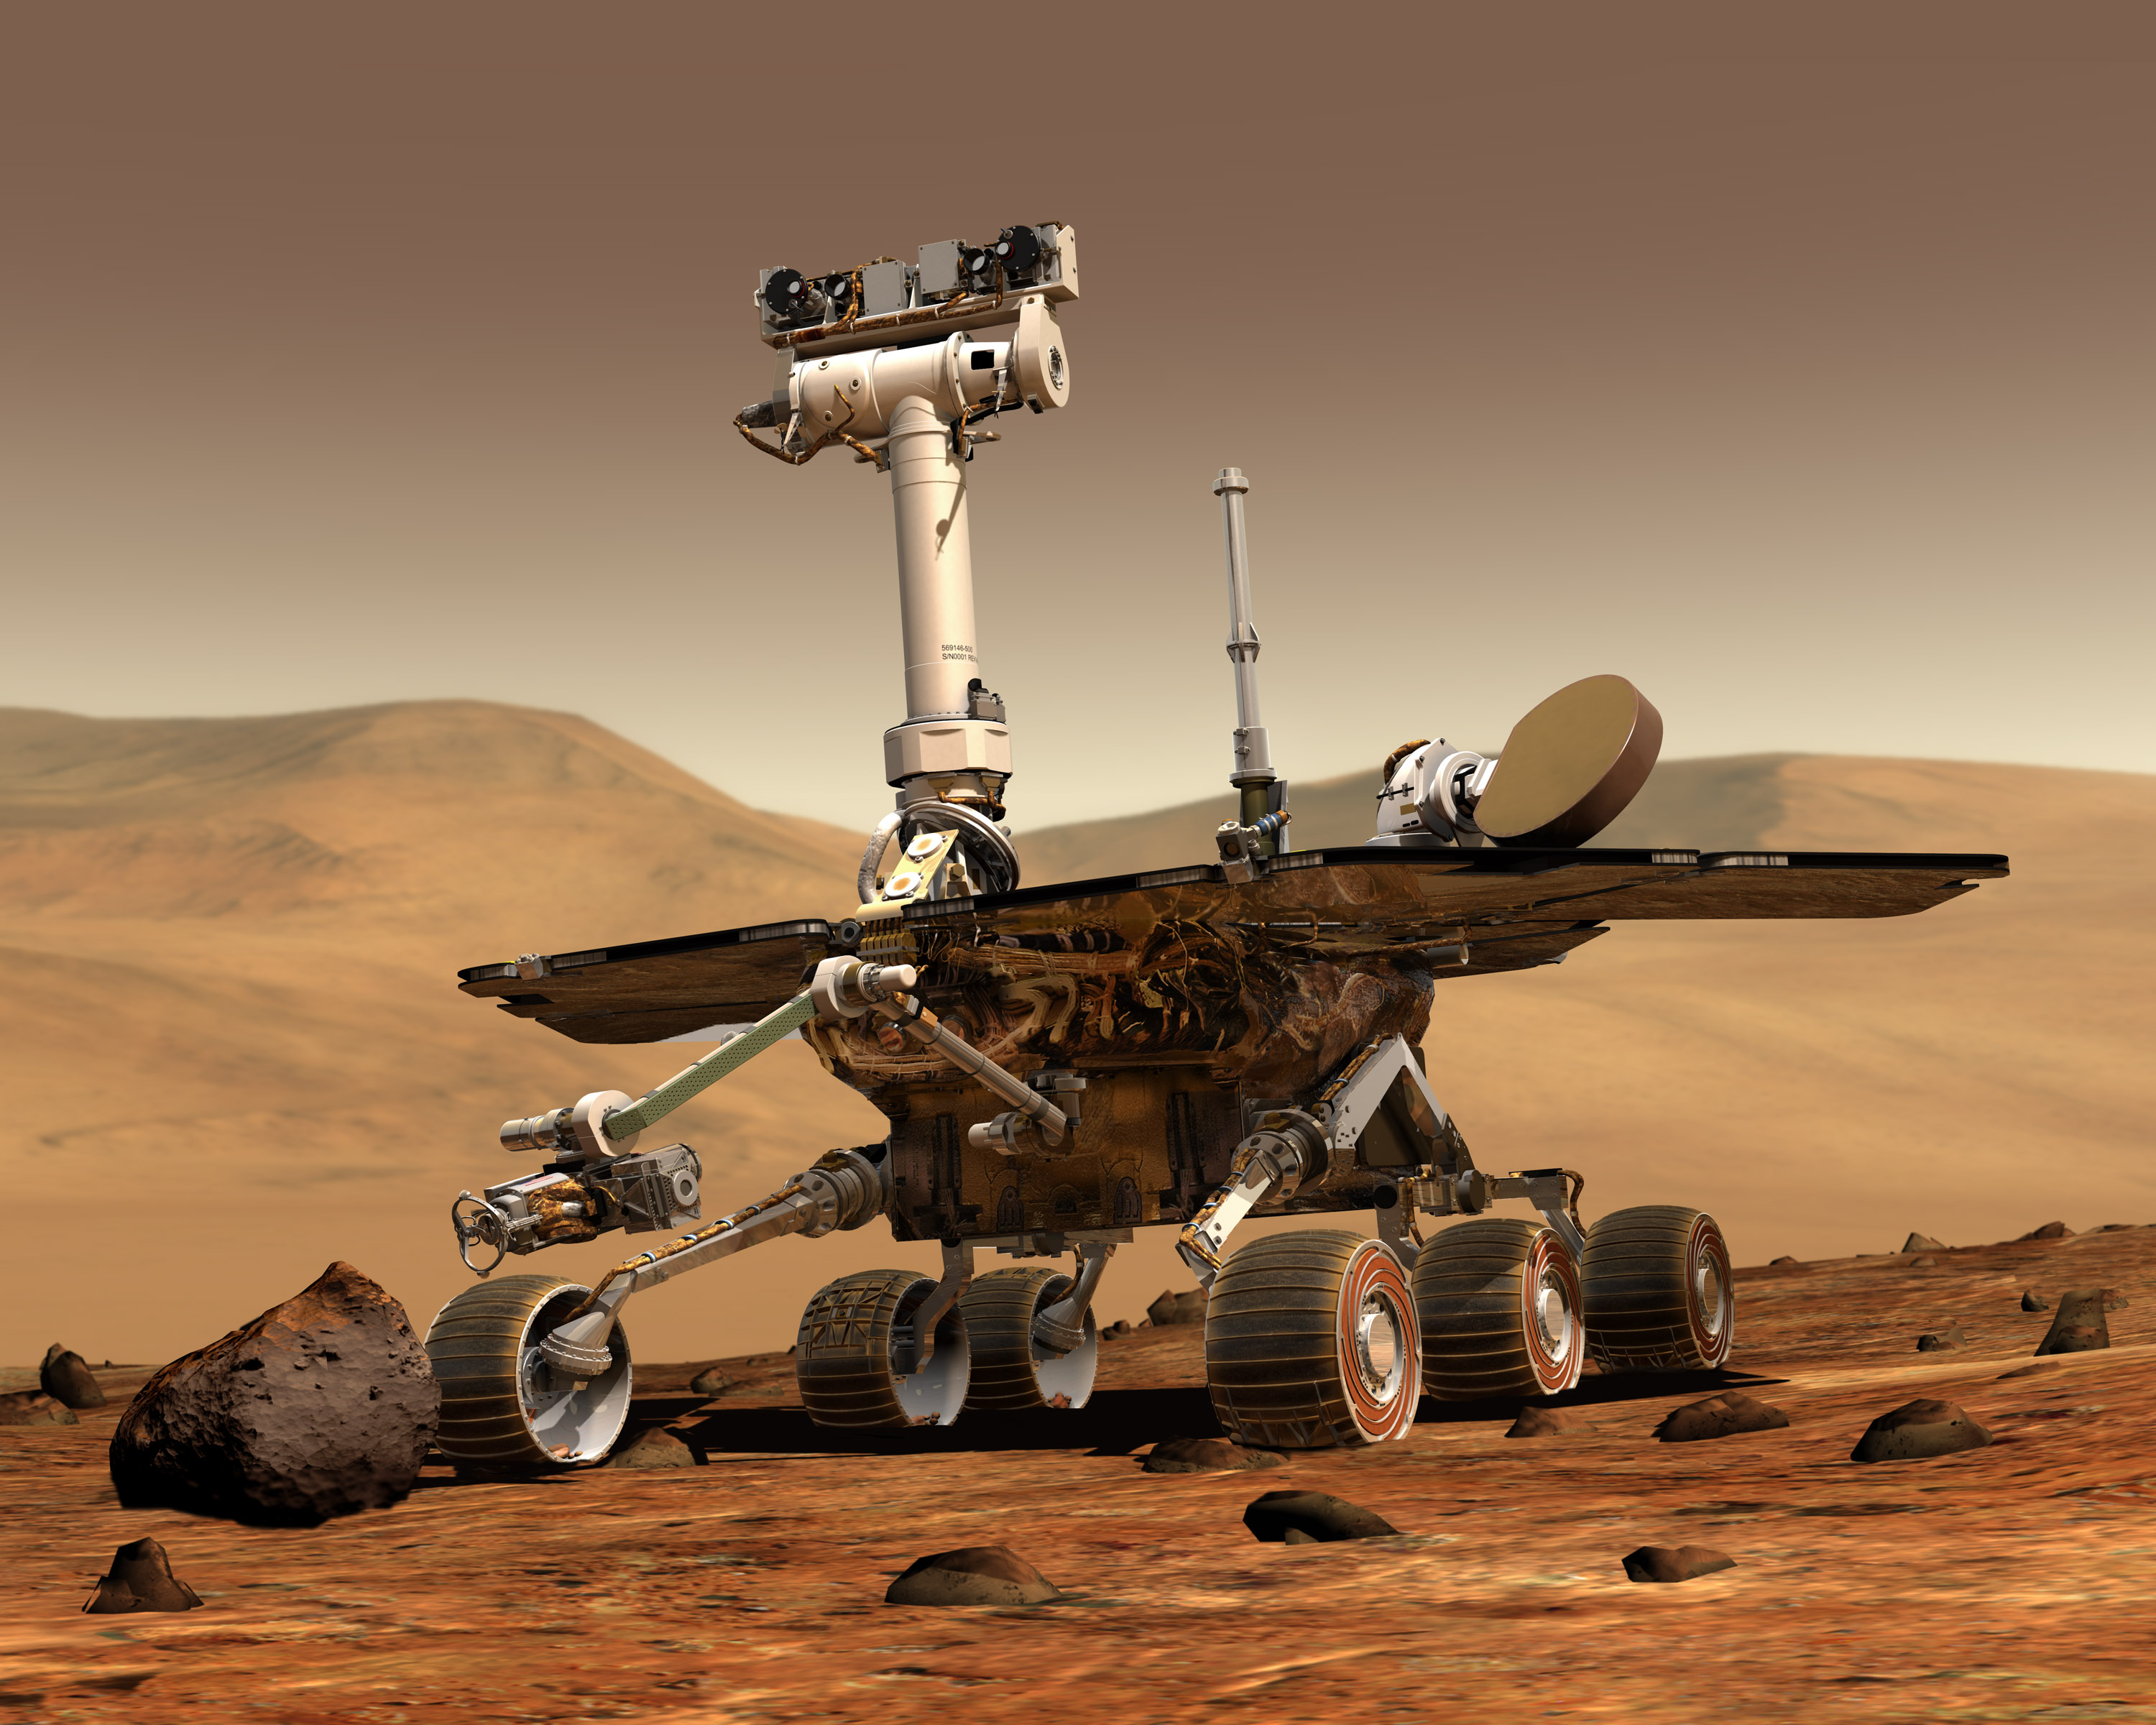
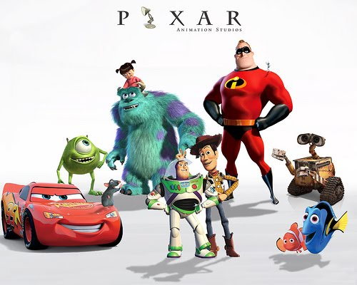
Programming
Even though computer science is not about the computer, we still need to tell the computer what to do!
We do this through programming, or the act of writing a computer program, known as software – its just instructions to the computer
Programming allows us to push the boundaries of science, view imaginary worlds, and improve our daily lives!

Slide 10
Programming

Slide 11
Computer organization A second look
User
Application Programs
Operating System
Hardware
Manages all resources (memory, files, etc)

Slide 12
A Brief Note on Programming Languages
Machine code – 0’s and 1’s…or simple commands. It is the set of primitive instructions built into the computer’s architecture or circuits. Extremely tedious and error prone
Assembly code – simple commands (ADD ra rb rc) to make programming easier to understand. An assembler translates the commands to machine code. Extremely tedious but less error prone.
High level languages – English-like commands that allow programming to be less tedious, less error prone, and much more expressive! Examples: Java, C++, Matlab, etc
Why we don’t use Natural language (English) – Its ambiguous…which vs which or break vs break or run vs run…ah the madness!!!!

Slide 13
Compiling a High level program
Program
Compiler (javac for us)
Machine Code
In Java
Translation to another language
Specific for an architecture
Execute Program (java for us)
Output
Program
Interpreter
In Java
Reads language directly
Execute Program
Output
Using a compiler
Using an interpreter

Slide 14
How do we program the computer?
We will use Java
NOTE – This is an arbitrary choice. All languages build on the same basic building blocks discussed in the course. So Java is merely the vessel to our exploration of computing!
Specifically:
Any Program
Objects
Methods
Arrays
Control Flow
Math/String
I/O
Primitive data types
Expressions

Slide 15
Why Java?
Java
Widely used.
Widely available.
Embraces full set of modern abstractions.
Variety of automatic checks for mistakes in programs.
Our study will
Minimal subset of Java.
Develop general programming skills that are applicable to many languages.
IT IS NOT ABOUT THE LANGUAGE!!!
“ There are only two kinds of programming languages: those people always [gripe] about and those nobody uses.”
– Bjarne Stroustrup

Slide 16
1.1 Your First Program

Slide 17
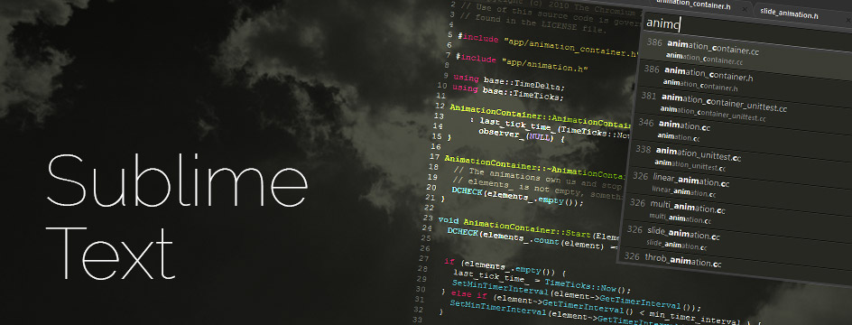
Sublime Text and Terminal
In this class, we will exclusively use Sublime text editor to write programs and use the terminal to compile and run our programs
Log in
Open a terminal
Open sublime

Slide 18
Terminal Reference Guide
A terminal is a window to interact with your operating system through commands. Things to know:
You are always in a specific directory, called the current (or working) directory
Filenames are specified “relative”ly – this means you have to be in the same directory or refer to the location relative to your current directory
Common commands (to move through folders and create them)
pwd – print the current directory
cd – change directory, e.g., cd Desktop
ls – print everything in a directory
mkdir – make a new directory, e.g., mkdir HelloWorldProject

Slide 19
Hello world
HelloWorld.java
// This program prints Hello World!
public class HelloWorld {
public static void main(String[] args) {
System.out.println(“Hello World!");
}
}
Compile: javac HelloWorld.java
Run: java HelloWorld

Slide 20
Anatomy of a Java Program
Class name
Main method
Statements
Statement terminator
Reserved words
Comments
Blocks

Slide 21
Class Name
Every Java program must have at least one class. Each class has a name. By convention, class names start with an uppercase letter.
// This program prints Hello World!
public class HelloWorld {
public static void main(String[] args) {
System.out.println(“Hello World!");
}
}

Slide 22
Main Method
Line 2 defines the main method. In order to run a class, the class must contain a method named main.
The program is executed from the main method.
// This program prints Hello World!
public class HelloWorld {
public static void main(String[] args) {
System.out.println(“Hello World!");
}
}

Slide 23
Statement
A statement represents an action or a sequence of actions.
The statement System.out.println(“Welcome to Java!”) in the program in Listing 1.1 is a statement to display the greeting “Welcome to Java!”.
// This program prints Hello World!
public class HelloWorld {
public static void main(String[] args) {
System.out.println(“Hello World!");
}
}

Slide 24
Statement Terminator
Every statement in Java ends with a semicolon (;).
// This program prints Hello World!
public class HelloWorld {
public static void main(String[] args) {
System.out.println(“Hello World!");
}
}

Slide 25
Reserved words
Reserved words or keywords are words that have a specific meaning to the compiler and cannot be used for other purposes in the program. For example, when the compiler sees the word class, it understands that the word after class is the name for the class.
// This program prints Hello World!
public class HelloWorld {
public static void main(String[] args) {
System.out.println(“Hello World!");
}
}

Slide 26
Blocks
A pair of braces in a program forms a block that groups components of a program.
// This program prints Hello World!
public class HelloWorld {
public static void main(String[] args) {
System.out.println(“Hello World!");
}
}
Class Block
Method Block

Slide 27
Special Symbols

Slide 28
Aside, Algorithmic pseudocode
In this class, we are learning the basic tools to express and model algorithms and software. We will learn not only Java, but something called Pseudocode.
Pseudocode is a detailed and stylized description for program and algorithm design. Often more natural than true language
Java code
Runs on a computer
Generates compile errors if done improperly
Pseudocode
Does not run on a computer
Is not compiled, therefor ‘;’, ‘{}’, etc “don’t matter”
Can use math and natural language
Can only use a restricted subset of math and natural language
Sometimes hard to read
Stylized and easy to read

Slide 29
Aside, Algorithmic pseudocode
Java Code
Pseudocode
HelloWorld.java
// This program prints
// Hello World!
public class HelloWorld {
public static void
main(String[] args) {
System.out.println(
“Hello World!");
}
}
HelloWorld
// This algorithm prints
// Hello World!
Output(“Hello World”);

Slide 30
Programming Style and Documentation
Appropriate Comments
Naming Conventions
Proper Indentation and Spacing Lines
Block Styles

Slide 31
Appropriate Comments
Include a summary at the beginning of the program to explain what the program does, its key features, its supporting data structures, and any unique techniques it uses.
Document each variable and method
Include your name, and a brief description at the beginning of the program.

Slide 32
Naming Conventions
Choose meaningful and descriptive names.
Class names:
Capitalize the first letter of each word in the name, called CamelCasing. For example, the class name ComputeExpression.

Slide 33
Proper Indentation and Spacing
Indentation
Indent two spaces.
Spacing
Use blank line to separate segments of the code.

Slide 34
Block Styles
Use end-of-line style for braces.

Slide 35
Programming Errors
Syntax Errors
Detected by the compiler
Runtime Errors also called Exceptions
Causes the program to abort
Logic Errors
Produces incorrect result

Slide 36
Syntax Errors
Syntax errors are errors from incorrectly written Java code. The compiler (javac) tells you these
Anatomy of a compiler error: filename.java:line_num: error: Confusing description of error including code where it occurs.
Deal with errors by experience, google, stack overflow, etc. After you have exhausted these resources…piazza/ask me. Advice, always handle the first error…not the last one.
// This program prints Hello World!
public class HelloWorld {
public static void main(String[] args) {
System.out.println(“Hello World!")
}
}

Slide 37
Runtime Errors
Runtime errors occur from impossible to complete commands encountered while executing the program (with java)
// This program prints Hello World!
public class HelloWorld {
public static void main(String[] args) {
System.out.println(1/0)
}
}

Slide 38
Logic Errors
// This program prints Hello World!
public class HelloWorld {
public static void main(String[] args)
System.out.println(
"Celsius 35 is Fahrenheit degree ");
System.out.println((9 / 5) * 35 + 32);
}
}

Slide 39
Standard Drawing

Slide 40
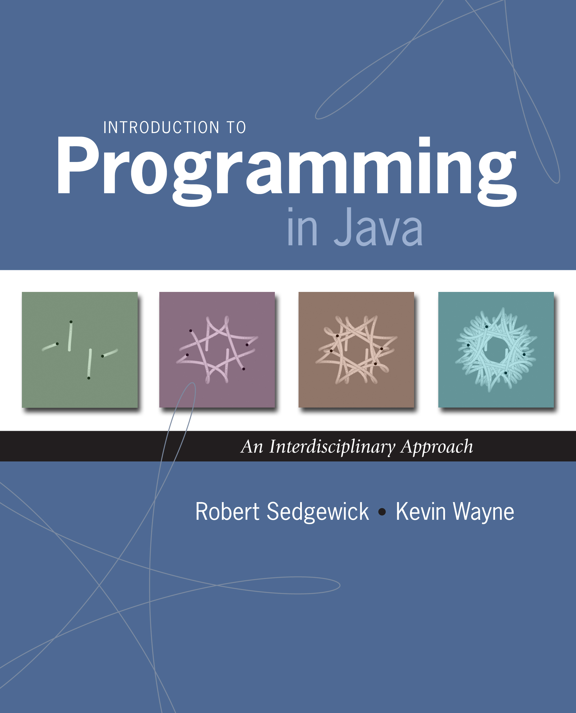
Standard Drawing
Standard drawing (StdDraw) is library for producing graphical output
library developed for an introduction course
(not for broad usage!)
Notes:
for example, many figures in textbook made with StdDraw

Slide 41
Standard Draw
Practice with StdDraw. To use: download StdDraw.java and put in working directory.
public class Triangle {
public static void main(String[] args) {
StdDraw.line(0.0, 0.0, 1.0, 0.0);
StdDraw.line(1.0, 0.0, 0.5, 0.866);
StdDraw.line(0.5, 0.866, 0.0, 0.0);
}
}
(½, ½√3)
(0, 0)
(1, 0)
Notes:
We want analog of standard output for pictures.
also good to play around in DrJava by typing drawing commands in Interaction Pane

Slide 42
Set size of window
Use StdDraw.setCanvasSize(width, height)
Width and height are integers representing pixels
This is the window
Height
Width

Slide 43
Coordinate System with StdDraw
Use StdDraw.setXscale(xmin, xmax) and StdDraw.setYscale(ymin, ymax)
xmin, xmax, ymin, and ymax are real numbers. Note the difference between pixels!
$$(x_{max},y_{max})$$
Default: $\left(1, 1\right)$
This is the window
$$\left(x_{min},y_{min}\right)$$
Default: $\left(0, 0\right)$

Slide 44
Colors
Change color with StdDraw.setPenColor(Color)
Use StdDraw.BLACK, StdDraw.WHITE, StdDraw.BLUE, StdDraw.RED, etc
Can define own colors with Java color library (uses RGB)
import java.awt.Color; //put at top of file
StdDraw.setPenColor(new Color(r, g, b));

Slide 45
Special Effects
Images. Put .gif, .png, or .jpg file in the working directory and use StdDraw.picture() to draw it.
Notes:
add laser.wav upon collision with vertical wall; add pop.wav upon collision with a horizontal wall

Slide 46
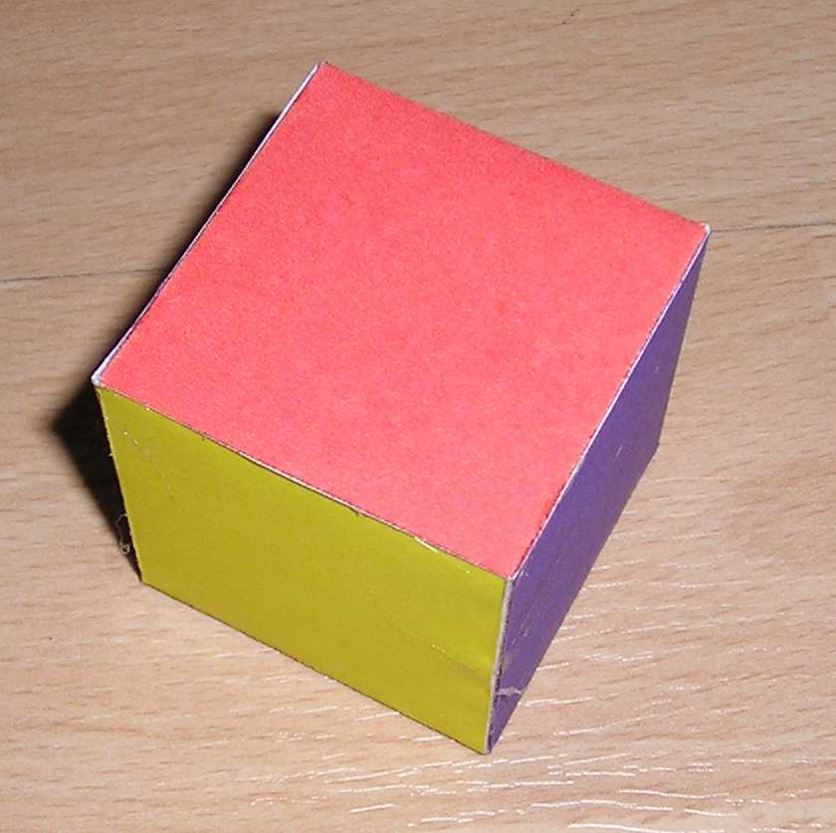
Exercises
Create a program to share three things about yourself. Please have each of the items nicely formatted with multiple System.out.println() commands.
Write a program using StdDraw to show a wireframe of a cube. Try to use different colors for the edges to show faces.
Work on Programming Assignment 1

